Slide 1
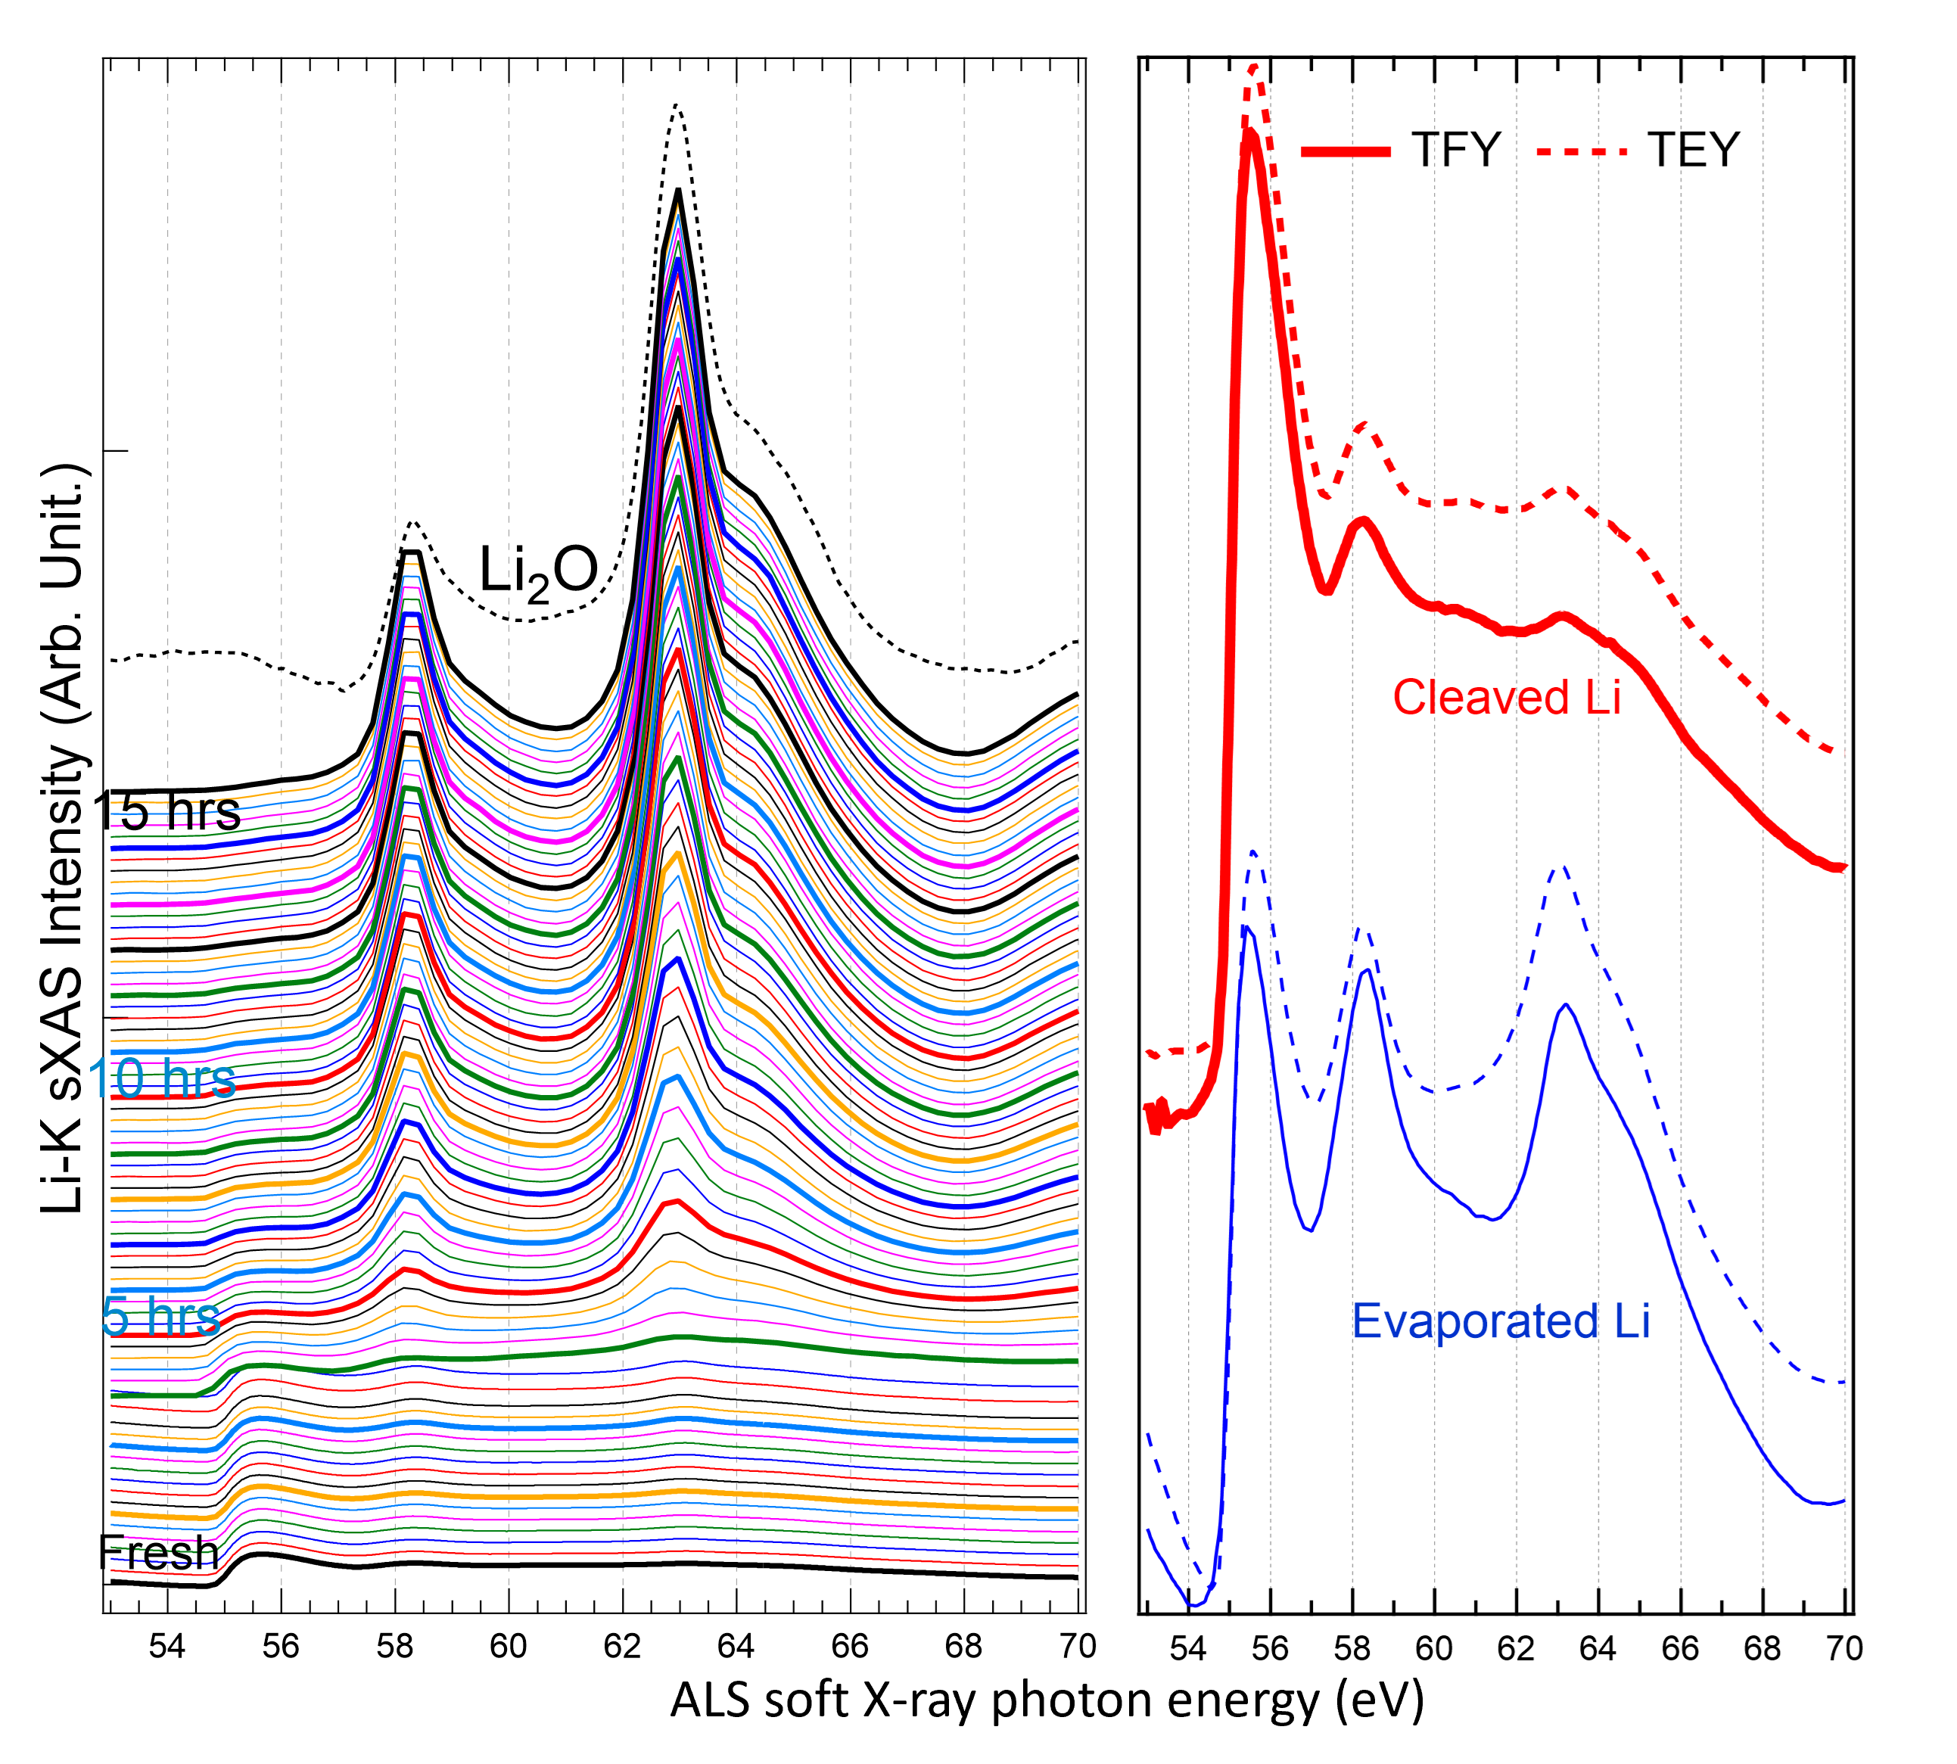
Revealing Lithium Metal’s Electronic Structure
Scientific Achievement
Spectroscopy at the Advanced Light Source and theoretical calculations at the Molecular Foundry revealed the intrinsic spectroscopic signature of lithium metal and explained the origin of previous contradictory reports.
Significance and Impact
The findings provide a benchmark for further studies of lithium compounds towards the development of batteries with higher capacity and energy density.
Research Details
Lithium K-edge soft x-ray absorption spectroscopy performed on an in-situ-prepared sample in ultra-high vacuum revealed a strong peak at 55.6 eV not recorded in previous studies due to degradation.
A newly developed computational treatment replicated the peak after accounting for the many-body response of all valence electrons to the core excitation.
Left: Spectral evolution of a freshly cleaved Li metal surface every 10 min. in ultra-high vacuum. Features from Li₂O emerge after only 20 min. and dominate the degraded spectral line shape. Right: K-edge soft x-ray absorption spectra of Li metal surfaces prepared in situ by cleaving (red) and evaporation (blue). Fresh Li metal shows a strong peak at 55.6 eV that has not been observed before.
Publication about this research: S. Roychoudhury, Z. Zhuo, R. Qiao, L. Wan, Y. Liang, F. Pan, Y.-D. Chuang, D. Prendergast, and W. Yang, “Controlled experiments and optimized theory of absorption spectra of Li metal and salts,” ACS Appl. Mater. Interfaces 13, 45488 (2021). Work was performed at Lawrence Berkeley National Laboratory, ALS Beamline 4.0.3. Operation of the ALS is supported by the U.S. Department of Energy, Office of Science, Basic Energy Sciences program.
Notes:
A battery with a metallic lithium anode has yet to be realized because of practical constraints and a lack of fundamental understanding of lithium’s chemistry. A combination of factors has plagued attempts to pin down lithium’s relevant electronic structure including lithium’s high reactivity, the low energy range of the K-edge electron excitation, and lithium’s small atomic radius, which leads to strong many-body effects that challenge popular computational models. Now, using the high soft x-ray flux of the ALS and novel theoretical approaches developed at the Molecular Foundry, researchers have uncovered new information about the electronic structure of lithium and explained the contradictions in previous studies.
The team used ALS Beamline 4.0.3 to probe the lithium K-edge. To avoid oxidation that often contaminates results, they measured a pure lithium sample in ultra-high vacuum immediately after cleaving it. They observed a strong peak at 55.6 eV, which was either absent or severely suppressed in previous studies.
The peak was also missing in previous theoretical calculations. These had relied on single-particle approaches based on density functional theory. To more accurately describe the x-ray excitation of lithium metal atoms’ core electrons, the researchers developed a new computational treatment that explicitly accounted for the many-body response of all valence electrons to the core excitation, and they were able to replicate the 55.6 eV peak.
Researchers: S. Roychoudhury (ALS and Molecular Foundry); Z. Zhuo, R. Qiao, Y.-D. Chuang, and W. Yang (ALS); L. Wan (Lawrence Livermore National Laboratory); Y. Liang and D. Prendergast (Molecular Foundry); and F. Pan (Peking University).
Funding: Laboratory Directed Research and Development program at Berkeley Lab, U.S. Department of Energy (DOE) Office of Science, Basic Energy Sciences (BES) program. Operation of the ALS and Molecular Foundry are supported by DOE BES.
Full highlight: https://als.lbl.gov/revealing-lithium-metals-electronic-structure/
1

