Slide 1
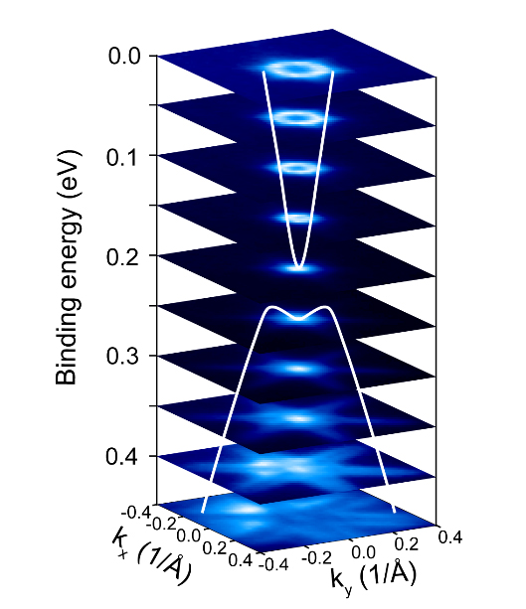
A Topological-Insulator Sandwich for Efficient Microelectronics
Scientific Achievement
At the Advanced Light Source (ALS), researchers synthesized a topological insulator between two ferromagnetic layers and found that it is electronically characterized by a large magnetic band gap.
Significance and Impact
The results open a new path toward lossless charge transport and perfect spin polarization, which could lead to the development of ultralow-energy electronics and spintronics.
Research Details
A topological insulator (Bi₂Te₃) was grown between two ferromagnetic insulators (single-layer MnBi₂Te₄) with closely matching lattices.
Angle-resolved photoemission spectroscopy (ARPES) revealed a large magnetic band gap, confirmed by magnetization measurements and temperature-dependent ARPES.
Results consistent with the quantum anomalous Hall (QAH) effect.
ARPES allows direct measurement of the band gap as well as visualization of the hexagonal warping (snowflake-like cross sections). Both were found to be in agreement with theoretical predictions for the QAH effect in this heterostructure.
Q. Li, C.X. Trang, W. Wu, J. Hwang, D. Cortie, N. Medhekar, S.-K. Mo, S.A. Yang, and M.T. Edmonds, Adv. Mater. 34, 2107520 (2022), doi:10.1002/adma.202107520. Work was performed at the Advanced Light Source at Lawrence Berkeley National Laboratory.
Notes:
Advances in microelectronics have put enormous computing power at our personal disposal, vastly improving the ways in which we work, play, and live. However, these benefits bear significant energy costs, and scientists are continually searching for ways to increase computing power while reducing power consumption. Toward that end, a team led by researchers from Monash University in Australia meticulously grew an ultrathin topological insulator, atom by atom, and sandwiched it between two ferromagnetic insulators. Such a heterostructure had been predicted to support a rare phenomenon known as the quantum anomalous Hall (QAH) effect, in which spin-polarized electrons (i.e., electrons with a single spin direction) travel along the edges of the topological insulator with near-zero resistance. A successfully fabricated QAH insulator would provide a promising avenue toward viable ultralow-energy electronic and spintronic devices.
Researchers: Q. Li, C.X. Trang, N. Medhekar, and M.T. Edmonds (Monash University, Australia); W. Wu (Singapore University of Technology and Design and Nanyang Technological University, Singapore): J. Hwang and S.-K. Mo (ALS); D. Cortie (Australian Nuclear Science and Technology Organization and University of Wollongon, Australia); and S.A. Yang (Singapore University of Technology and Design).
Funding: Australian Research Council, Australia's Nuclear Science and Technology Organisation, and Singapore Ministry of Education. Operation of the ALS is supported by the U.S. Department of Energy, Office of Science, Basic Energy Sciences program.
Full highlight: https://als.lbl.gov/a-topological-insulator-sandwich-for-efficient-microelectronics/

