Slide 1
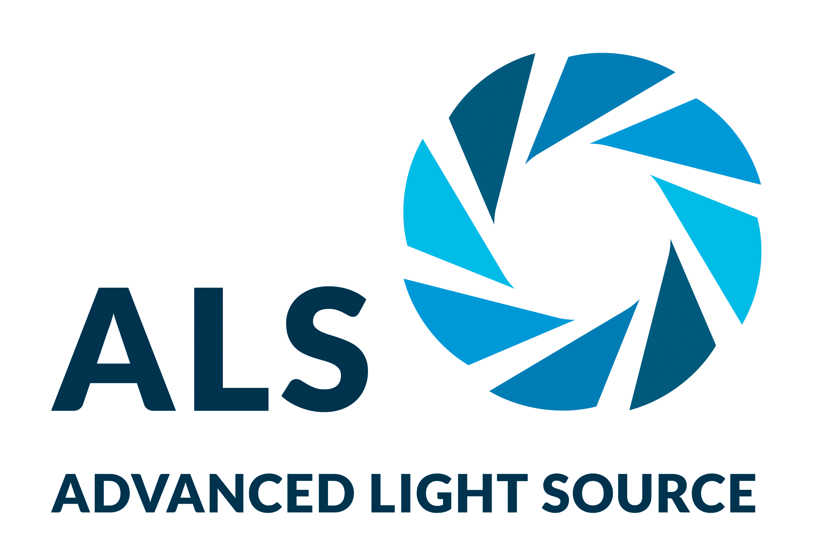
Hybrid Semiconductors Perform Under Pressure
Scientific Achievement
Supported by high-pressure studies at the Advanced Light Source (ALS), researchers found that compressing hybrid (organic–inorganic) semiconductors significantly boosts their conductivity.
Significance and Impact
The work demonstrates a novel doping mechanism in which the material’s organic molecules serve as charge reservoirs for tuning charge-carrier concentration, with promising applications in solar cells, lasers, and LEDs.
Research Details
Synthesized an expanded Sn₂I₆ hybrid perovskite analog with redox-active (electron-accepting) organic molecules.
Ambient- and high-pressure measurements using powder x-ray diffraction revealed high compressibility of the inorganic framework.
Compression increased conductivity by five orders of magnitude.
Structure of a hybrid (organic–inorganic) perovskite-like analog. The expanded cavities are large enough to accommodate organic molecules that can act as electron donors or acceptors.
R. Matheu, F. Ke, A. Breidenbach, N.R. Wolf, Y. Lee, Z. Liu, L. Leppert, Y. Lin, and H.I. Karunadasa, Angew. Chem. Int. Ed. 61, e202202911(2022), doi:10.1002/anie.202202911. Work was performed at the Advanced Light Source at Lawrence Berkeley National Laboratory.
Notes:
Tunable semiconductor materials containing organic compounds can be synthesized from solution using scalable, inexpensive methods. The resulting hybrid (organic–inorganic) compounds belong to a class of materials known as perovskites, named after the mineral in which their distinctive octahedral structures were first identified. The structures are stable, yet flexible enough to allow for variations to produce desired material properties. In halide perovskites, metal ions (e.g., lead or tin) are enclosed in octahedral cages defined by halide ions (e.g., bromide or iodide). Such materials offer useful optoelectronic properties, including tunable band gaps and strong optical absorption. Accordingly, they are of great interest for use in applications such as light-emitting diodes (LEDs), lasers, and solar cells. In the latter case, lead iodide in particular has shown remarkable improvements in photovoltaic efficiency. However, there are still fundamental challenges in need of solutions. For example, a greater understanding of how to control electronic transport properties in these materials via doping is needed to improve their performance as semiconductors and open up new possibilities.
Researchers: R. Matheu and N.R. Wolf (Stanford University); F. Ke, A. Breidenbach, Y. Lee, and H.I. Karunadasa (SLAC National Accelerator Laboratory and Stanford University); Z. Liu (University of Illinois at Chicago); L. Leppert (University of Twente, The Netherlands); and Y. Lin (SLAC National Accelerator Laboratory).
Funding: U.S. Department of Energy (DOE), Office of Science, Basic Energy Sciences (BES) program; DOE National Nuclear Security Administration; National Science Foundation; and Stanford University. Operation of the ALS is supported by DOE BES.
Full highlight: https://als.lbl.gov/hybrid-semiconductors-perform-under-pressure/

