Slide 1
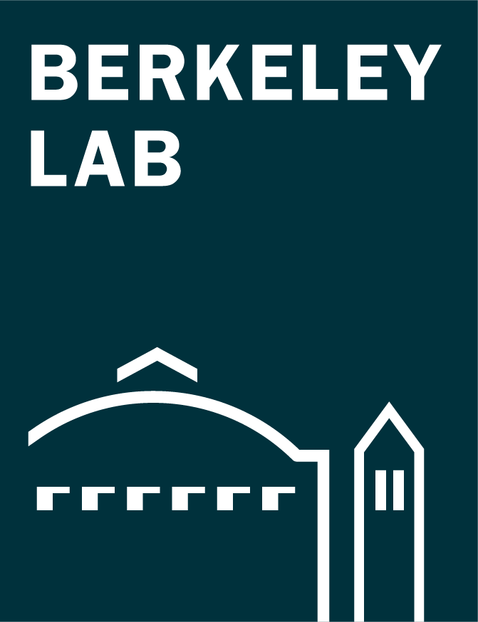
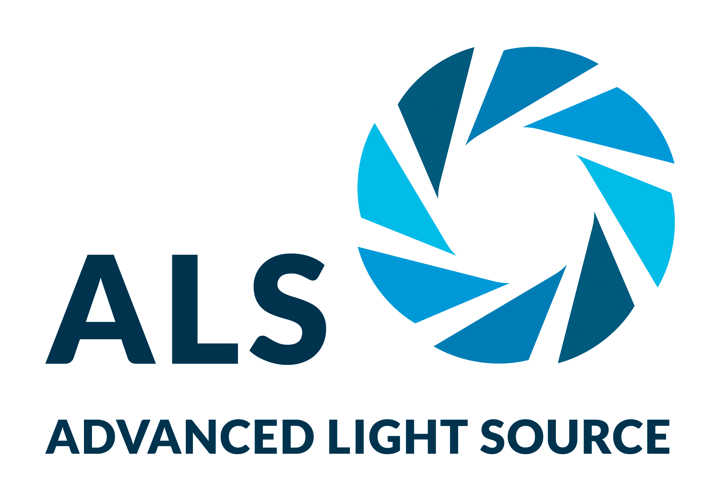
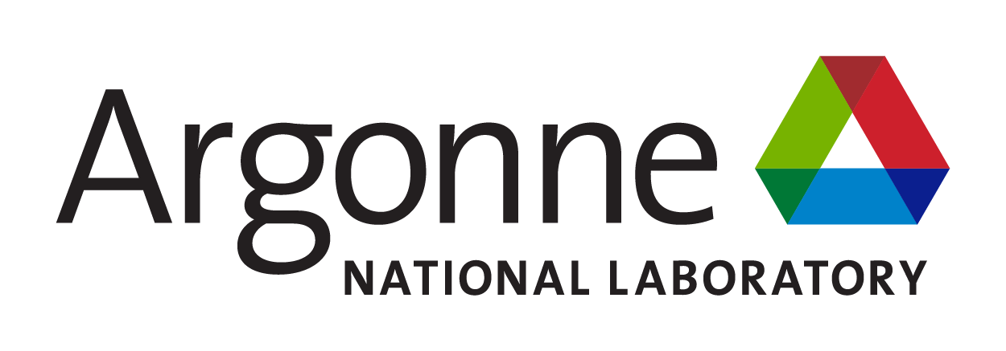
Multilayer Stack Opens Door to Low-Power Electronics
Scientific Achievement
Researchers found that a stack of ultrathin materials, characterized in part at the Advanced Light Source (ALS), exhibits an unusual phenomenon called negative capacitance, which reduces the voltage required for transistor operation.
Significance and Impact
The material is fully compatible with today’s silicon-based technology and is capable of reducing power consumption without sacrificing transistor size or performance.
Transistor device layout (left) that integrates the 2-nm HZH gate stack (right). This arrangement enhances capacitance without having to scavenge thickness from the SiO₂ layer, which would adversely affect electron transport and gate leakage. M1 and W are metal and tungsten contacts.
Research Details
Stack of 3 atomic layers of ZrO₂ between 2 single atomic layers of HfO₂ was used as gate oxide (“HZH”).
X-ray absorption spectroscopy probed structural evolution in ferroelectric and antiferroelectric phases.
Data suggests that a delicate balance between competing phases helps stabilize negative capacitance.
S.S. Cheema et al., Nature 604, 65 (2022), doi:10.1038/s41586-022-04425-6. Work was performed at ALS/LBNL, Molecular Foundry/LBNL, APS/ANL, and SSRL/SLAC. The research was supported in part by the DOE’s Microelectronics Co-Design Program.
Notes:
Microelectronics is expected to account for about 5% of total electricity production by 2030 thanks to ever-increasing demands for information processing. Maintaining progress will require a fundamental shift toward more efficient devices, with an emphasis on materials compatible with state-of-the-art silicon technology. The phenomenon of negative capacitance represents one possible solution, promising to significantly reduce power consumption in electronic devices while fitting seamlessly into current semiconductor protocols. In this work, researchers took a key step toward integrating negative capacitance into advanced transistors, with support from various government and industrial groups including Samsung, Intel, SK hynix, Applied Materials, and DARPA.
A transistor is essentially an on-off switch for the flow of current through a semiconductor, activated by a small voltage from a “gate” electrode. A thin insulating layer (the gate oxide) separates the semiconductor from the gate. Increasing the gate oxide’s ability to store charge (i.e., its capacitance) lowers the transistor’s operating voltage and thus reduces overall power consumption. In advanced silicon transistors, the gate oxide is a combination of silicon oxide (SiO2) and hafnium oxide (HfO2). In this work, researchers replaced the HfO2 with a multilayered stack that displays negative capacitance—a counterintuitive effect in which decreasing the gate voltage increases the stored charge on the gate oxide, thus maintaining performance at reduced power.
Researchers: S.S. Cheema, N. Shanker, L.-C. Wang, C.-H. Hsu, S.-L. Hsu, Y.-H. Liao, W. Li, J.-H. Bae, S.K. Volkman, D. Kwon, Y. Rho, C.P. Grigoropoulos, and C. Hu (Univ. of California, Berkeley); M. San Jose, J. Gomez, W. Chakraborty, P. Fay, and S. Datta (Univ. of Notre Dame); G. Pinelli, R. Rastogi, D. Pipitone, C. Stull, M. Cook, B. Tyrrell, and M. Mohamed (Massachusetts Institute of Technology); V.A. Stoica (Pennsylvania State Univ.); Z. Zhang and J.W. Freeland (Argonne National Laboratory); C.J. Tassone and A. Mehta (SLAC National Accelerator Laboratory); G. Saheli and D. Thompson (Applied Materials, Inc.); D.I. Suh and W.-T. Koo (SK hynix, Korea); K.-J. Nam, D.J. Jung, W.-B. Song, S. Nam, and J. Heo (Samsung Electronics, Korea); C.-H. Lin (Intel Corporation); N. Parihar, and S. Mahapatra (Indian Institute of Technology); P. Shafer (ALS); J. Ciston (Berkeley Lab); and R. Ramesh and S. Salahuddin (Univ. of California, Berkeley, and Berkeley Lab).
Funding: Berkeley Center for Negative Capacitance Transistors, U.S. Department of Defense, University of California Multicampus Research Programs and Initiatives project, and the U.S. Department of Energy (DOE), Office of Basic Energy Sciences (BES), Materials Sciences and Engineering Division, Microelectronics Co-Design program. Operation of the ALS, APS, SSRL and Molecular Foundry are supported by DOE BES, Office of Science, Basic Energy Sciences program.
Full highlight: https://als.lbl.gov/multilayer-stack-opens-door-to-low-power-electronics/

