Slide 1
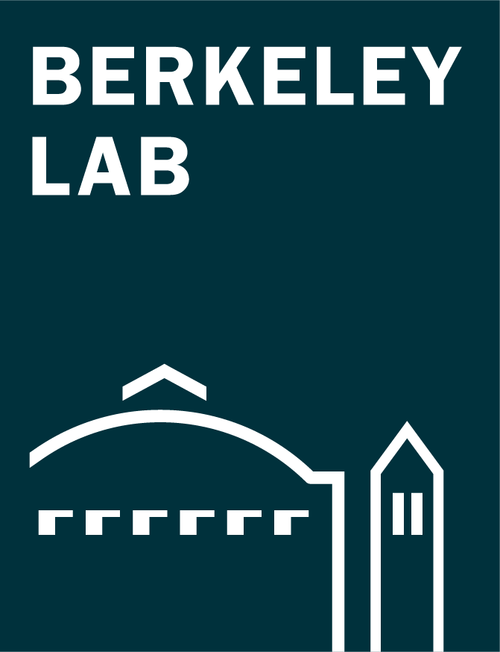
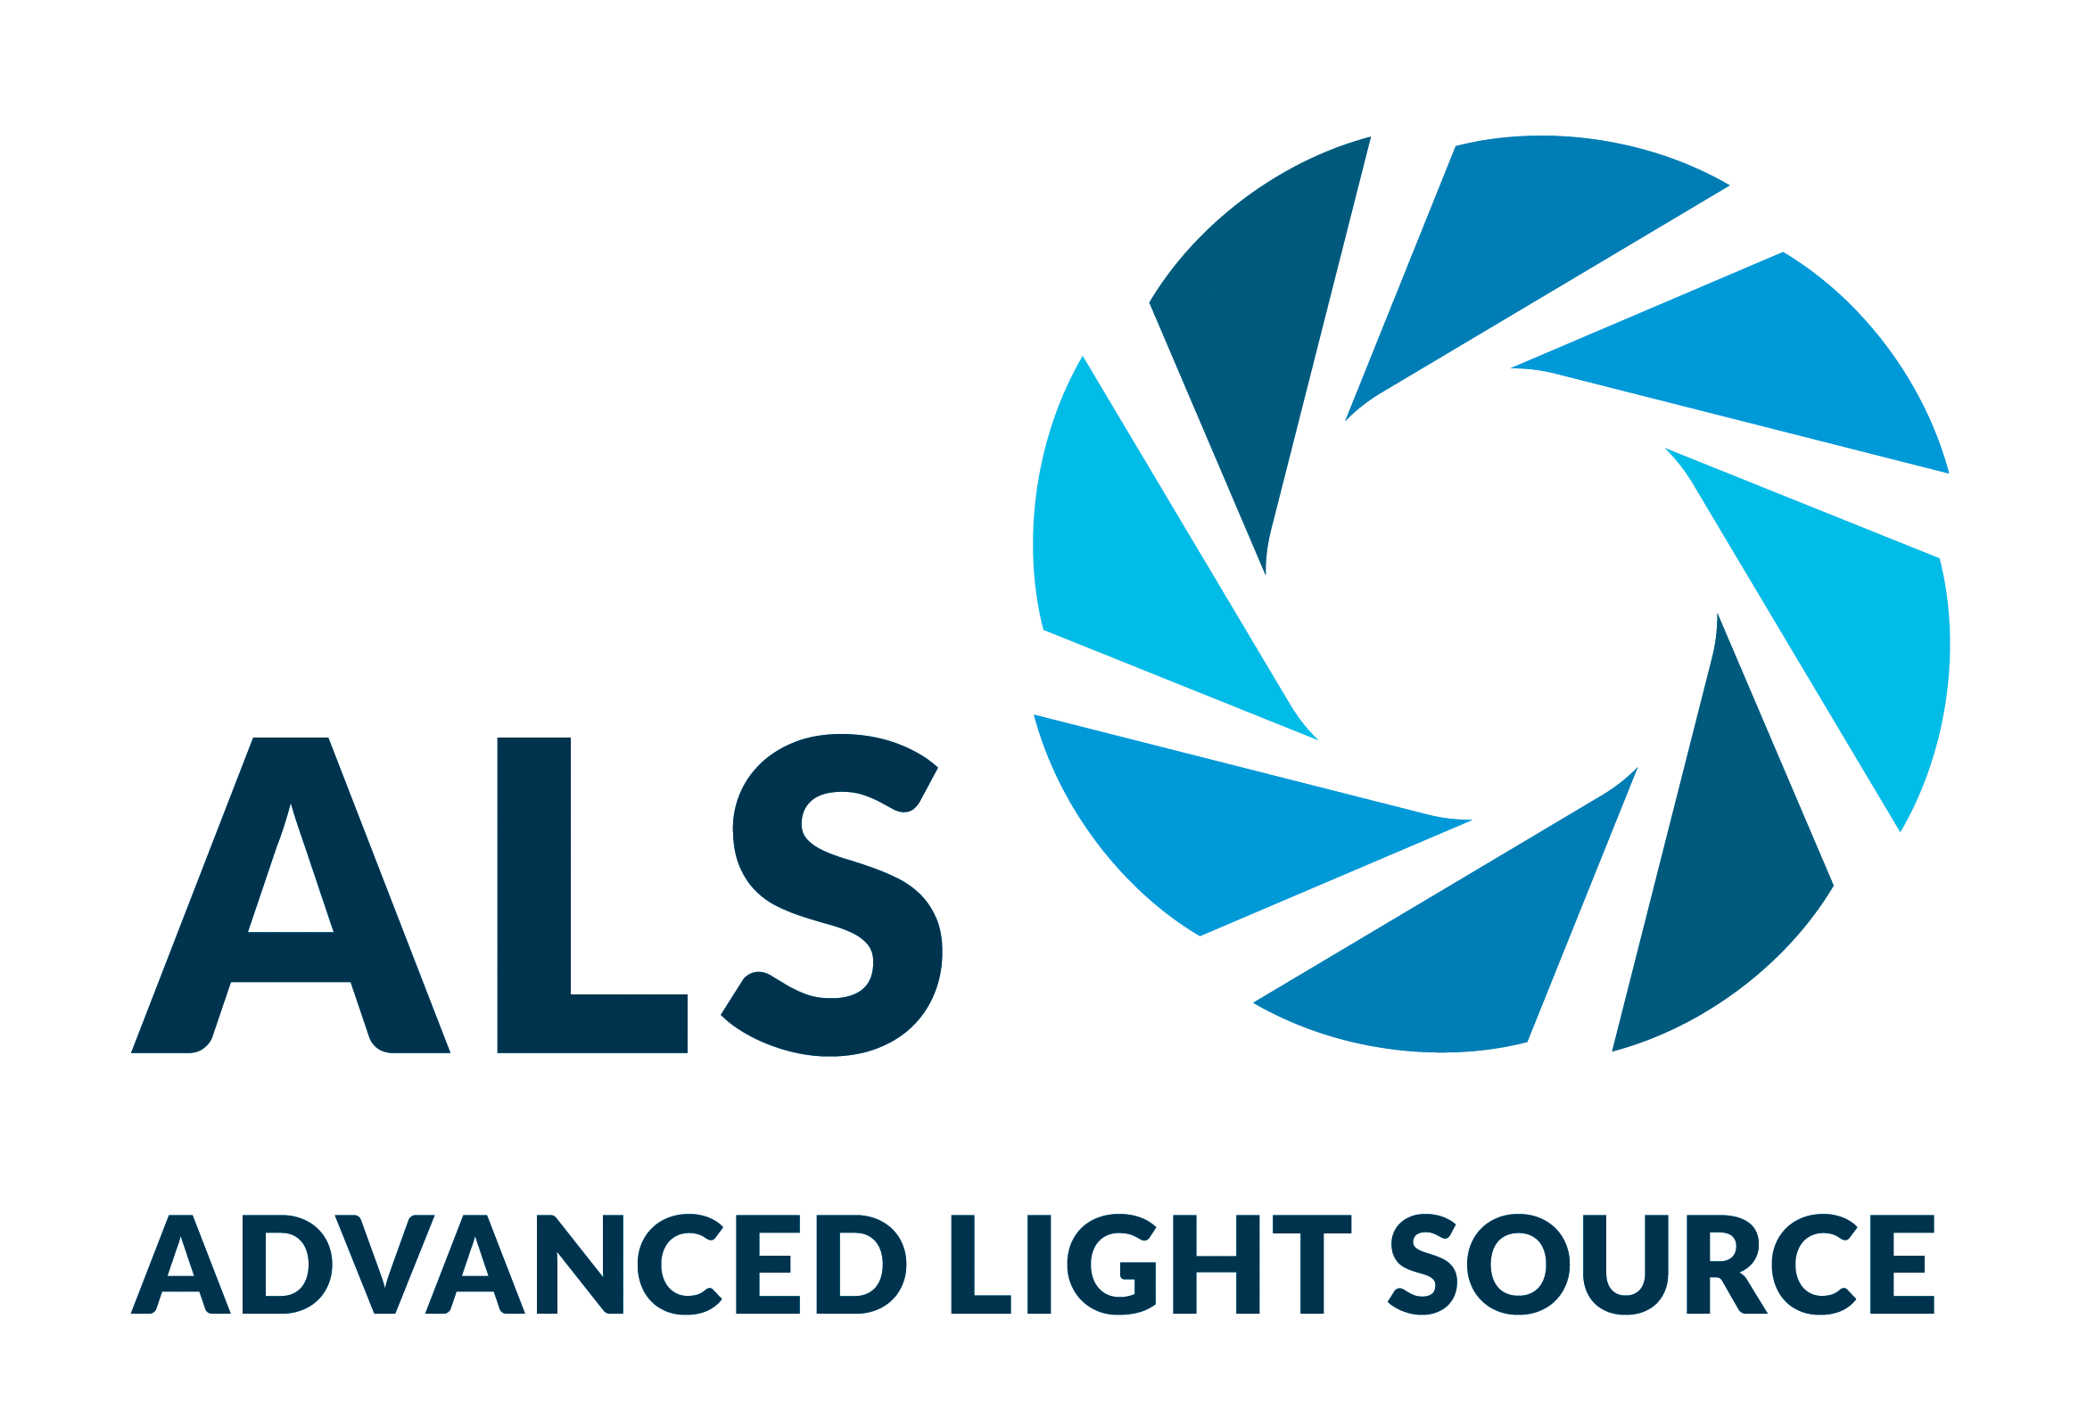
Protein Assemblies Show Surprising Variability
Scientific Achievement
Protein-structure studies performed in part at the Advanced Light Source (ALS) helped researchers discover that the protein assemblies in a key carbon-cycling enzyme can rearrange with surprising ease.
Significance and Impact
The findings raise the prospect of genetically tuning the enzyme in agricultural plant species to produce more productive and resource-efficient crops.
Research Details
Rubisco is an enzyme that enables photosynthetic organisms to convert CO₂ from the atmosphere into biomass.
Small-angle x-ray scattering (SAXS) and protein crystallography provided data for genomic studies showing rubisco’s structural plasticity.
Mutational experiments led to discovery of rubisco that’s better at utilizing its target molecule, CO₂.
Crystal structure of novel tetrameric state of rubisco from the bacterium, S. caldicuralii, resolved at 1.7 Å at the ALS.
A.K. Liu, J.H. Pereira, A.J. Kehl, D.J. Rosenberg, D.J. Orr, S.K.S. Chu, D.M. Banda, M. Hammel, P.D. Adams, J.B. Siegel, and P.M. Shih, Sci. Adv. 8, eadc9440 (2022), doi:10.1126/sciadv.adc9440. Work was performed at ALS/LBNL and NSLS-II/BNL.
Notes:
One of the key steps to understanding biology is discovering how a protein does its job. This requires knowledge of protein structures, from the atomic level to that of multiprotein assemblies. In a study of rubisco—an enzyme that enables photosynthetic organisms to convert CO₂ in the atmosphere into biomass—researchers showed how evolution can lead to a surprising diversity of molecular assemblies that all accomplish the same task. In this work, the researchers studied a type of rubisco (form II) found in bacteria and a subset of photosynthetic microbes. At the ALS, the study combined the atomic resolution of traditional crystallography with small-angle x-ray scattering (SAXS), a high-throughput process that can take snapshots of proteins in their native form in liquid mixtures. Previous work has shown that the type of rubisco found in plants (form I) has an octameric core, whereas form II was believed to exist mostly as a dimer with a few rare examples of hexamers. Here, the researchers used a number of analytical approaches—structural, genomic, biochemical, and computational—to investigate the evolutionary trajectory of form II rubisco.
Researchers: A.K. Liu (UC Berkeley, UC Davis, and Berkeley Lab); J.H. Pereira (Joint BioEnergy Institute and Berkeley Lab); A.J. Kehl, S.K.S. Chu, and J.B. Siegel (UC Davis); D.J. Rosenberg (UC Berkeley and Berkeley Lab); D.J. Orr (Lancaster Environment Centre, UK); D.M. Banda and M. Hammel (Berkeley Lab); P.D. Adams and P.M. Shih (Joint BioEnergy Institute, UC Berkeley, and Berkeley Lab).
Funding: Branco Weiss fellowship (ETH Zürich); David and Lucile Packard Foundation; U.S. Department of Energy (DOE), Office of Science, Biological and Environmental Research program; National Institutes of Health; and Biotechnology and Biological Sciences Research Council (UK). Operation of the ALS and NSLS-II is supported by DOE, Office of Science, Basic Energy Sciences (BES) program.
Full highlight: https://als.lbl.gov/protein-assemblies-show-surprising-variability/

