Slide 1
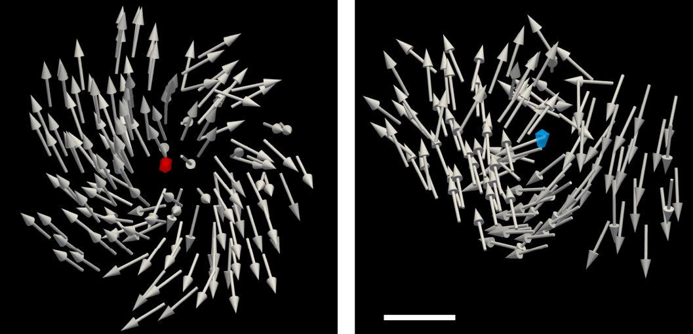
Imaging Topological Magnetic Monopoles in 3D
Scientific Achievement
Researchers created topologically stable magnetic monopoles and imaged them in 3D with unprecedented spatial resolution using a technique developed at the Advanced Light Source (ALS).
Significance and Impact
The work enables the study of magnetic monopole behavior for both fundamental interest and potential use in information storage and transport applications.
Research Details
Silicon nanospheres embedded in nickel create a ferromagnetic meta-lattice that hosts topological magnetic monopoles (TMMs).
Soft x-ray vector ptycho-tomography produces 3D, 10-nm-resolution images of magnetization vectors and emergent magnetic fields.
Oppositely polarized TMM pairs were stabilized closer together than similarly polarized TMMs.
Visualizations of positive (red) and negative (blue) topological magnetic monopoles (TMMs) and their spin configurations. Scale bar: 10 nm.
A. Rana, C.-T. Liao, E. Iacocca, J. Zou, M. Pham, X. Lu, E.-E. Cating Subramanian, Y.H. Lo, S.A. Ryan, C.S. Bevis, R.M. Karl Jr, A.J. Glaid, J. Rable, P. Mahale, J. Hirst, T. Ostler, W. Liu, C.M. O’Leary, Y.-S. Yu, K. Bustillo, H. Ohldag, D.A. Shapiro, S. Yazdi, T.E. Mallouk, S.J. Osher, H.C. Kapteyn, V.H. Crespi, J.V. Badding, Y. Tserkovnyak, M.M. Murnane, and J. Miao, Nat. Nanotechnol. 18, 227 (2023) doi:10.1038/s41565-022-01311-0. Work was performed at ALS/LBNL and the Molecular Foundry/LBNL.
Notes:
A bar magnet cut in half will always have a north and south pole, ad infinitum. Thus, magnetic monopoles—particles with a single magnetic “charge”—have never been observed in isolation. Yet the idea continues to intrigue: How would magnetic monopoles behave? What could you do with the magnetic equivalent of electric charge or current? Remarkably, scientists might be able to explore such questions via quasiparticles—particle-like phenomena emerging from collective interactions in condensed matter. However, it has been difficult to directly measure these quasiparticles and probe their behavior at the nanoscale. In this work, researchers report on the synthesis of a specially nanostructured magnetic material containing topologically stable, room-temperature magnetic monopoles. Furthermore, to study such materials, they developed a powerful coherent diffractive imaging technique capable of capturing magnetic textures in 3D with high spatial resolution. The collaboration involved a partnership between the Department of Energy (DOE) and the National Science Foundation (NSF), through the NSF Science and Technology Center on Real-Time Functional Imaging (STROBE).
Researchers: A. Rana, M. Pham, Y.H. Lo, W. Liu, C.M. O’Leary, S.J. Osher, and J. Miao (UCLA, Univ. of Colorado, Boulder, and NIST); C.-T. Liao, E.-E. Cating Subramanian, S.A. Ryan, C.S. Bevis, R.M. Karl Jr, H.C. Kapteyn, and M.M. Murnane (Univ. of Colorado, Boulder, and NIST); E. Iacocca (Northumbria Univ., UK, and Univ. of Colorado, Colorado Springs); X. Lu (UCLA and Soochow Univ., China); A.J. Glaid, J. Rable, V.H. Crespi, and J.V. Badding (Penn State Univ.); P. Mahale and T.E. Mallouk (Penn State Univ. and Univ. of Pennsylvania); J. Hirst (Sheffield Hallam Univ., UK); T. Ostler (Sheffield Hallam Univ. and Univ. of Hull, UK); Y.-S. Yu, H. Ohldag, and D.A. Shapiro (ALS); K. Bustillo (Berkeley Lab); S. Yazdi (Univ. of Colorado, Boulder); and J. Zou and Y. Tserkovnyak (UCLA).
Funding: National Science Foundation; U.S. Department of Energy, Office of Science, Basic Energy Sciences program (DOE BES); Army Research Office; DARPA; and Univ. of Colorado, Colorado Springs. Operation of the ALS and Molecular Foundry is supported by DOE BES.
Full highlight: https://als.lbl.gov/imaging-topological-magnetic-monopoles-in-3d/

