Slide 1
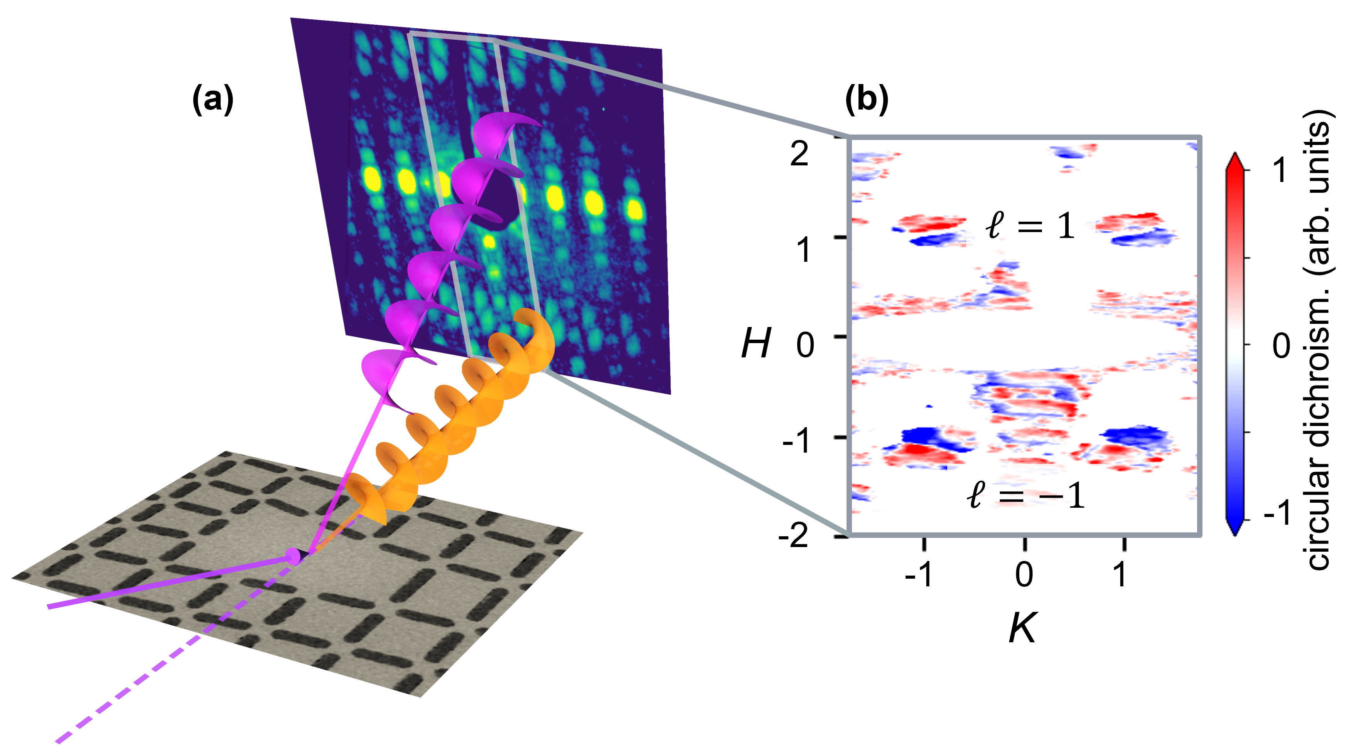
Spiraling Beams Differentiate Antiferromagnetic States
Scientific Achievement
Using spiraling x-ray beams generated at the Advanced Light Source (ALS), researchers differentiated between energetically equivalent (“degenerate”) states in an antiferromagnetic lattice.
Significance and Impact
The work shows the potential of these beams to probe properties that would otherwise be inaccessible, to better understand phenomena of fundamental interest and for applications such as spintronics.
Research Details
The magnetic configuration of the sample (a nanomagnet array) was revealed by photoemission electron microscopy (PEEM).
Resonant x-ray scattering (RXS) with orbital angular momentum (OAM) beams showed contrast between antiferromagnetic states.
Measurements after heating/cooling confirmed random thermal switching between states.
(a) In this experiment, circularly polarized x-rays were scattered by an antiferromagnet array with a lattice defect, producing spiral beams with orbital angular momentum (OAM) of both positive and negative helicity. (b) The resulting diffraction patterns differ depending on the polarization and helicity of the beam (an effect known as dichroism). The peaks of diffraction order (H) +1 and -1 have positive and negative helicity (ℓ), respectively. Each peak has half positive (red) and half negative (blue) circular dichroism, with the pattern inverted for opposite helicities.
M.R. McCarter, A.I.U. Saleheen, A. Singh, R. Tumbleson, J.S. Woods, A.S. Tremsin, A. Scholl, L.E. De Long, J.T. Hastings, S.A. Morley, and S. Roy, Phys. Rev. B 107, L060407 (2023), doi:10.1103/PhysRevB.107.L060407. Work was performed at ALS/LBNL, Molecular Foundry/LBNL, and Center for Nanoscale Materials/ANL.
Notes:
X-ray experiments are an important tool for understanding the electronic and magnetic properties of materials. The polarization (i.e., the direction of the oscillating electromagnetic field) of x-rays is often used to probe anisotropy or chirality. A property of x-rays that has yet to be utilized in experiments is their orbital angular momentum (OAM). X-rays with OAM have an azimuthally varying phase, which means the phase twists as the x-rays propagate. This leads to a gradient in the electromagnetic field, which could cause the twisted photons to have different interactions with materials. X-rays with OAM have a helicity ℓ = ±1, which corresponds to whether the phase is twisting in the clockwise or counterclockwise direction. Similar to how polarization is used in experiments, OAM can be used to probe chirality and magnetism, and potentially more exotic properties like topology. It could also improve the resolution of x-ray imaging and microscopy techniques. In this work, researchers showed how helicity-dependent effects in resonant x-ray scattering (RXS) can be used to investigate the magnetic configuration of a lattice.
Researchers: M.R. McCarter, A.I.U. Saleheen, A. Scholl, S.A. Morley, and S. Roy (ALS); A. Singh (Berkeley Lab); R. Tumbleson (UC Santa Cruz and ALS); J.S. Woods (Univ. of Kentucky and Argonne National Laboratory); A.S. Tremsin (UC Berkeley); and L.E. De Long and J.T. Hastings (Univ. of Kentucky).
Funding: Laboratory Directed Research and Development program (Berkeley Lab), National Science Foundation, and U.S. Department of Energy, Office of Science, Basic Energy Sciences program (DOE BES). Operation of the ALS, Molecular Foundry, and Center for Nanoscale Materials is supported by DOE BES.
Full highlight: https://als.lbl.gov/spiraling-beams-differentiate-antiferromagnetic-states/

