Slide 1
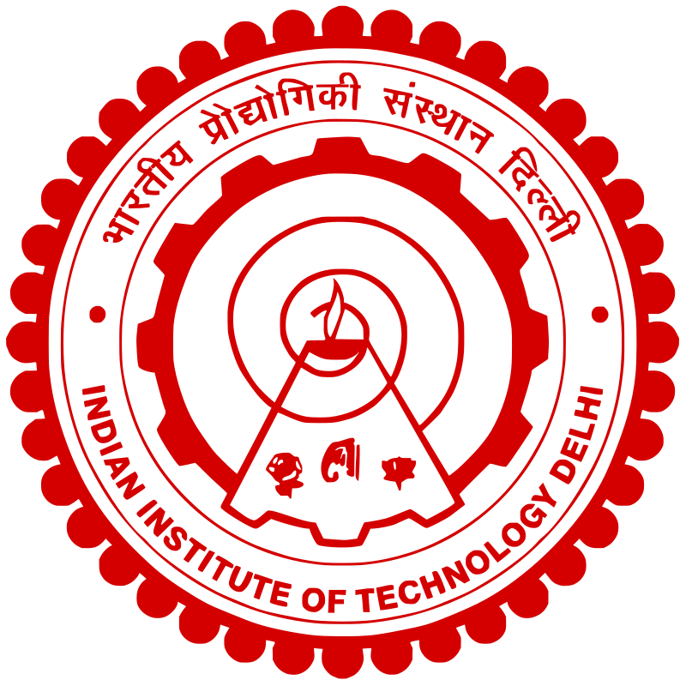
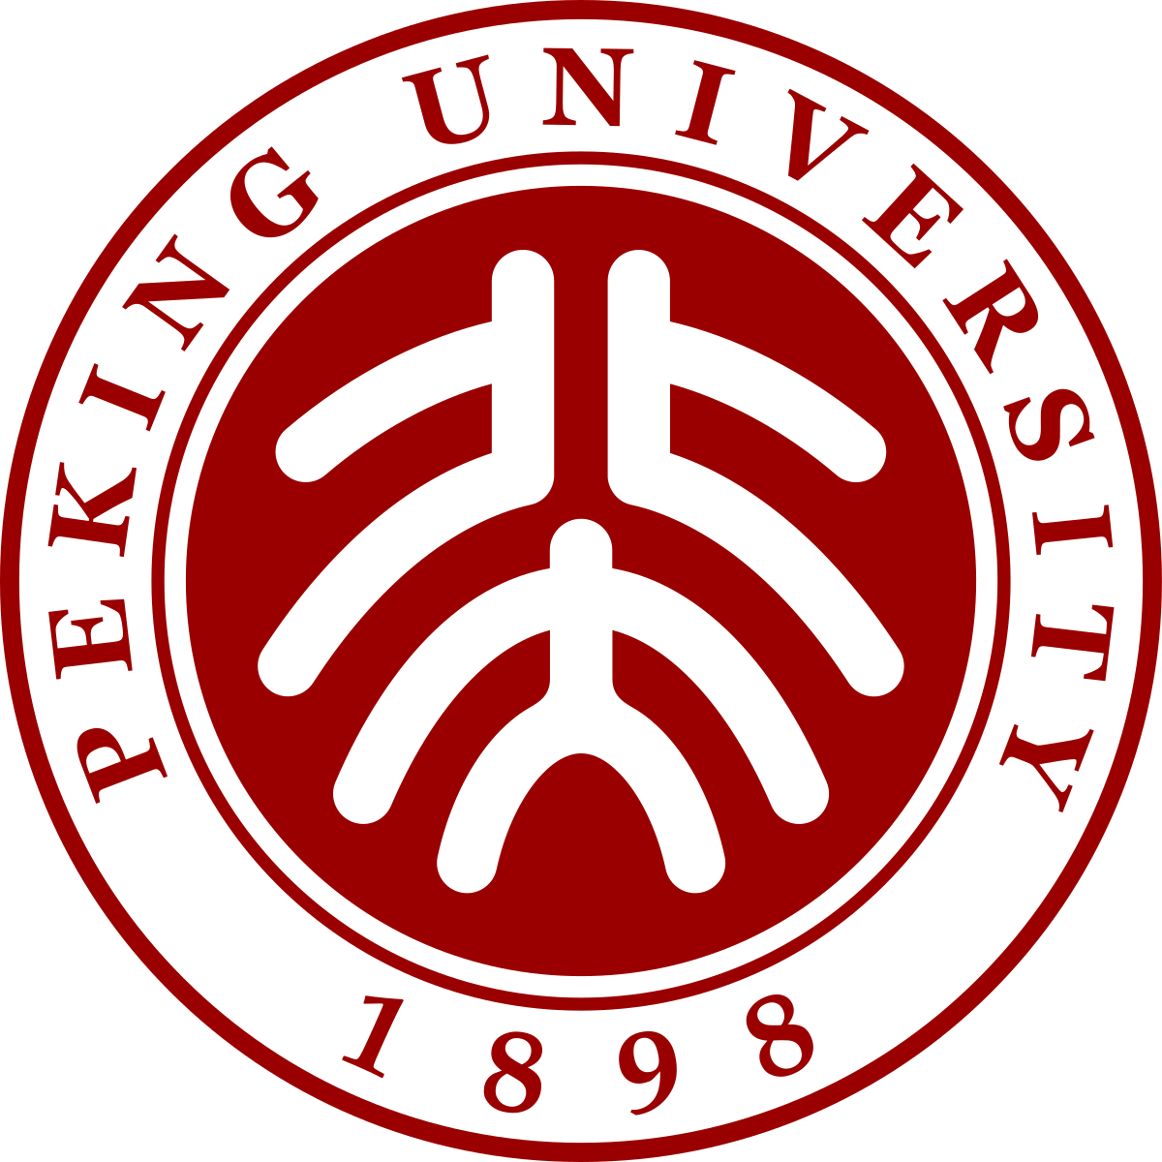
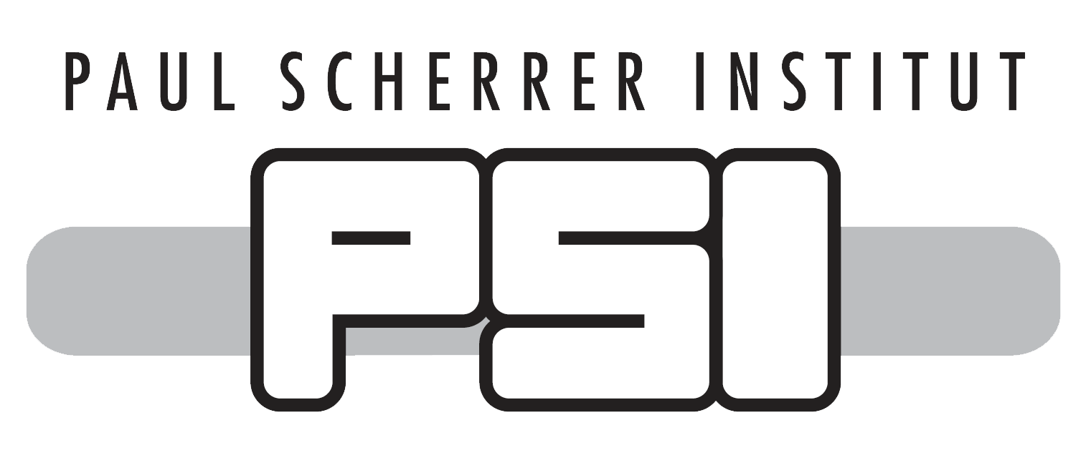
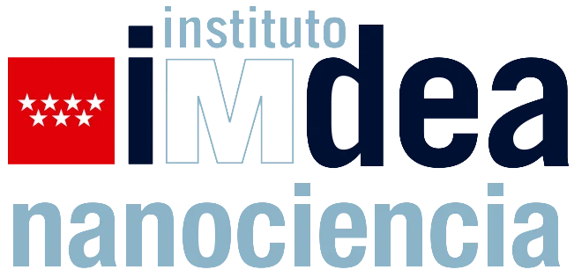
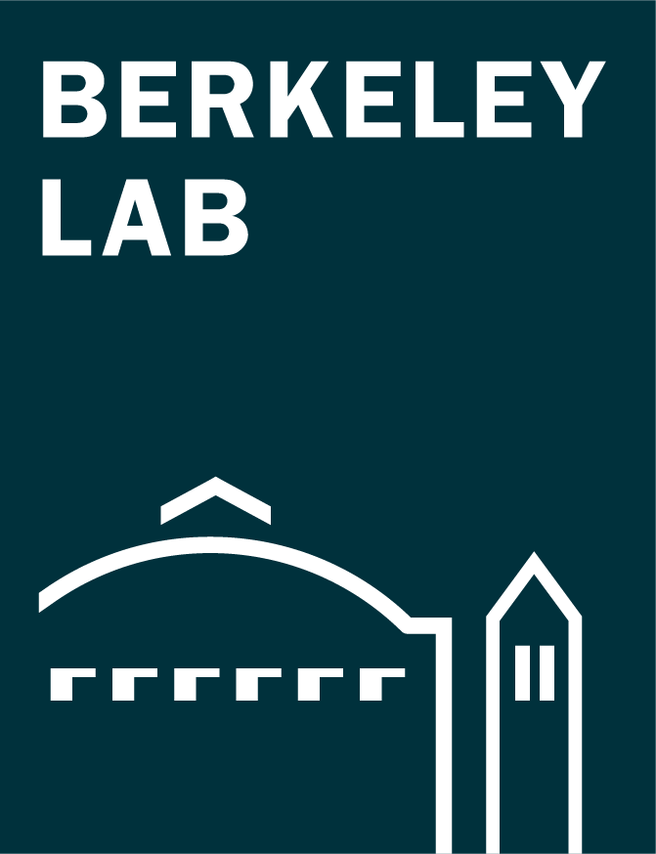
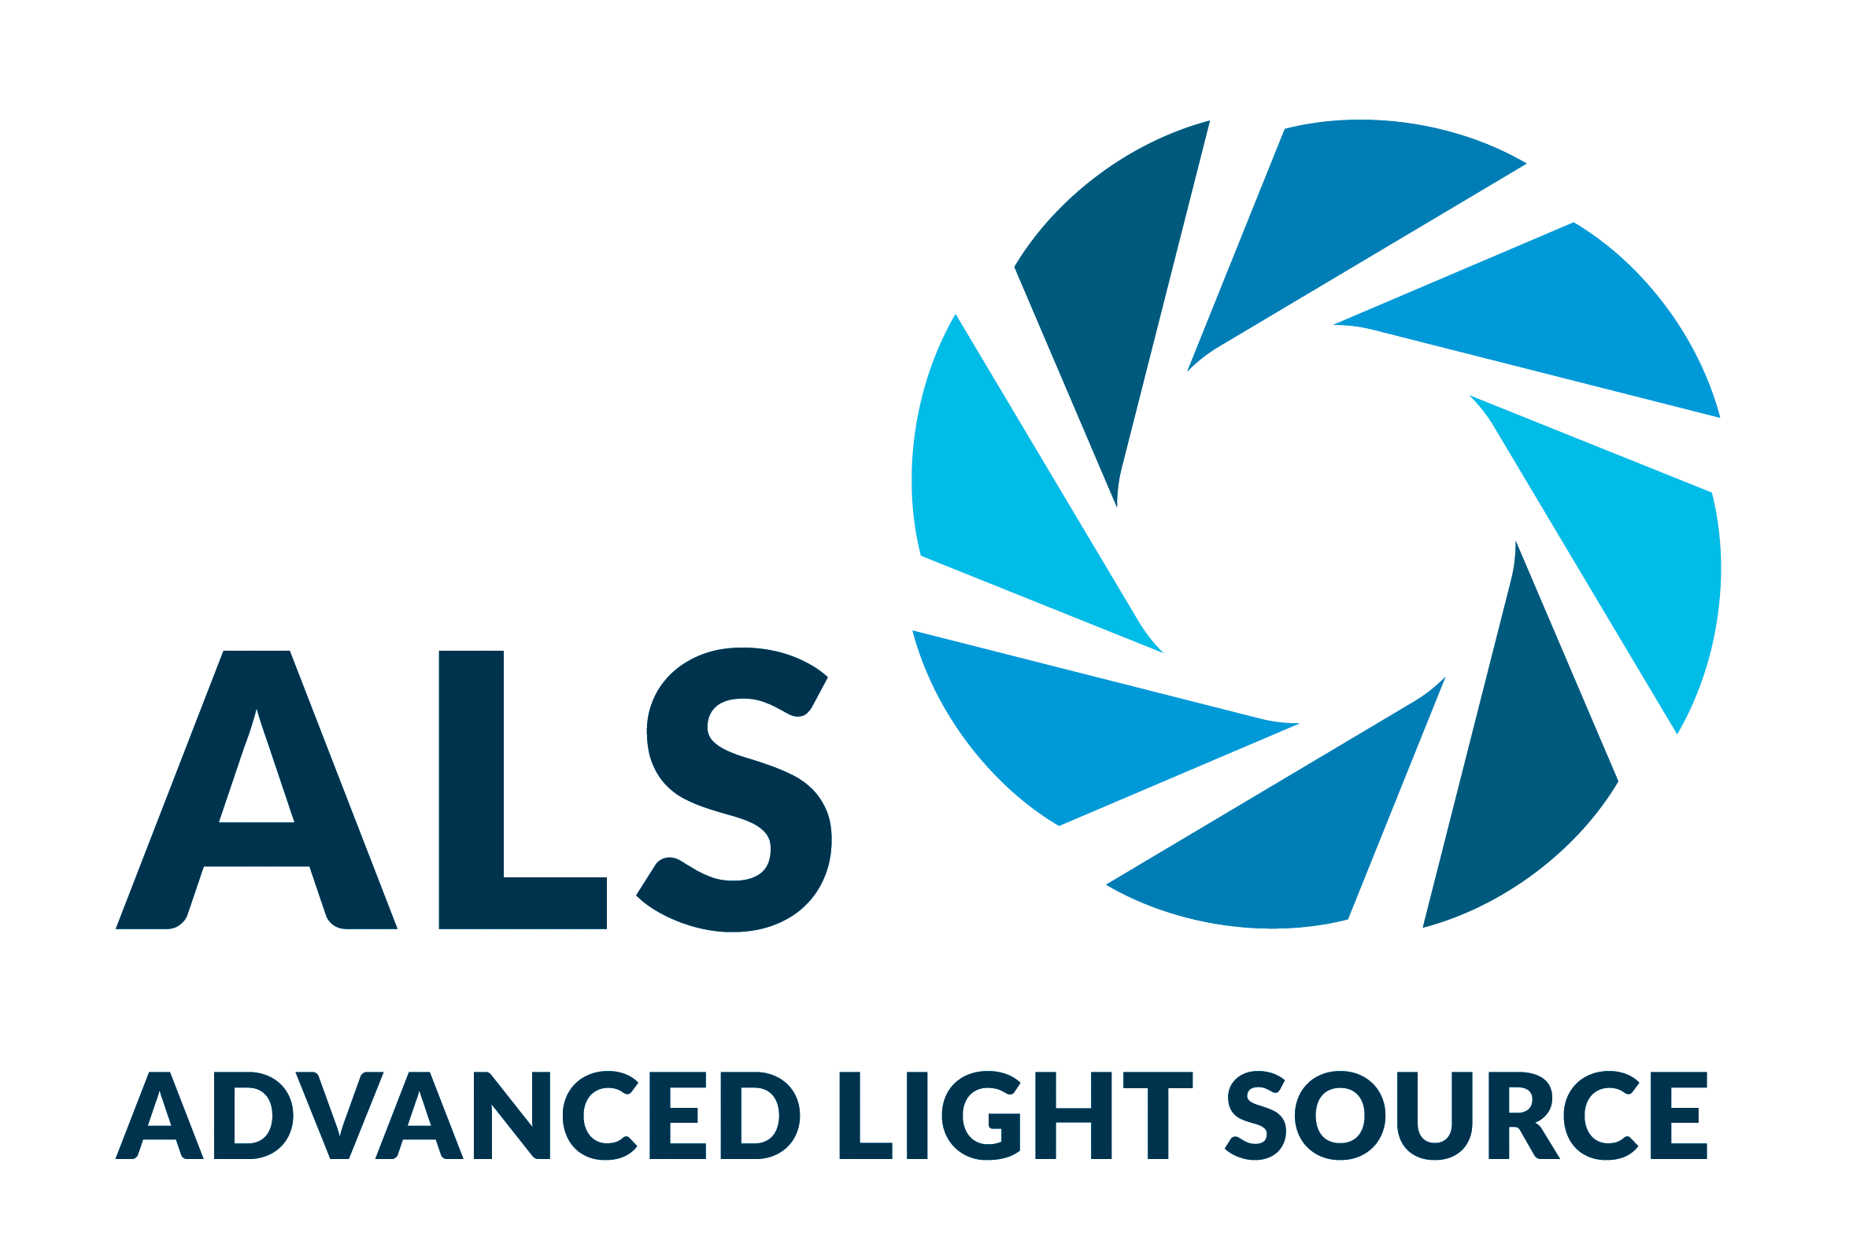
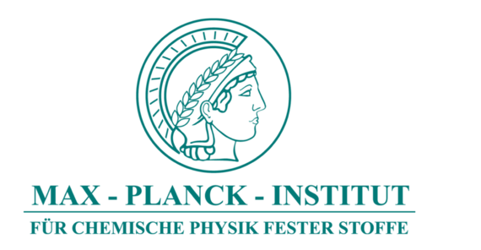
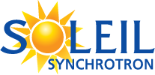
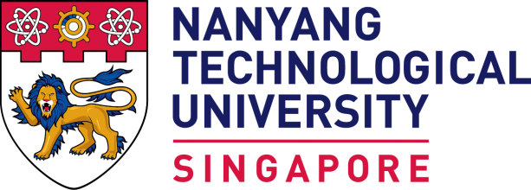
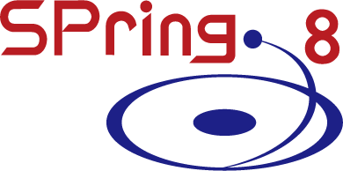
Chiral Twists and Turns Lead Way to New Materials
Scientific Achievement
Using the Advanced Light Source (ALS), researchers found that, in crystals with structural chirality (left- or right-handedness), tuning the electronic behavior reveals hidden chiral phases and singularities.
Significance and Impact
The results provide a new way to predict, test, and manipulate novel materials that exhibit desirable properties for next-generation electronic and spintronic devices.
Research Details
Angle-resolved photoemission spectroscopy (ARPES) was used to study RhSi and CoSi, which have chiral/helical crystal structures.
Ultraviolet used to probe surface states, soft x-rays for bulk.
Band structure was tuned by doping with Ni or Fe.
Strong evidence for the topological nature of the surface states.
Two types of Van Hove singularities found: inter- and intra-helicoid.
Chiral electron trajectories on the surface of a rhodium-silicon (RhSi) crystal. The looping helicoid arcs of the electron spectrum have a definite handedness, connected to the chirality of the atomic lattice.
T.A. Cochran, I. Belopolski, K. Manna, M. Yahyavi, Y. Liu, D.S. Sanchez, Z.-J. Cheng, X.P. Yang, D. Multer, J.-X. Yin, H. Borrmann, A.Chikina, J.A. Krieger, J. Sánchez-Barriga, P. Le Fèvre, F. Bertran, V.N. Strocov, J.D. Denlinger, T.-R. Chang, S. Jia, C. Felser, H. Lin, G. Chang, and M.Z. Hasan, Phys. Rev. Lett. 130, 066402 (2023), doi:10.1103/PhysRevLett.130.066402; and D.S. Sanchez, T.A. Cochran, I. Belopolski, Z.-J. Cheng, X.P. Yang, Y. Liu, T. Hou, X. Xu, K. Manna, C. Shekhar, J.-X. Yin, H. Borrmann, A. Chikina, J.D. Denlinger, V.N. Strocov, W. Xie, C. Felser, S. Jia, G. Chang, and M.Z. Hasan, Nat. Phys. 19, 682 (2023), doi:10.1038/s41567-022-01892-6. Work was performed at ALS/LBNL.
Notes:
Chirality is a key principle in cutting-edge materials research because it breaks crystal symmetries, a condition that often leads to new physical phenomena with relevance to next-generation electronic and spintronic devices. One example of the consequences of chirality in materials involves the peculiar helical trajectories of electrons in crystals with chiral atomic structures. In earlier work, physicists at Princeton University predicted and confirmed a link between this type of crystal-lattice chirality and the chiral momentum distribution of topologically protected electrons at the crystal surface. These chiral electronic behaviors manifested as looping, helicoid “Fermi arcs” in spectroscopic data obtained at the ALS. Now, in two recently published studies, the Princeton group has extended their study of topological chiral crystals by tuning the electronic structure using chemical doping. This enabled them to probe the multiple intertwined topological phases of the surface electrons as well as saddle-shaped features (“van Hove singularities”) associated with the emergence of exotic material properties.
Researchers: T.A. Cochran, I. Belopolski, D.S. Sanchez, Z.-J. Cheng, X.P. Yang, D. Multer, and J.-X. Yin (Princeton University); K. Manna (Max Planck Institute for Chemical Physics of Solids, Germany, and Indian Institute of Technology, India); M. Yahyavi (National Cheng Kung University, Taiwan, and Nanyang Technological University, Singapore); Y. Liu and X. Xu (Peking University); H. Borrmann and C. Shekhar (Max Planck Institute for Chemical Physics of Solids, Germany); A. Chikina and V.N. Strocov (Swiss Light Source); J.A. Krieger (Swiss Light Source and Paul Scherrer Institute, Switzerland); J. Sánchez-Barriga (BESSY II and IMDEA Nanociencia, Spain); P. Le Fèvre and F. Bertran (SOLEIL Synchrotron); J.D. Denlinger (ALS); T.-R. Chang (National Cheng Kung University, Taiwan); S. Jia, G. Chang, and T. Hou (Nanyang Technological University, Singapore); W. Xie (Michigan State University); C. Felser (Max Planck Institute for Chemical Physics of Solids, Germany); H. Lin (Academia Sinica, Taiwan); and M.Z. Hasan (Princeton University and Berkeley Lab).
Funding: US Department of Energy, Office of Science, Basic Energy Sciences program (DOE BES); National Science Foundation; Helmholtz Association (Germany); European Research Council; Swiss National Science Foundation; National Research Foundation (Singapore); Nanyang Technological University (Singapore); Department of Atomic Energy (India); and Max Planck Society (Germany). Operation of the ALS is supported by DOE BES.
Full highlight: https://als.lbl.gov/chiral-twists-and-turns-lead-way-to-new-materials/

