Slide 1
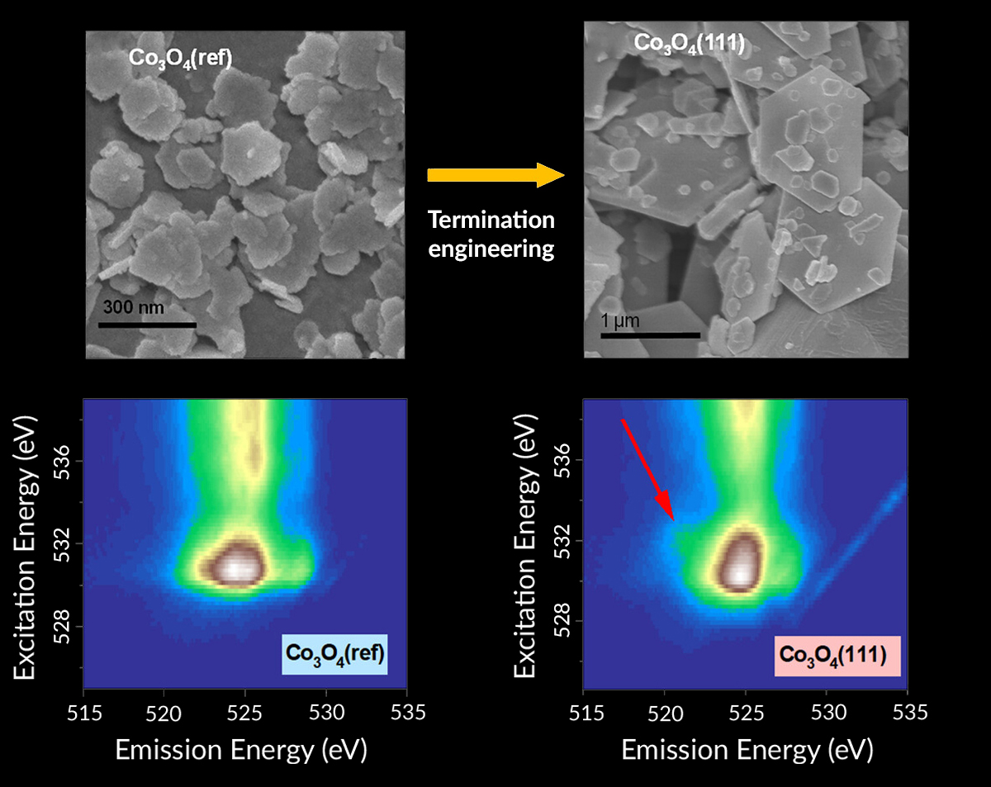
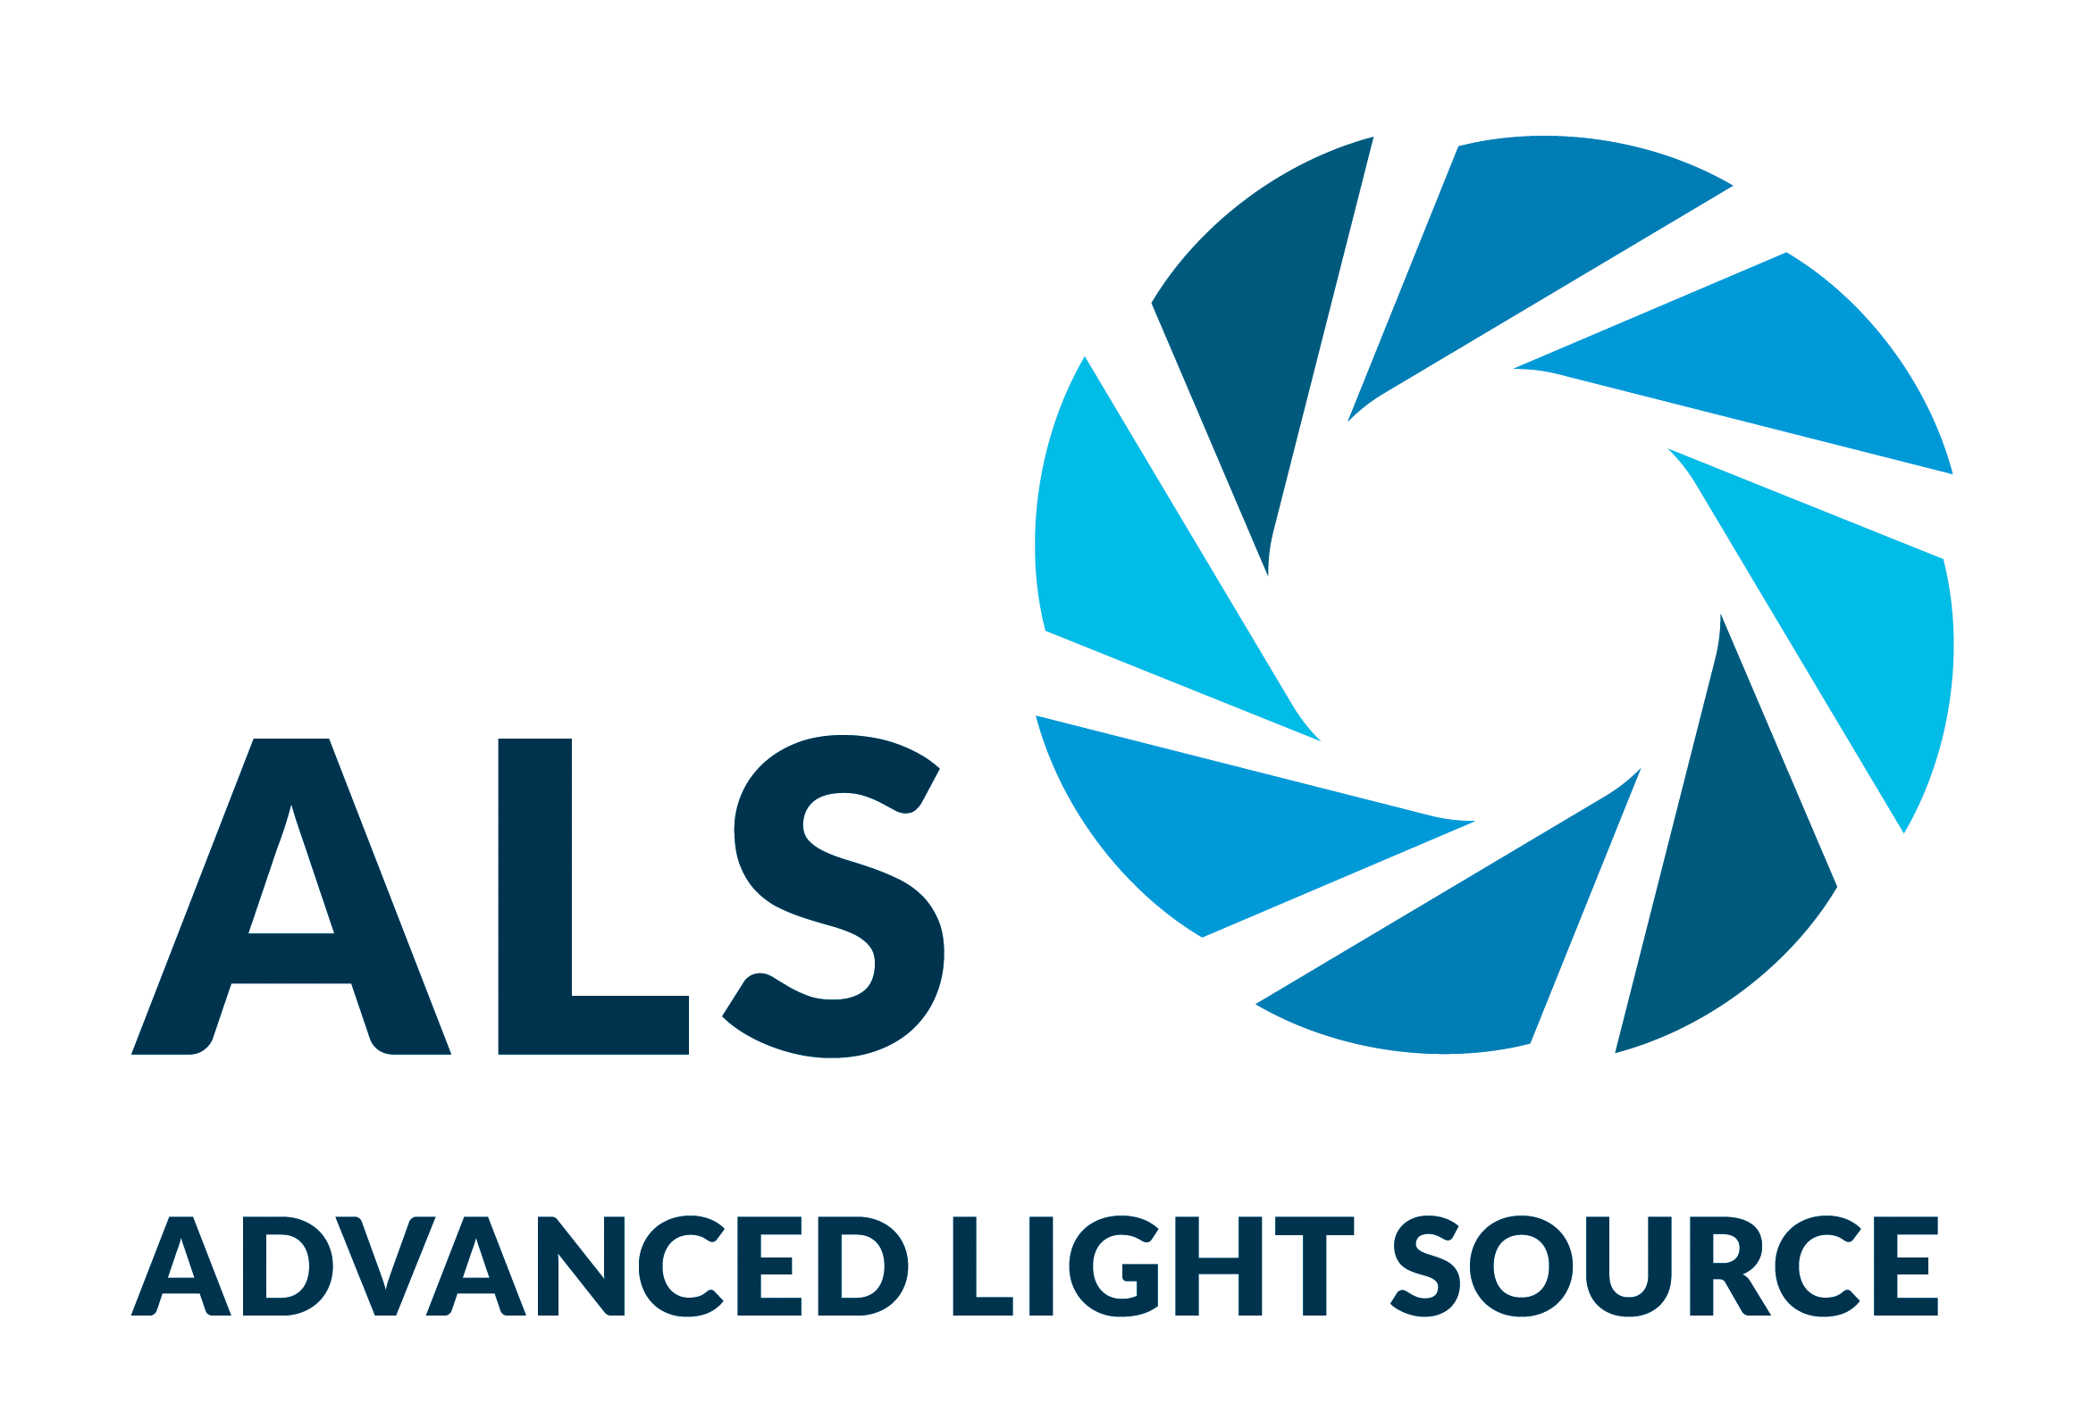
Surface Engineering Boosts Water-Splitting Efficiency
Scientific Achievement
With the support of data from the Advanced Light Source (ALS), researchers modified the surface of an electrocatalyst to maximize its efficiency at splitting water.
Significance and Impact
The optimized material is approximately 40 times more efficient than similar commercial electrocatalysts and could help make the production of clean hydrogen fuel more sustainable and economical.
Research Details
Termination engineering of Co₃O₄ placed the (111) plane at the surface to maximize oxygen evolution reaction (OER) activity.
Samples were characterized using various microscopy and spectroscopy techniques, including high-efficiency mapping of resonant inelastic x-ray scattering (mRIXS) at the ALS.
The data plus calculations revealed that the material's improved performance is a result of the increased surface density of highly active Co³⁺ and the involvement of oxygen anions as independent active sites.
Top: SEM images show the differing morphologies of nonfaceted Co₃O₄(ref) and faceted Co₃O₄(111) after surface-termination engineering. Bottom: The mRIXS data for Co₃O₄(111) shows the "fingerprint" of oxygen states (red arrow in right panel) associated with greatly improved electrocatalytic performance.
X. Li, L. Ge, Y. Du, H. Huang, Y. Ha, Z. Fu, Y. Lu, W. Yang, X. Wang, and Z. Cheng, ACS Nano 17, 6811 (2023), doi:10.1021/acsnano.3c00387. Work was performed at ALS/LBNL.
Notes:
The production of hydrogen fuel through the use of renewable energy is a promising way to address the energy needs of the modern world. Currently, the process of splitting water to generate “clean” hydrogen—avoiding the input of fossil fuels and the output of greenhouse gases—requires precious-metal electrocatalysts such as platinum and ruthenium. While these materials are effective at lowering the energy barriers that slow down a key chemical reaction (the oxygen evolution reaction, or OER), they raise economic barriers because of their rarity and expense. Less costly earth-abundant materials, on the other hand, have proven less effective at driving the sluggish OER, creating a bottleneck in the generation of hydrogen. In this work, researchers synthesized a modified form of cobalt oxide (Co₃O₄) that is 40 times more efficient in driving the OER than ruthenium oxide (RuO₂), a commercial precious-metal electrocatalyst. Numerous experiments, including x-ray spectroscopy at the ALS, revealed key information about the material’s modified surface structure and chemical properties, advancing our understanding of oxide electrocatalysts for a wide variety of energy technologies.
Researchers: X. Li, Y. Du, X. Wang, and Z. Cheng (University of Wollongong, Australia); L. Ge, H. Huang, Z. Fu, and Y. Lu (University of Science and Technology of China); and Y. Ha and W. Yang (ALS).
Funding: National Natural Science Foundation of China, Australia Research Council, and Anhui Provincial Department of Science and Technology (China). Operation of the ALS is supported by the US Department of Energy, Office of Science, Basic Energy Sciences program.
Full highlight: https://als.lbl.gov/surface-engineering-boosts-water-splitting-efficiency/

