Slide 1
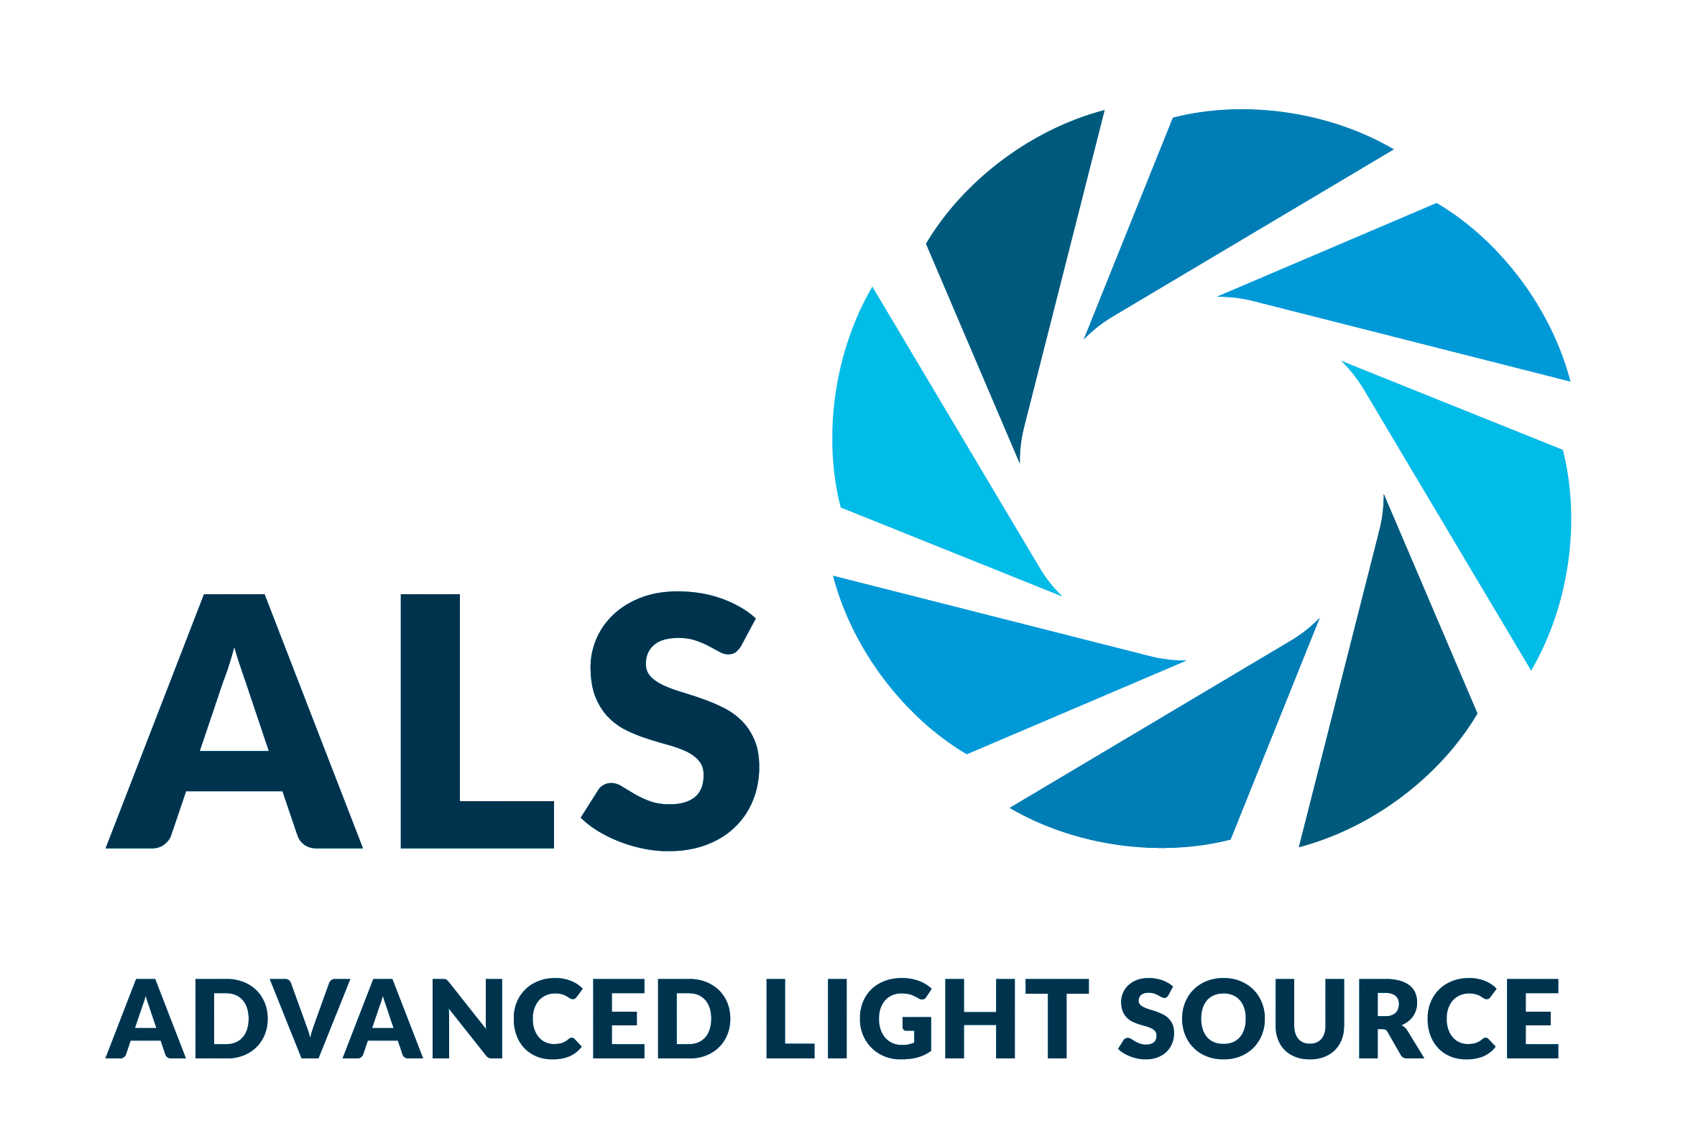
Coaxing Molecules to Stand Tall for Better Solar Cells
Scientific Achievement
Multimodal probes at the Advanced Light Source (ALS) and the Molecular Foundry revealed a way to prevent the formation of undesirable phases in a perovskite-type compound that shows promise for the efficient harvesting of light for solar cells.
Significance and Impact
The work led to new fabrication protocols that resulted in devices with improved power-conversion efficiencies and operational stability.
Research Details
Thin films of formamidinium lead iodide (FAPbI₃) were fabricated using a spin coater in an x-ray beamline while diffraction and photoluminescence data were collected simultaneously.
Sample preparation, complementary measurements done at the Foundry.
Adding pentanamidine hydrochloride (PAD) induced oriented nucleation, resulting in higher-quality crystals with improved properties.
The introduction of pentanamidine hydrochloride (PAD) to perovskite precursor solution decreased the surface energy of the (100) plane. This induced oriented nucleation and the preferential formation of the perovskite’s photoactive black phase.
P. Shi, Y. Ding, B. Ding, Q. Xing, T. Kodalle, C.M. Sutter-Fella, I. Yavuz, C. Yao, W. Fan, J. Xu, Y. Tian, D. Gu. K. Zhao, S. Tan, X. Zhang, L. Yao, P.J. Dyson, J.L. Slack, D. Yang, J. Xue, M. Khaja Nazeeruddi, Y. Yang, and R. Wang, Nature (2023), doi:10.1038/s41586-023-06208-z. Work was performed at the ALS and Molecular Foundry at LBNL.
Notes:
A relatively new class of materials, organic–inorganic halide perovskites, offers an alternative to silicon for photovoltaic (PV) power generation. Halide perovskites offer a range of benefits, including being up to 1000 times thinner than silicon, absorbing incoming solar irradiation more efficiently, and having a better matched bandgap for the solar spectrum. Perovskite thin-film fabrication also offers lower-cost processes, but more research, such as this study, needs to be done to capitalize on that potential. Formamidinium lead iodide (FAPbI₃) is one of the most promising halide perovskite candidates for PV applications. One challenge, however, is the existence of polytypes of FAPbI₃ (different configurations of the same atoms), called black and yellow phases. The black phase absorbs most of the solar spectrum, but it is energetically unfavorable and therefore not normally stable at room temperature. As a consequence, the photoactive black phase is hampered by conversion to the non-photoactive yellow phase. To counteract this, researchers have developed a new method of perovskite crystallization that reliably suppresses yellow-phase formation by encouraging the oriented nucleation of FaPbI₃ crystals.
Researchers: P. Shi, W. Fan, Y. Tian, and K. Zhao (Zhejiang Univ. and Westlake Univ., China); Y. Ding (École Polytechnique Fédérale de Lausanne [EPFL], Switzerland, and North China Electric Power Univ.); B. Ding, P.J. Dyson, and M.K. Nazeeruddin (EPFL); Q. Xing, S. Tan, and Y. Yang (Univ. of California, Los Angeles); D. Yang and J. Xue (Zhejiang Univ., China); T. Kodalle and C.M. Sutter-Fella (Berkeley Lab); I. Yavuz (Marmara Univ., Turkey); C. Yao (Fudan Univ., China); J. Xu, D. Gu, X. Zhang, L. Yao, and R. Wang (Westlake Univ., China); and J.L. Slack (ALS).
Funding: Natural Science Foundation of Zhejiang Province of China, National Natural Science Foundation of China, Shanxi-Zheda Institute of Advanced Materials and Chemical Engineering (China), Westlake University (China), Valais Energy Demonstrators fund (EPFL), German Research Foundation, and National Center for High Performance Computing of Turkey. Operation of the ALS and Molecular Foundry is supported by the US Department of Energy, Office of Science, Basic Energy Sciences program.
Full highlight: https://als.lbl.gov/coaxing-molecules-to-stand-tall-for-better-solar-cells/

