Slide 1
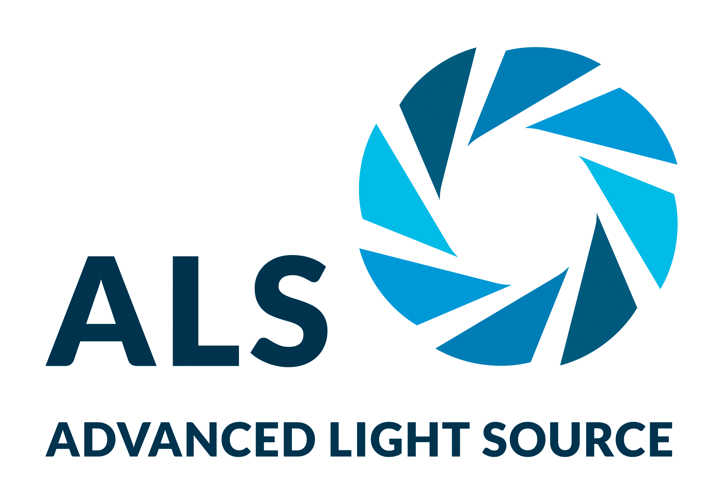
A New Pathway for Clearing Misfolded Proteins
Scientific Achievement
Researchers integrated several approaches, such as cryogenic 3D imaging at the Advanced Light Source (ALS), to define a novel cellular pathway—involving a shared “garbage dump”—for clearing misfolded proteins from cells.
Significance and Impact
The pathway is a potential therapy target for age-related diseases like Alzheimer’s, Huntington’s, and Parkinson’s diseases.
Research Details
Intact yeast cells were imaged using cryogenic soft x-ray tomography at the ALS and super-resolution visible-light microscopy.
Misfolded protein clusters (inclusions) migrated toward the nucleus–vacuole boundary (where proteins are queued up for degradation).
Inclusions from the nucleus budded straight into the vacuole at the junction of the two membranes.
Genetic experiments showed that the budding action was facilitated by proteins that help transport molecules around cells.
Left: Soft x-ray tomographic reconstruction of a yeast cell in which misfolded proteins (magenta) in the cytoplasm are being engulfed by vacuoles (gray), the cell’s protein degradation machinery. Right: Super-resolution visible-light microscopy reconstruction showing misfolded nuclear proteins (green) being extruded from the nucleus (blue) toward a vacuole through a nuclear-vacuolar junction (yellow). (Image credit: Fabián Morales-Polanco/Stanford University).
E.M. Sontag, F. Morales-Polanco, J.H. Chen, G. McDermott, P.T. Dolan, T. Gestaut, M.A. Le Gros, C. Larabell, and J. Frydman, Nat. Cell Biol. 25, 699 (2023), doi:10.1038/s41556-023-01128-6. Work was performed at the ALS/LBNL.
Notes:
Misfolded proteins are toxic to cells. They disrupt normal functions and cause some age-related human degenerative diseases, like Alzheimer’s, Parkinson’s, and Huntington’s diseases. Cells can deal with misfolded proteins by refolding or eliminating them. While the cell decides whether to refold or degrade proteins, it sequesters them into membraneless inclusions—clusters of misfolded proteins, like tiny garbage dumps, that occur in both the cytoplasm and the nucleus. In this work, researchers visually followed the fate of the misfolded proteins through cryogenic soft x-ray tomographic imaging and super-resolution visible-light microscopy. The results led to a previously unknown cellular pathway for clearing misfolded proteins from the nucleus, a discovery that could lead to new targets for age-related disease therapies.
Researchers: E.M. Sontag (Marquette University and Stanford University); F. Morales-Polanco, T. Gestaut, and J. Frydman (Stanford University); J.H. Chen and G. McDermott (UCSF); P.T. Dolan (National Institute of Allergy and Infectious Diseases); and M.A. Le Gros and C. Larabell (UCSF and Berkeley Lab).
Funding: National Institutes of Health, Way Klingler Startup Funds (Marquette University), Pew Charitable Trusts, and the Gordon and Betty Moore Foundation. Operation of the ALS is supported by the US Department of Energy, Office of Science, Basic Energy Sciences program.
Full highlight: https://als.lbl.gov/a-new-pathway-for-clearing-misfolded-proteins/

