Slide 1
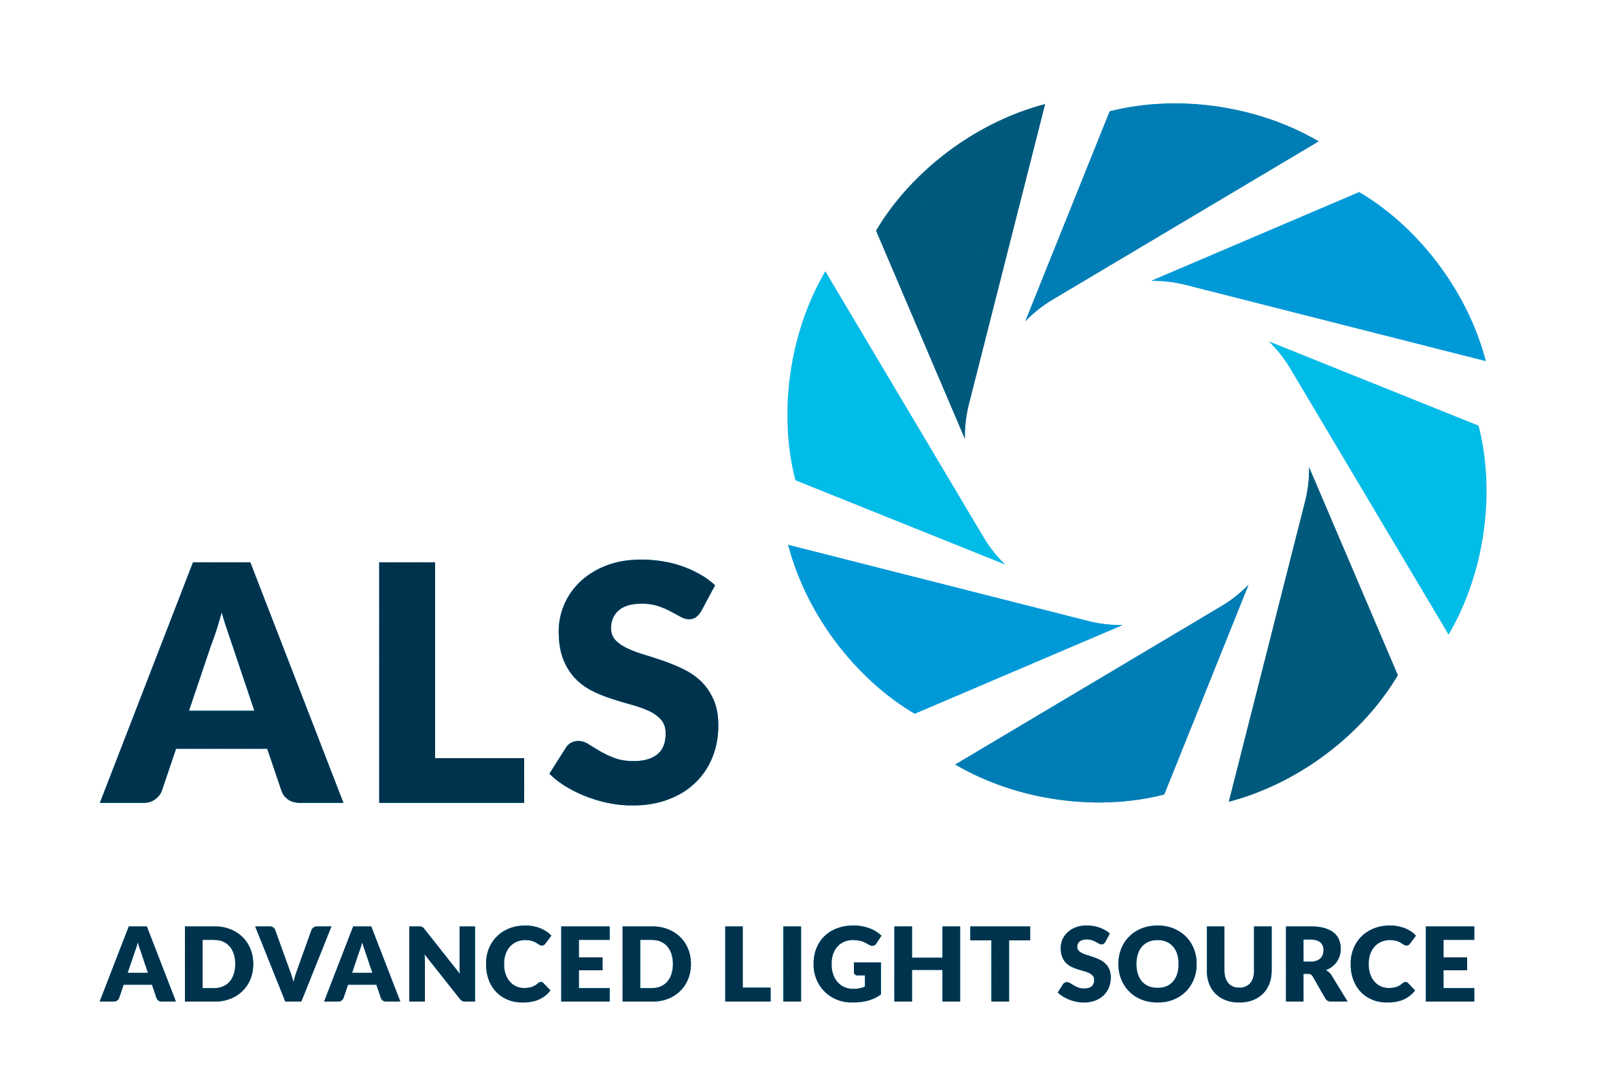
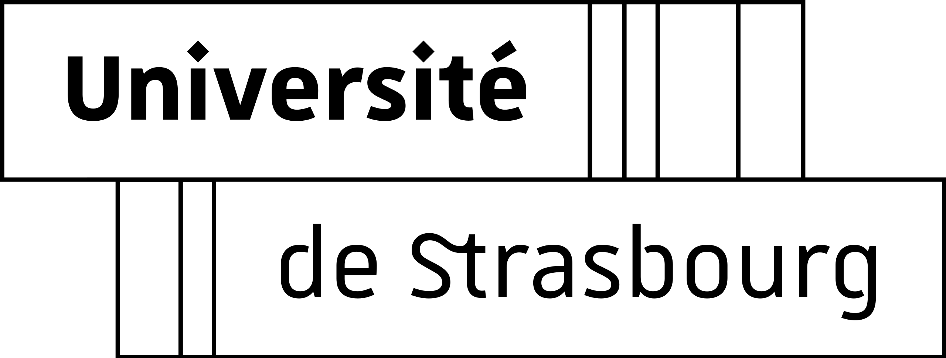
Eco-Friendly Processing of Organic Photovoltaics
Scientific Achievement
As revealed by x-ray microscopy at the Advanced Light Source (ALS), researchers controlled the mixing of electron-donating and -accepting constituents of an organic photovoltaic (OPV) material made using a process that replaces toxic solvents with water.
Significance and Impact
With efficiencies comparable to less eco-friendly OPVs, this material shows promise for many advanced device and building applications.
Research Details
Morphologies of nanoparticles with fullerene (PC₆₁BM) and non-fullerene (Y6) acceptor phases were analyzed using scanning transmission x-ray microscopy (STXM).
Y6 was chosen to closely match the surface energy of the donor phase (PTQ10), resulting in greater intermixing than with PC₆₁BM.
PTQ10:Y6 yielded a 9.8% power-conversion efficiency vs 11.2% for films made using a chlorine-based solvent.
STXM composition maps of nanoparticle assemblies with fullerene (top row) and non-fullerene (bottom row) electron-acceptor phases, before and after annealing at 200 °C. With fullerene acceptors, nanoparticles display a core–shell morphology, coalescing after annealing into large domains that reduce efficiency. With non-fullerene acceptors, no clear phase separation is observed within nanoparticles and the morphology appears intermixed, even after annealing. Scale bars = 500 nm.
H. Laval, A. Holmes, M.A. Marcus, B. Watts, G. Bonfante, M. Schmutz, E. Deniau, R. Szymanski, C. Lartigau-Dagron, X. Xu, J.M. Cairney, K. Hirakawa, F. Awai, T. Kubo, G. Wantz, A. Bousquet, N.P. Holmes, and S. Chambon, Adv. Energy Mater. 13, 202300249 (2023); doi:10.1002/ aenm.202300249. Work was performed in part at ALS/LBNL.
Notes:
Organic (carbon-based) photovoltaics (OPVs) offer many advantages over traditional silicon solar panels. OPVs can be manufactured inexpensively at industrial scale using solution-based deposition techniques onto rolls of flexible substrates. The end result is a thin, lightweight, and bendable photoactive material that can take on different colors and varying degrees of transparency. While less efficient in converting light into electricity than classic silicon solar cells, OPVs can potentially be used in more ways, including in tensile-fabric architectural structures, rollable solar panels for disaster relief operations, and printed bioelectronic devices. However, fabrication of photoactive OPV films typically involves solutions of organic semiconductors dissolved in toxic solvents. Although a cleaner way is possible by synthesizing organic semiconductor nanoparticles dispersed in water, it has so far resulted in lower power-conversion efficiencies. In this work, an international team of researchers discovered a way to optimize the makeup of the nanoparticles, which allowed water-processed OPV films to reach higher efficiencies.
Researchers: H. Laval, R. Szymanski, and G. Wantz (University of Bordeaux, France); A. Holmes, C. Lartigau-Dagron, and A. Bousquet (University of Pau and the Pays de l'Adour [UPPA], France); M.A. Marcus (ALS); B. Watts (Paul Scherrer Institute, Switzerland); G. Bonfante, K. Hirakawa, F. Awai, and T. Kubo (University of Tokyo, Japan); M. Schmutz (University of Strasbourg, France); E. Deniau (UPPA and University of Le Mans, France); X. Xu (University of Technology Sydney, Australia); J.M. Cairney and N.P. Holmes (University of Sydney, Australia); and S. Chambon (University of Bordeaux and University of Tokyo).
Funding: French National Research Agency (ANR); French National Center for Scientific Research (CNRS); Research Center for Advanced Science and Technology (RCAST), University of Tokyo; Japan Society for the Promotion of Science (JSPS); University of Bordeaux; Energy and Environment Solutions (E2S), UPPA; International Higher Institute for Research Training (ISIFoR), France; German Federal Ministry of Education and Research (BMBF); and Australian Nuclear Science and Technology Organisation. Operation of the ALS is supported by the US Department of Energy, Office of Science, Basic Energy Sciences program.
Full highlight: https://als.lbl.gov/eco-friendly-processing-of-organic-photovoltaics/

