Slide 1
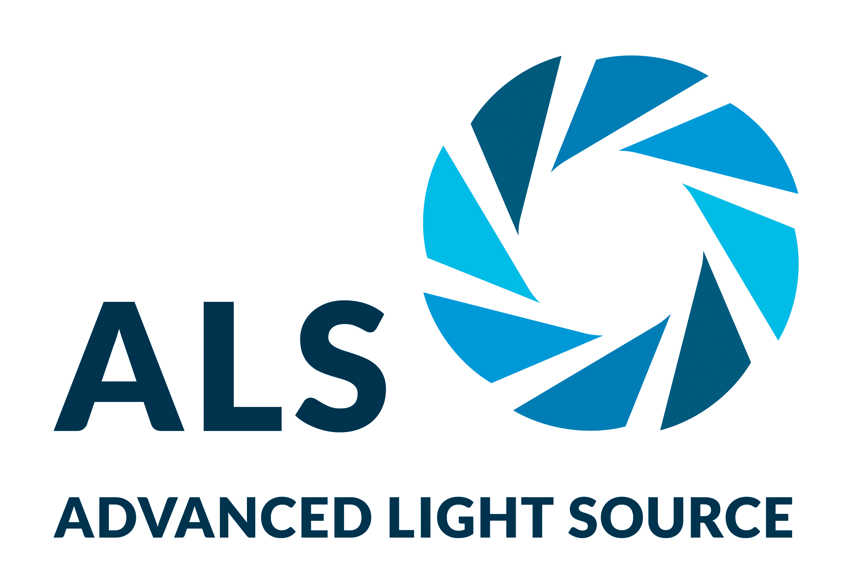
How Structure Affects the Activity of Lipid Nanoparticles
Scientific Achievement
Berkeley Lab and Genentech scientists related the internal structures of lipid nanoparticles to their efficacy at drug delivery, using a combination of methods including x-ray scattering at the Advanced Light Source (ALS).
Significance and Impact
The work promises to expedite the development of drug delivery systems for the treatment of diseases such as COVID-19 and cancer.
Research Details
Genentech's high-throughput workflow generates and screens hundreds of LNP formulations in just a few hours.
At the ALS SIBYLS beamline, the development of a high-throughput x-ray scattering platform allowed the comprehensive mapping of LNP formulation space, which is currently infeasible using other techniques.
Led to finding that a lower ratio of disordered to ordered core phases correlates with stronger gene-silencing activity.
To better understand the structure–activity relationship in liquid nanoparticles (LNPs), a seamless, high-throughput screening approach was developed that uses small-angle x-ray scattering (SAXS) to identify LNP liquid phases and relate that structural information to gene silencing activity in vitro.
M. Hammel, Y. Fan, A. Sarode, A.E. Byrnes, N. Zang, P. Kou, K. Nagapudi, D. Leung, C.C. Hoogenraad, T. Chen, C.-W. Yen, and G.L. Hura, ACS Nano 17, 11454 (2023), doi:10.1021/acsnano.3c01186. Work was performed in part at ALS/LBNL.
Notes:
Many diseases can be successfully treated in the simple environment of a cell culture dish, but to successfully treat real people, the drug agent has to take a journey through the infinitely more complex environment within our bodies and arrive, intact, inside the affected cells. This process, called drug delivery, is one of the most significant barriers in medicine. Researchers from Berkeley Lab and Genentech, a member of the Roche Group, are working together to design more effective lipid nanoparticles (LNPs)—tiny spherical pouches made of fatty molecules (lipids) that encapsulate therapeutic agents until they dock with cell membranes and release their contents. The first drug to use LNPs was approved in 2018, but the delivery method rose to global prominence with the Pfizer and Moderna mRNA COVID vaccines. LNPs are now being widely explored as a delivery system for vaccines for other infectious diseases or therapeutic vaccines for cancer. The viability of these new applications will depend on how well the lipid envelopes fuse with target cells, how stable the drug–LNP formulations are in storage, and how stable they are in the body. All these properties are controlled by the mixture of molecules used to create the LNP, and the resulting 3D structure of the particle.
Researchers: M. Hammel (Berkeley Lab); Y. Fan, A. Sarode, A.E. Byrnes, N. Zang, P. Kou, K. Nagapudi, D. Leung, C.C. Hoogenraad, T. Chen, and C.-W. Yen (Genentech Inc.); and G.L. Hura (Berkeley Lab and Univ. of California, Santa Cruz).
Funding: Genentech Inc.; National Institutes of Health; and US Department of Energy (DOE), Office of Science, Biological and Environmental Research program. Operation of the ALS is supported by DOE, Office of Science, Basic Energy Sciences program.
Full highlight: https://als.lbl.gov/how-structure-affects-the-activity-of-lipid-nanoparticles/

