Slide 1
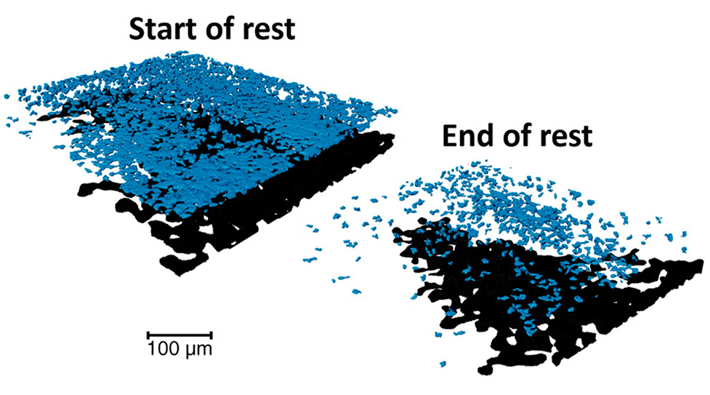
Internal Currents in Li Batteries after Fast Charging
Scientific Achievement
In lithium batteries after fast charging, researchers measured the persistence of internal currents and found that large local currents continue even after charging has stopped.
Significance and Impact
The work uses hard x-ray 3D imaging at the Advanced Light Source (ALS) in a novel way and sheds light on the causes of thermal runaway and the catastrophic failure of lithium batteries at rest.
Research Details
Volume changes in Li metal on electrode surface and in graphite particles in the electrode were measured by x-ray microtomography.
The data was used to determine spatially resolved ionic current densities in the Li (current source) and graphite (current sink).
The Li current density was independent of time, with outliers generating current densities higher than that used for fast charging.
3D tomographic data from a lithium-ion battery electrode, a few minutes after fast charging (start of rest) and about 20 minutes later (end of rest). The blue layer shows metallic lithium that has plated on the electrode surface, while the black layer shows underlithiated graphite particles in the electrode itself. By analyzing changes in this data over time, researchers were able to quantify ionic currents generated by the movement of lithium ions from the plated lithium to the underlithiated graphite.
A.S. Ho, D.Y. Parkinson, S.E. Trask, A.N. Jansen, and N.P. Balsara, ACS Nano 17, 19180 (2023), doi:10.1021/acsnano.3c05470. Work was performed at ALS/LBNL and Chemical Sciences and Engineering/ANL and was primarily funded by the DOE's Advanced Battery Cell Research Program (eXtreme fast charge Cell Evaluation of Lithium-ion batteries, XCEL).
Notes:
How likely is an electric-vehicle battery to self-combust and explode? The chances of that happening are actually pretty slim: Some analysts say that gasoline vehicles are nearly 30 times more likely to catch fire than electric vehicles. But recent news of EVs catching fire while parked have left many consumers—and researchers—scratching their heads over how these rare events could possibly happen. Researchers have long known that high electric currents can lead to “thermal runaway”—a chain reaction that can cause a battery to overheat, catch fire, and explode. But without a reliable method to measure currents inside a resting battery, it has not been clear why some batteries go into thermal runaway when an EV is parked. Now, by using operando x-ray microtomography at the ALS, scientists have shown that the presence of large local currents inside batteries at rest after fast charging could be one of the causes behind thermal runaway.
Researchers: A.S. Ho and N.P. Balsara (UC Berkeley and Berkeley Lab), D.Y. Parkinson (ALS), and S.E. Trask and A.N. Jansen (Argonne National Laboratory).
Funding: US Department of Energy (DOE), Office of Energy Efficiency and Renewable Energy, Vehicle Techologies Office; and the National Science Foundation. Operation of the ALS is supported by the US DOE, Office of Science, Basic Energy Sciences program.
Full highlight: https://als.lbl.gov/internal-currents-in-lithium-batteries-after-fast-charging/

