Slide 1
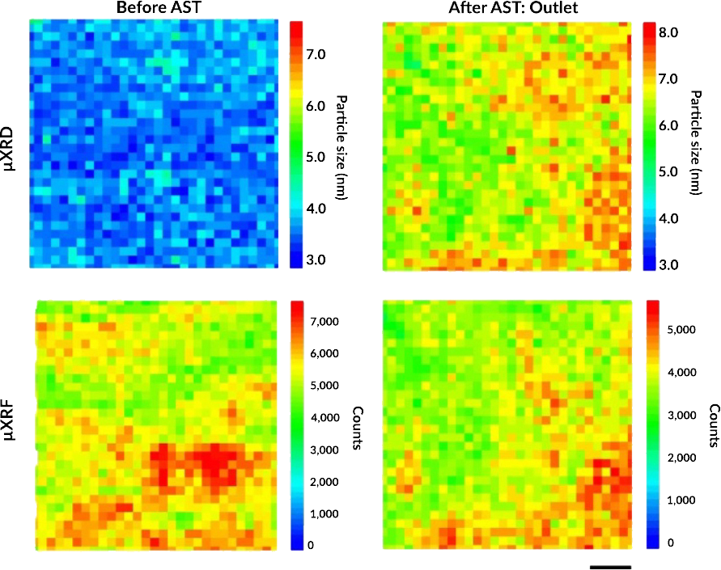
Tracking Platinum Movement on Fuel-Cell Electrodes
Scientific Achievement
Using the Advanced Light Source (ALS), researchers tracked the movement of the platinum nanoparticles that catalyze reactions in polymer electrolyte fuel cells (PEFCs) and correlated this movement with nanoparticle degradation.
Significance and Impact
The results yielded solutions that can immediately reduce platinum waste in emission-free heavy-duty fuel-cell vehicles.
Research Details
Catalyst-coated membranes (CCMs) designed for potential use in heavy-duty vehicles were subjected to accelerated stress tests (ASTs).
X-ray microdiffraction (µXRD) and microfluorescence (µXRF) revealed a linear correlation between Pt nanoparticle growth (i.e., degradation) and local Pt mass loading (i.e., distribution).
More durable PEFCs will require homogenous initial distribution of Pt and avoidance of undesired morphological features in the cathode catalyst layer.
CCMs were scanned before (left) and after (right) ASTs. µXRD (top) yielded Pt particle size, and µXRF (bottom) revealed Pt particle loading. Statistical analysis showed a linear correlation between particle size and loading only after the ASTs. Scale bar = 50 µm.
K. Khedekar, A. Zaffora, M. Santamaria, M. Coats, S. Pylypenko, J. Braaten, P. Atanassov, N. Tamura, L. Cheng, C. Johnston, and I.V. Zenyuk, Nat. Catal. 6, 676 (2023), doi:10.1038/s41929-023-00993-6. Work was performed at ALS/LBNL.
Notes:
Polymer electrolyte fuel cells (PEFCs) that run on green hydrogen are a promising option for powering heavy-duty vehicles that produce zero greenhouse-gas emissions. This type of fuel cell has the potential to extend driving range without incurring additional weight penalties. However, PEFCs use platinum as a catalyst to drive a key chemical reaction. The fast degradation of this precious metal in a PEFC and the resulting high cost currently prevent the widespread commercialization of this otherwise excellent technology. In this study, researchers wanted to better understand the nanoscale mechanisms by which platinum degrades during PEFC operation. They put the relevant components through accelerated stress tests that simulated the conditions of use in heavy-duty vehicles. They then probed the changes in platinum nanoparticle size and location using x-ray microdiffraction and microfluorescence at the ALS. The results point the way to improvements in PEFC fabrication that can significantly extend the lifetime and efficiency of PEFCs in heavy-duty vehicles, reduce their cost, improve air quality, and fight climate change.
Researchers: K. Khedekar, P. Atanassov, and I.V. Zenyuk (University of California, Irvine); A. Zaffora (UC Irvine and University of Palermo, Italy); M. Santamaria (University of Palermo, Italy); M. Coats and S. Pylypenko (Colorado School of Mines); J. Braaten, L. Cheng, and C. Johnston (Bosch Research and Technology Center North America); and N. Tamura (ALS).
Funding: Bosch Research and Technology Center North America. Operation of the ALS is supported by the US Department of Energy, Office of Science, Basic Energy Sciences program.
Full highlight: https://als.lbl.gov/tracking-platinum-movement-on-fuel-cell-electrodes/

