Slide 1
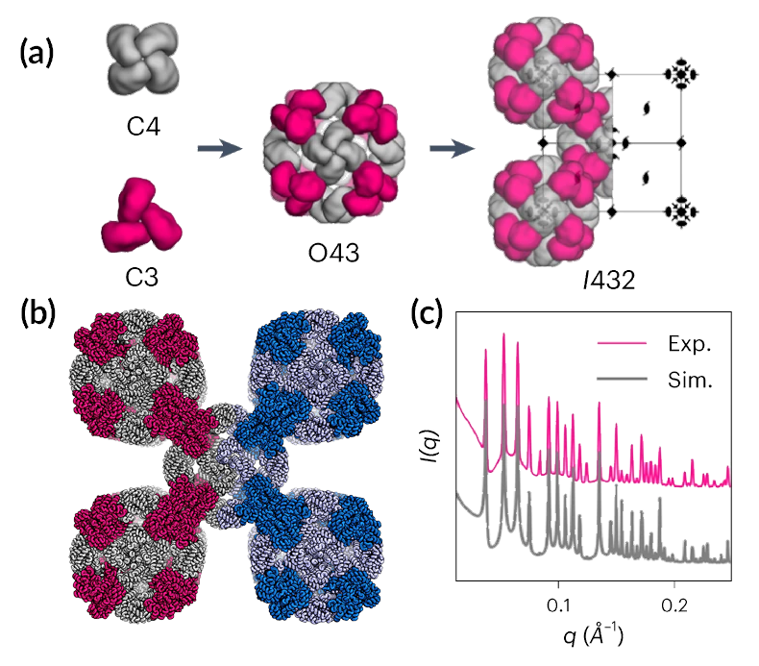
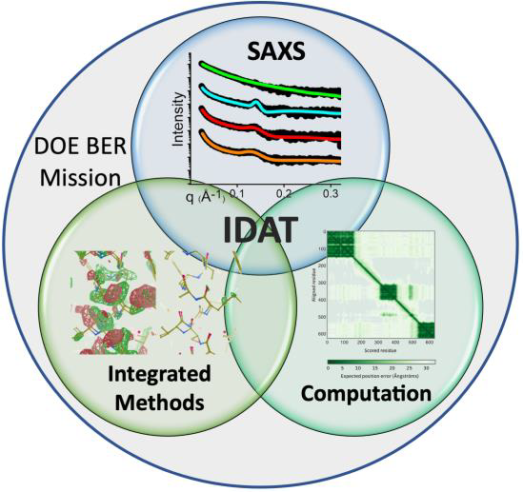
Computer-Aided Protein Design for New Biomaterials
Scientific Achievement
Using a computer-based approach, researchers designed porous protein crystals that were revealed to be stable, tunable, and atomically accurate using x-ray scattering and diffraction at the Advanced Light Source (ALS).
Significance and Impact
The work provides a powerful new platform for biological materials engineering and opens up wide applications in biotechnology and medicine.
Research Details
Crystal structures verified to high precision using x-ray crystallography.
Structures of oligomers and intermediate cage structures verified using customized small-angle x-ray scattering (SAXS) setup.
Gold nanoparticles were encapsulated in crystal pores to form nanoparticle superlattices, enabling optical properties to be tuned.
Crystals can be purified at large scale, are stable under extreme conditions, and provide robust and tunable 3D scaffolds.
(a) Steps in crystal construction. (b) Computational design model (left, pink/grey) spliced to determined structure (right, sky blue/light blue). (c) SAXS profiles (pink) compared to simulated profiles (grey).
Z. Li, S. Wang, U. Nattermann, A.K. Bera, A.J. Borst, M.Y. Yaman, M.J. Bick, E.C. Yang, W. Sheffler, B. Lee, S. Seifert, G.L. Hura, H. Nguyen, A. Kang, R. Dalal, J.M. Lubner, Y. Hsia, H. Haddox, A. Courbet, Q. Dowling, M. Miranda, A. Favor, A. Etemadi, N.I. Edman, W. Yang, C. Weidle, B. Sankaran, B. Negahdari, M.B. Ross, D.S. Ginger, and D. Baker, Nat. Mater. (2023), doi: 10.1038/s41563-023-01683-1. Work was performed at ALS/LBNL and APS/ANL.
Notes:
Protein crystallization has always been mysterious—requiring a lot of work and luck to coax large, irregular molecules to form orderly crystalline arrays. Typically, scientists have wanted to crystallize protein molecules to learn where the atoms are, using x-ray diffraction, to understand or manipulate protein function. Now, with computational protein design, scientists are exploring ways to use proteins to create completely new materials with precisely tuned characteristics such as lattice dimensions and pore sizes. In this work, an international team led by researchers from the Institute for Protein Design at the University of Washington (UW) developed a computer-aided approach for designing three-dimensional protein crystals with prespecified lattice architectures and atomic accuracy. The ability to genetically encode and express precise building blocks for synthesized biomaterials sets the stage for the development of advanced optical tools, new technologies for chemical separation, and a range of other applications in biotechnology and medicine.
Researchers: Z. Li, S. Wang, U. Nattermann, A.K. Bera, A.J. Borst, M.Y. Yaman, M.J. Bick, E.C. Yang, W. Sheffler, H. Nguyen, A. Kang, R. Dalal, J.M. Lubner, Y. Hsia, H. Haddox, Q. Dowling, M. Miranda, A. Favor, N.I. Edman, W. Yang, C. Weidle, and D.S. Ginger (University of Washington); B. Lee and S. Seifert (Argonne National Laboratory); G.L. Hura and B. Sankaran (Berkeley Lab); A. Courbet and D. Baker (University of Washington and Howard Hughes Medical Institute); A. Etemadi (University of Washington and Tehran University of Medical Sciences); B. Negahdari (Tehran University of Medical Sciences), and M.B. Ross (University of Massachusetts Lowell).
Funding: Howard Hughes Medical Institute; Amgen; Novo Nordisk; Institute for Protein Design Directors Fund; Audacious Project at the Institute for Protein Design; Open Philanthropy Project Improving Protein Design Fund; Defense Advanced Research Projects Agency; Washington Research Foundation; Nordstrom Barrier Institute for Protein Design Directors Fund; Human Frontiers Science Program; National Institutes of Health; National Science Foundation; US Department of Energy (DOE), Office of Science, Basic Energy Sciences (BES) program; DOE Office of Science, Biological and Environmental Research program, IDAT grant; and Center for the Science of Synthesis Across Scales (a DOE BES Energy Frontier Research Center). Operation of the ALS and APS is supported by DOE BES.
Full highlight: https://als.lbl.gov/computer-aided-protein-design-for-new-biomaterials/

