Slide 1
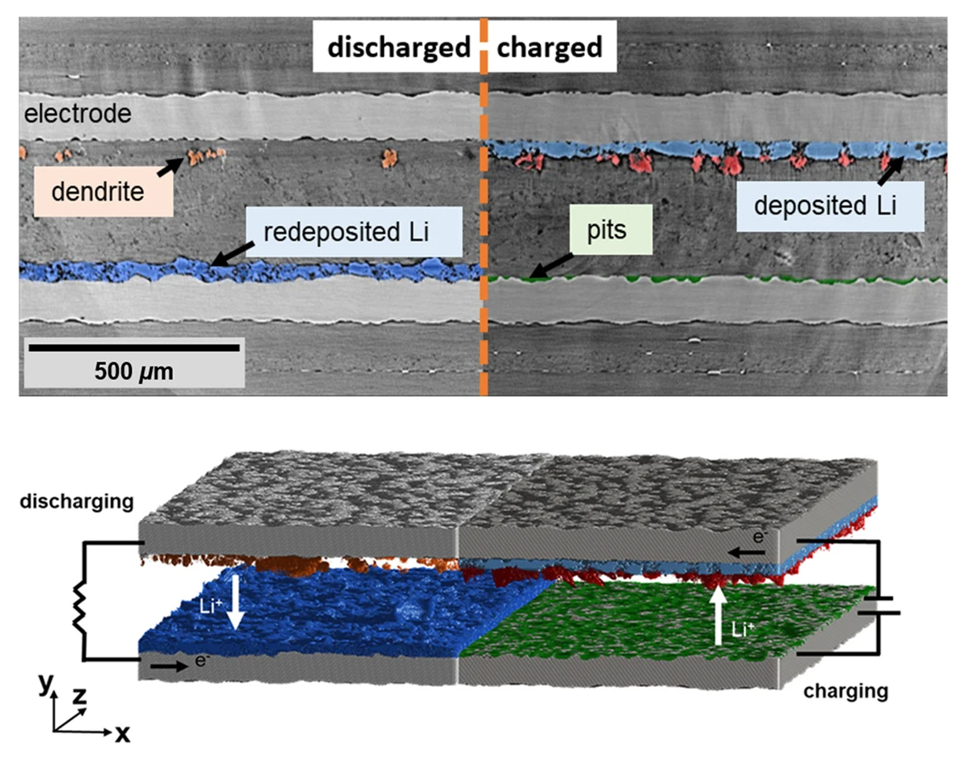
Deep-Learning Analysis of Lithium Plating in Batteries
Scientific Achievement
Researchers combined operando x-ray micro-computed tomography with a deep-learning computer algorithm ("batteryNET") to gain an enhanced understanding of solid-state batteries’ inner workings.
Significance and Impact
The approach could enable more advanced optimization of battery designs, improving safety and allowing the exploration of the full potential of this energy storage technology.
Research Details
Process turns high-resolution (but low-contrast) micro-CT data into information about the electrodes, electrolyte, and lithium distribution that can be used to inspect batteries for longer duration and safety.
Operando detection and tracking of dendrite formations can inform materials scientists about optimal electrode–electrolyte compositions and interactions.
Top: Micro-computed tomography of lithium-related battery components during charging and discharging. Each pixel was categorized as part of a class or object (semantically segmented). Bottom: Three-dimensional reconstruction with different phases colored as labeled above. The arrows indicate how Li ions and electrons move during the charging and discharging stages.
Y. Huang, D. Perlmutter, A.F.-H. Su, J. Quenum, P. Shevchenko, D.Y. Parkinson, I.V. Zenyuk, and D. Ushizima, npj Comput. Mater. 9, 93 (2023); doi:10.1038/s41524-023-01039-y. Work was performed at ALS/LBNL, NERSC/LBNL, and APS/ANL.
Notes:
Lithium-metal solid-state batteries are a promising technology, but the deposition (plating) of lithium metal on electrode surfaces remains a significant technical hurdle. In this work, researchers used micro-computed tomography (micro-CT) data to train an artificial intelligence model to identify characteristics vital to improving battery performance. The training data consisted of micro-CT images of a lithium-metal battery as it charged and discharged. During this process, lithium ions become less mobile and start depositing at one of the electrode surfaces. As the deposits increase, dendritic structures can grow and penetrate the electrolyte that separates positive and negative electrodes, eventually short-circuiting the battery.
Researchers: Y. Huang and A.F.-H. Su (UC Irvine), D. Perlmutter (Berkeley Lab), J. Quenum and D. Ushizima (UC Berkeley and Berkeley Lab), P. Shevchenko (Advanced Photon Source), D.Y. Parkinson (ALS), and I.V. Zenyuk (UC Irvine and UC Berkeley).
Funding: National Science Foundation and US Department of Energy (DOE), Office of Science, Advanced Scientific Computing Research program. Operation of the ALS and APS is supported by DOE, Office of Science, Basic Energy Sciences program.
Full highlight: https://als.lbl.gov/a-deep-learning-analysis-of-lithium-plating-dynamics-in-batteries/

