Slide 1
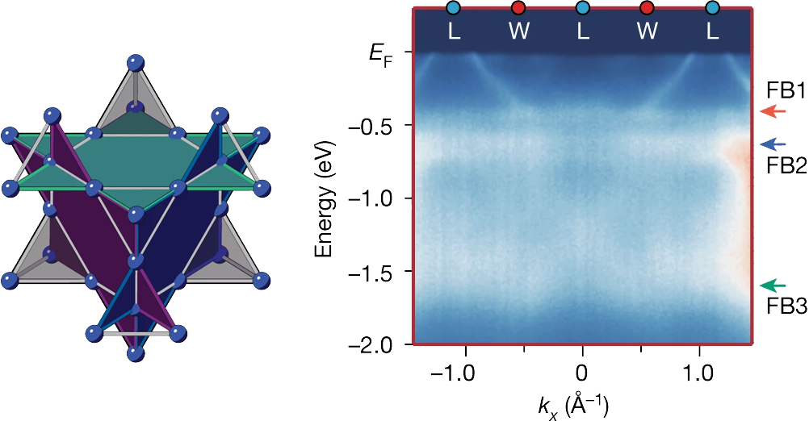
Flat Bands Signal Electrons Trapped in 3D
Scientific Achievement
Using the Advanced Light Source (ALS), researchers found flat electronic band structures—known hallmarks of electrons trapped in two dimensions—but in a material that extends this phenomenon to three dimensions.
Significance and Impact
The work opens up a material framework for exploring superconductivity and other exotic states in three dimensions for advanced electronic applications.
Research Details
CaNi₂ has a 3D lattice structure analogous to 2D “kagome” structures (hexagonal networks of corner-sharing triangles) known to trap electrons.
Angle-resolved photoemission spectroscopy (ARPES) of CaNi₂ revealed three flat bands.
Chemical tuning of the flat bands to the Fermi level coincided with enhanced electronic correlations and the appearance of superconductivity.
Left: The "pyrochlore" crystal structure has four hexagonal planes (teal, purple, blue, and gray) that trap electrons in localized states in three dimensions, leading to greater electron–electron interactions and exotic properties such as superconductivity. Right: ARPES data showing three flat bands (FB1, FB2, and FB3) in CaNi₂, a pyrochlore metal.
J.P. Wakefield, M. Kang, P.M. Neves, D. Oh, S. Fang, R. McTigue, S.Y.F. Zhao, T.N. Lamichhane, A. Chen, S. Lee, S. Park, J.-H. Park, C. Jozwiak, A. Bostwick, E. Rotenberg, A. Rajapitamahuni, E. Vescovo, J.L. McChesney, D. Graf, J.C. Palmstrom, T. Suzuki, M. Li, R. Comin, and J.G. Checkelsky, Nature 623, 301 (2023), doi:10.1038/s41586-023-06640-1. Work was performed at ALS/LBNL, NSLS-II/BNL, and APS/ANL.
Notes:
When a material’s electrons are trapped together, they can settle into the same energy state and start to behave as one. In this collective state, the electron energies remain constant no matter what their momentum values are. In angle-resolved photoemission spectroscopy (ARPES) experiments, which map electron energy versus momentum, this state is signaled by a flat band in the data. Scientists predict that when electrons are in this state, they can start to feel the quantum effects of other electrons and act in coordinated, quantum ways. Then, exotic behavior such as superconductivity and unique forms of magnetism may emerge. In this work, a team led by researchers from the Massachusetts Institute of Technology (MIT) have found a three-dimensional material that exhibits this distinctive flat-band signature in ARPES data, previously observed only for two-dimensional systems. With some chemical manipulation, the researchers also showed that they could transform the crystal into a superconductor—a material that conducts electricity with zero resistance.
Researchers: J.P. Wakefield, P.M. Neves, D. Oh, S. Fang, R. McTigue, S.Y.F. Zhao, T.N. Lamichhane, A. Chen, M. Li, R. Comin, and J.G. Checkelsky (MIT); M. Kang (MIT and Max Planck POSTECH Center for Complex Phase Materials [Republic of Korea]; S. Lee, S. Park, and J.-H. Park (Max Planck POSTECH Center and Pohang University of Science and Technology); C. Jozwiak, A. Bostwick, and E. Rotenberg (ALS); A. Rajapitamahuni and E. Vescovo (NSLS-II); J.L. McChesney (APS); D. Graf (National High Magnetic Field Laboratory, Florida); J.C. Palmstrom (National High Magnetic Field Laborabory, New Mexico); and T. Suzuki (Toho University, Japan).
Funding: Gordon and Betty Moore Foundation; Air Force Office of Scientific Research; National Science Foundation; State of Florida; US Department of Energy (DOE), Office of Science, Basic Energy Sciences (BES) program, Center for Advancement of Topological Semimetals; National Research Foundation of Korea; Japan Society for the Promotion of Science. Operation of the ALS, NSLS-II, and APS is supported by DOE BES.
Full highlight: https://als.lbl.gov/flat-bands-signal-electrons-trapped-in-3D/

