Slide 1
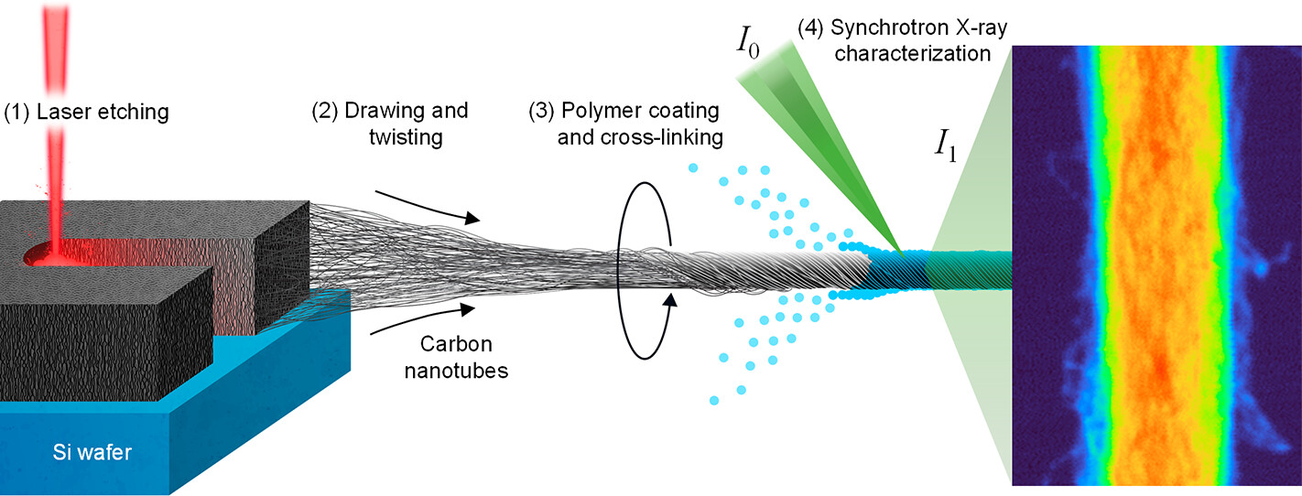
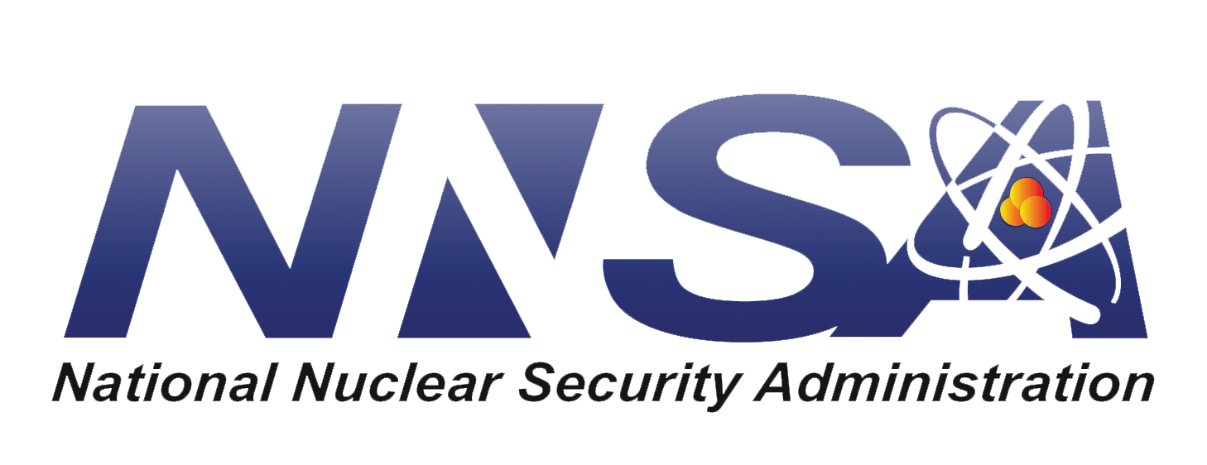
How Processing Affects Structure in Composite Nanotube Yarns
Scientific Achievement
Researchers found quantitative correlations between processing parameters and the structure of ultrafine, polymer-reinforced carbon-nanotube fibers.
Significance and Impact
The work will facilitate the production of high-strength materials, including those needed for positioning target capsules for fusion research at the National Ignition Facility.
Research Details
At the Advanced Light Source, scanning transmission x-ray microscopy (STXM) provided nanoscale, element-specific, density mapping of carbon nanotube yarns; small-angle x-ray scattering (SAXS) revealed nanotube alignment and bundling structure.
Data validated benefits of vapor-phase polymer infiltration.
Workflow for carbon nanotube yarn fabrication and characterization. (1) “Forests” of carbon nanotubes, grown on a Si wafer, are laser-etched to create tracks. (2) Nanotubes in a track are drawn out and spun and then either left untreated or (3) treated with a vapor-phase polymer coating, either with or without a final thermal cross-linking step. (4) Yarns are mounted in a synchrotron x-ray beamline (ex situ) for structural characterization.
E.R. Meshot, A. Baker, D. Malone, S. Hayes, H. Hamza, C. Wang, M.A. Marcus, and X. Lepró, ACS Nano 17, 10589 (2023), doi:10.1021/acsnano.3c01537.
Work was performed at ALS/LBNL, Molecular Foundry/LBNL, and NIF/LLNL.
Notes:
Carbon nanotubes are remarkable structures: conductive, lightweight, and incredibly strong. But despite decades of research, it remains unclear how to retain these properties when scaling up to the macroscale. At Lawrence Livermore National Laboratory, researchers developed a promising approach. They made twist-spun yarns out of individual carbon nanotubes and coated the resulting fibers with polymers to stitch together neighboring nanotubes, boosting mechanical performance. However, further development required more details about the internal structure of these polymer-nanotube composites. In particular, the researchers sought to understand how processing parameters influence key structural features such as nanotube alignment, density, porosity, and polymer loading. In this work, the Livermore researchers used synchrotron x-ray techniques to analyze the hierarchical, twisted morphology of dry-spun carbon-nanotube yarns and their composites. Such high-tensile strength fibers are of interest as a way to support target capsules for inertial confinement fusion experiments at the National Ignition Facility (NIF). The fibers may also be useful for wearable electronics and smart textiles, or artificial muscles and neurons.
Researchers: E.R. Meshot (Lawrence Livermore National Laboratory and Atomic Machines Inc.); A. Baker, D. Malone, S. Hayes, H. Hamza, and X. Lepró (Lawrence Livermore National Laboratory); and C. Wang and M.A. Marcus (ALS).
Acknowledgement from paper: Laboratory Directed Research & Development (LDRD) program 20-ERD-023 (Lawrence Livermore National Laboratory) and US Department of Energy (DOE), National Nuclear Security Administration. Operation of the ALS and Molecular Foundry is supported by DOE, Office of Science, Basic Energy Sciences program.
Full highlight: https://als.lbl.gov/how-processing-affects-structure-in-composite-nanotube-yarns/

