Slide 1
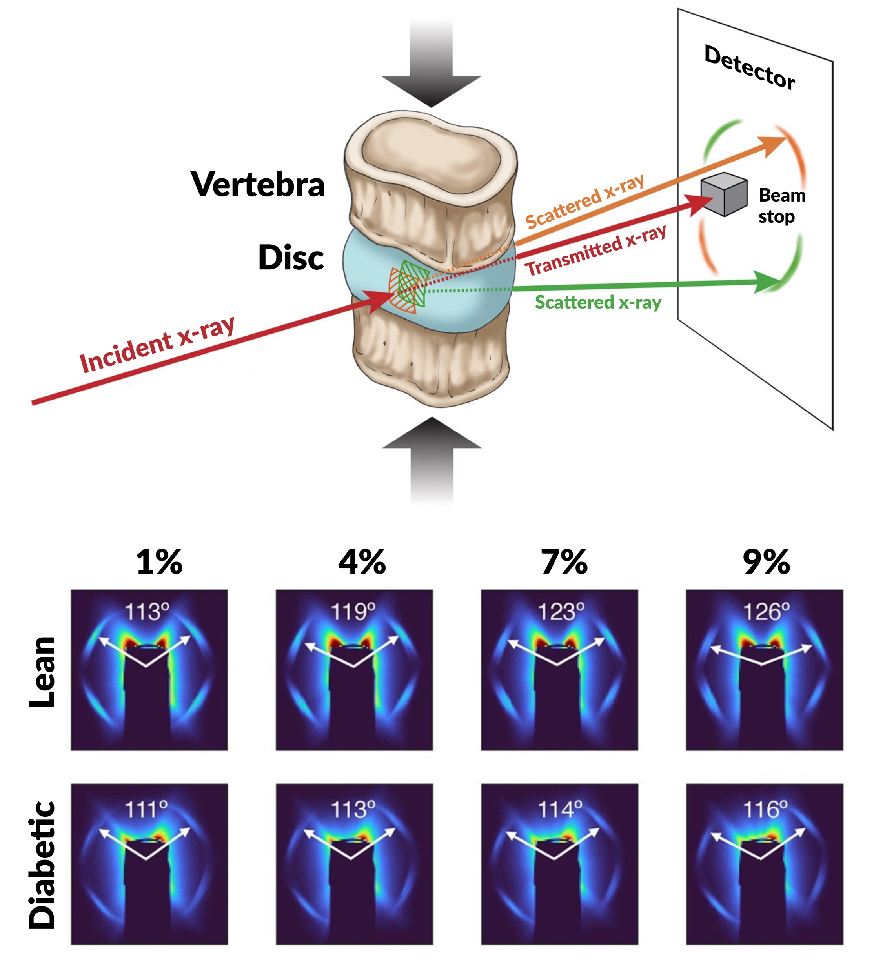
The Effects of Diabetes on Spinal-Column Biomechanics
Scientific Achievement
Researchers found that type 2 diabetes induces earlier onset of plastic (nonrecoverable) deformation in intervertebral discs by impairing the biomechanical behavior of collagen.
Significance and Impact
A greater understanding of the underlying causes of tissue failure in diabetes—a growing problem worldwide—is important in helping to prevent and treat symptoms.
Research Details
At the Advanced Light Source (ALS), small-angle x-ray scattering (SAXS) was performed under compressive load on intervertebral discs from rat models with and without type 2 diabetes.
The results showed that collagen fibers in diabetic discs stretch and rotate less, leading to earlier plastic damage and earlier failure.
Top: Schematic of the SAXS experiment. Bottom: Scattering patterns of discs from lean vs diabetic rats, showing the relative peak positions at various amounts of disc compression. Applied compressive strains (top) and corresponding interlamellar fiber angles for each case are shown.
J.L. Rosenberg, E. Schaible, A. Bostrom, A.A. Lazar, J.L. Graham, K.L. Stanhope, R.O. Ritchie, T.N. Alliston, J.C. Lotz, P.J. Havel, C. Acevedo, A.J. Fields, PNAS Nexus 2, pgad363 (2023), doi:10.1093/pnasnexus/pgad363. Work was performed at ALS/LBNL.
Notes:
Worldwide, the prevalence of diabetes is increasing, leading to a growing global burden in health care costs and significant losses in quality of life. One debilitating condition linked to type 2 (“adult onset”) diabetes is back pain. Type 2 diabetes appears to increase the risk of back pain, which is often caused by the degeneration of intervertebral discs, the flexible shock-absorbing tissue located between rigid vertebral bones in the spine. Understanding the underlying causes of such tissue failure in diabetes is important in helping to prevent and treat symptoms. The researchers recognized that there are statistical associations between diabetes and a number of different disc pathologies. So they wondered: what are the mechanisms by which type 2 diabetes affects disc biomechanical behavior? To answer this question, they turned to small-angle x-ray scattering at the ALS. They compared the nanostructures of discs from diabetic rats with those from lean, age-matched control animals. A tension/compression stage in the beamline allowed the researchers to compress the discs as they were exposed to the x-ray beam.
Researchers: J.L. Rosenberg (University of Utah; E. Schaible (ALS); A. Bostrom, A.A. Lazar, T.N. Alliston, J.C. Lotz, and A.J. Fields (UCSF); J.L. Graham, K.L. Stanhope, and P.J. Havel (UC Davis); R.O. Ritchie (Berkeley Lab and UC Berkeley); and C. Acevedo (Univ. of Utah and UC San Diego).
Acknowledgement from paper: UCSF, UC Office of the President, National Institutes of Health, and University of Utah. Operation of the ALS is supported by the US Department of Energy, Office of Science, Basic Energy Sciences program.
Full highlight: https://als.lbl.gov/the-effects-of-diabetes-on-spinal-column-biomechanics/

