Slide 1
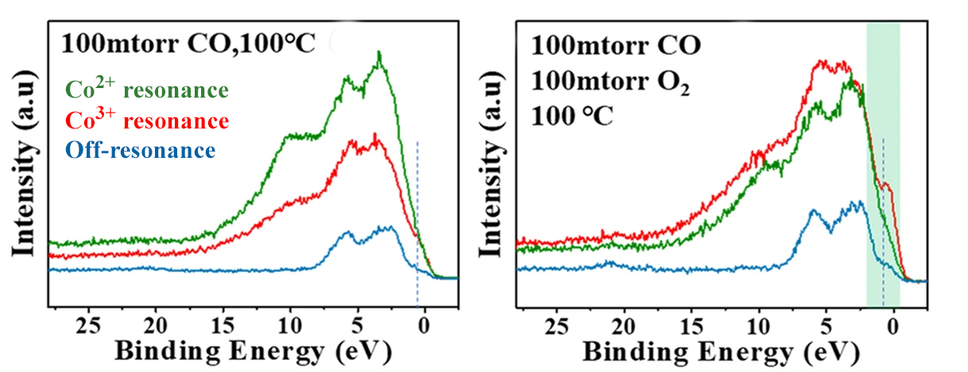
Probing Active-Site Chemical States in a Cobalt-Based Catalyst
Scientific Achievement
Researchers identified the dominant chemical state of active sites in a cobalt-based catalyst using resonant photoemission spectroscopy under realistic conditions.
Significance and Impact
The work will help scientists develop more-efficient catalysts for removing noxious carbon monoxide from exhaust streams generated by the burning of fossil fuels.
Research Details
Cobalt oxide films were studied in various environmental conditions (gas mixtures and temperatures) using resonant photoemission spectroscopy (ResPES) at the Advanced Light Source (ALS).
The results showed that Co³⁺ provides the most-active sites for the CO-to-CO₂ reaction in a wide range of temperatures.
Resonant valence-band photoelectron spectra of CoO_{x} film on a substrate of Au(111) under CO exposure (left) and under CO oxidation conditions (right). Green and red spectra correspond to Co²⁺ and Co³⁺ resonant excitation energies, while the blue spectrum was measured off-resonance. With resonant enhancement, it can be clearly distinguished that the Co³⁺ sites contribute the most to catalytic activity under CO oxidation conditions.
H. Chen, L.J. Falling, H. Kersell, G. Yan, X. Zhao, J. Oliver-Meseguer, M. Jaugstetter, S. Nemsak, A. Hunt, I. Waluyo, H. Ogasawara, A.T. Bell, P. Sautet, and M. Salmeron, Nat. Commun. 14, 6889 (2023), doi:10.1038/s41467-023-42301-7. Work was performed at ALS/LBNL, NSLS-II/BNL, and SSRL/SLAC.
Notes:
Catalytic converters have been successfully used for decades to remove noxious gases from exhaust streams produced by fossil-fuel combustion. The central chemical reaction, the conversion of carbon monoxide (CO) to carbon dioxide (CO₂), requires a catalyst that provides special sites where the reactants and products can bind, react, and detach without requiring much energy. In particular, noble metals such as gold or platinum, when combined with “reducible” oxides (i.e., oxygen-containing materials that can exchange electrons with the metal), have been found to exhibit superior catalytic activity. However, to maximize efficiency, scientists need a clearer understanding of the origins of this increased activity. To this end, researchers used resonant photoelectron spectroscopy (ResPES) at the ALS to study thin films of cobalt oxide (CoO_{x}) on a gold substrate. The findings provide new insight into the enhanced catalytic reactivity of CoO_{x} catalysts, highlighting both their chemical and topographical evolution in response to varied ambient-pressure environments.
Researchers: H. Chen, L.J. Falling, J. Oliver-Meseguer, M. Jaugstetter (Berkeley Lab); H. Kersell (ALS and Oregon State University); G. Yan and P. Sautet (UCLA); X. Zhao, A.T. Bell, and M. Salmeron (Berkeley Lab and UC Berkeley); S. Nemsak (ALS and UC Davis); A. Hunt and I. Waluyo (NSLS-II); and H. Ogasawara (SLAC).
Acknowledgement from paper: US Department of Energy, Office of Science, Basic Energy Sciences program (DOE BES); Alexander von Humboldt Foundation; National Science Foundation; and US-Israel Binational Science Foundation. Operation of the ALS, NSLS-II, and SSRL is supported by DOE BES.
Full highlight: https://als.lbl.gov/probing-active-site-chemical-states-in-a-cobalt-based-catalyst/

