Slide 1
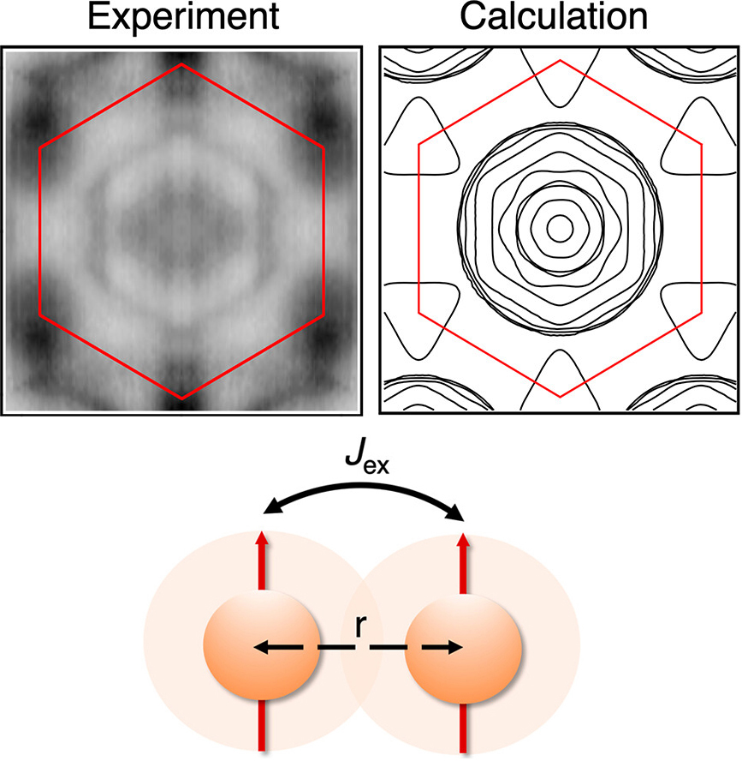
Room-Temperature 2D Magnet: Electronic-Structure Insights
Scientific Achievement
Researchers found that small changes in how electron spins interact with each other can make a big difference in the magnetic transition temperatures of 2D magnets.
Significance and Impact
Understanding the factors affecting magnetic transition temperatures can help create better magnetic materials for information storage, sensors, medical imaging, and energy-efficient computing.
Research Details
Fe₃GaTe₂ electronic structure measured with linearly polarized angle-resolved photoemission spectroscopy (ARPES) at the Advanced Light Source (ALS).
Results set boundary conditions for density functional theory (DFT) calculations of key magnetic parameters (e.g., Heisenberg exchange interaction, J_{ex}).
Small changes in J_{ex} due to slight changes in lattice parameters can have significant impacts on magnetic transition temperature.
Top: ARPES image of the Fe₃GaTe₂ Fermi surface and the theoretically calculated version. Bottom: The results show that the Heisenberg exchange interaction (J_{ex}) between spins has a big effect on the magnetic transition temperature.
J.-E. Lee, S.H. Yan, S.H. Oh, J.W. Hwang, J.D. Denlinger, C.G. Hwang, H. Lei, S.-K. Mo, S.Y. Park, and H. Ryu, Nano Lett. 23, 11526 (2023), doi:10.1021/acs.nanolett.3c03203. Work was performed at ALS/LBNL.
Notes:
“Two-dimensional” (2D) magnetic materials have attracted a lot of interest recently for several reasons: they are highly tunable, they can be stacked into heterostructures for more functionality, they can be used for energy-efficient computing and data-storage applications, and they can deepen our fundamental understanding of magnetism itself. Unfortunately, many of these materials are not very stable in air and their magnetic transition temperatures are much lower than room temperature. Iron gallium telluride (Fe₃GaTe₂) is a 2D ferromagnet with a record-breaking magnetic transition temperature (~370 K) and a tendency for its magnetic alignment to be perpendicular to the surface—both useful features for spintronics applications. Its closely related “sister” material, iron germanium telluride (Fe₃GeTe₂), has nearly the same crystal structure but a much lower transition temperature (~220 K). To understand how a simple change from germanium to gallium can improve the magnetic transition temperature, the researchers approached the question from an electronic-structure point of view.
Researchers: J.-E. Lee (ALS and Pohang University of Science and Technology, Korea), S.H. Yan and H. Lei (Renmin University of China), S.H. Oh and S.Y. Park (Soongsil University, Korea), J.W. Hwang (Kangwon National University, Korea), J.D. Denlinger and S.-K. Mo (ALS), C.G. Hwang (Pusan National University, Korea), and H. Ryu (Korea Institute of Science and Technology).
Acknowledgement from paper: National Research Foundation of Korea, National Key R&D Program of China, Beijing Natural Science Foundation, National Natural Science Foundation of China, Renmin University of China, Beijing National Laboratory for Condensed Matter Physics, Korea Institute of Science and Technology, Ministry of Science and ICT (Korea), Ministry of Education (Korea). J.-E. Lee is supported by an ALS Collaborative Postdoctoral Fellowship. Operation of the ALS is supported by the US Department of Energy, Office of Science, Basic Energy Sciences program.
Full highlight: https://als.lbl.gov/room-temperature-2d-magnet-electronic-structure-insights/

