Slide 1
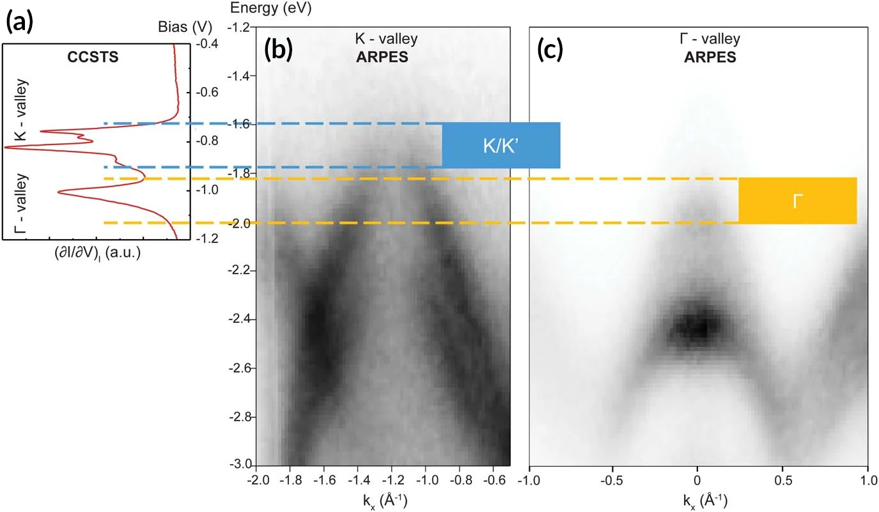
Big Twist Leads to Tunable Energy Gaps in a Bilayer Stack
Scientific Achievement
Using a combination of probes, researchers found that twisting 2D layers at atypically large angles opens up potentially useful energy gaps in the material’s band structure.
Significance and Impact
The results suggest a new way to tune materials for optoelectronic applications and provides a platform for exploring novel “moiré” phenomena beyond those observed at small twist angles.
Research Details
Constant-current scanning tuneling spectroscopy (CCSTS) peaks were attributed to band-structure features ("valleys"), and indicated the formation of energy gaps caused by interlayer interactions ("minigaps").
Nanoscale-resolution angle-resolved photoemission spectroscopy (nanoARPES) at the Advanced Light Source (ALS) confirmed that the CCSTS features correspond to the expected structures in k-space.
Comparison of feature assignments between CCSTS and nanoARPES. (a) CCSTS data showing peaks associated with K- and Γ-valleys in WSe₂. (b) K-valley spectrum from the nanoARPES measurements. (c) Γ-valley spectrum from the nanoARPES measurements.
Y. Li, F. Zhang, V.-A. Ha, Y.-C. Lin, C. Dong, Q. Gao, Z. Liu, X. Liu, S.H. Ryu, H. Kim, C. Jozwiak, A. Bostwick, K. Watanabe, T. Taniguchi, B. Kousa, X. Li, E. Rotenberg, E. Khalaf, J.A. Robinson, F. Giustino, and C.K. Shih, Nature 625, 494 (2024), doi:10.1038/s41586-023-06904-w. Work was performed at ALS/LBNL.
Notes:
The discovery of emergent electronic properties in stacks of two-dimensional materials has led to a surge in efforts to engineer layered heterostructures with new functional properties. One fascinating twist in the story was the revelation that, by slightly rotating two layers with respect to each other, a moiré-effect “superlattice” can be generated. This extra level of organization induces modifications to the material’s electronic properties that could prove to be useful—in optoelectronic applications, for example. Thus far, most superlattices investigated have been in bilayers with small twist angles that result in a crystalline moiré pattern, characterized by repeating unit cells. In this work, a form of 2D material was created by twisting the layers at a larger angle, leading to an aperiodic “quasicrystalline” moiré lattice with a more complex structure and whose electronic properties are hard to predict. The material was characterized using advanced spectroscopic techniques that demonstrated the presence of rich band-structure features—valleys and minigaps—that present opportunities for tuning electronic properties. The results establish bilayers with large twist angles as a viable platform for exploring “moiré physics.”
Researchers: Y. Li, F. Zhang, V.-A. Ha, Q. Gao, Z. Liu, X. Liu, H. Kim, B. Kousa, X. Li, E. Khalaf, F. Giustino, and C.K. Shih (University of Texas at Austin); Y.-C. Lin (Pennsylvania State University and National Yang Ming Chiao Tung University, Taiwan); C. Dong and J.A. Robinson (Pennsylvania State University); S.H. Ryu, C. Jozwiak, A. Bostwick, and E. Rotenberg (ALS); and K. Watanabe and T. Taniguchi (National Institute for Materials Science, Japan).
Acknowledgement from paper: National Science Foundation; US Air Force; Welch Foundation; US Department of Energy, Office of Science, Basic Energy Sciences program (DOE BES) and National Quantum Information Science Research Centers; National Yang Ming Chiao Tung University; Ministry of Education of Taiwan; and Japan Society for the Promotion of Science. Operation of the ALS is supported by DOE BES.
Full highlight: https://als.lbl.gov/big-twist-leads-to-tunable-energy-gaps-in-a-bilayer-stack/

