Slide 1
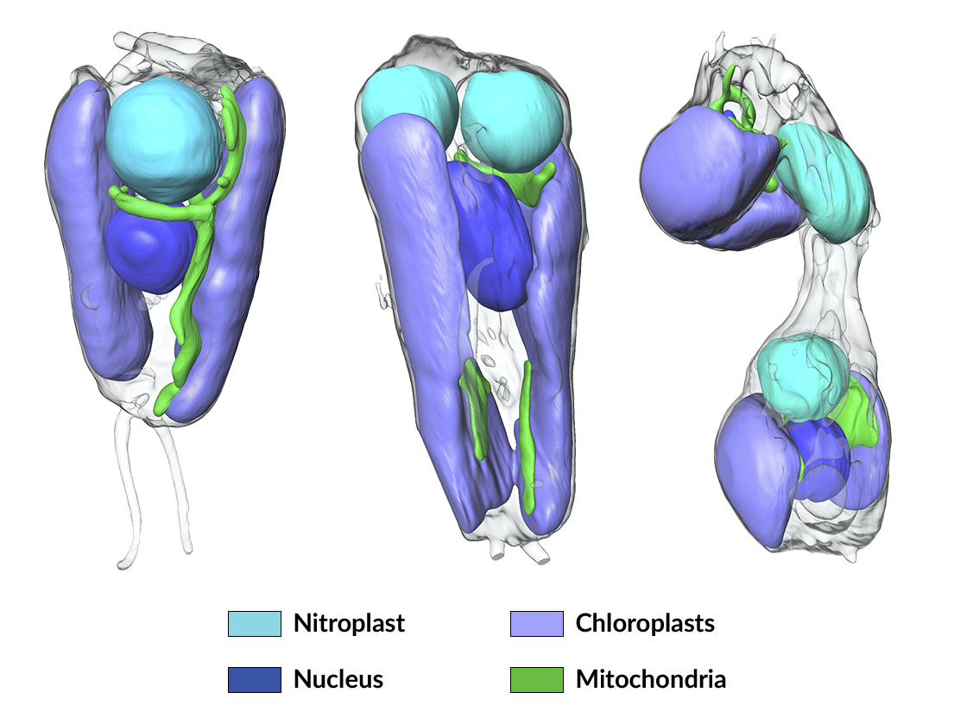
Symbiotic Nitrogen-Fixing Microbe Evolves into Organelle
Scientific Achievement
Researchers found that a symbiont capable of fixing nitrogen (turning it into a biologically usable form) has evolved into an organelle—an intrinsic part of the algae cells that host it.
Significance and Impact
The discovery is of great interest for understanding organelle genesis and for efforts to engineer agricultural plants with built-in nitrogen-fixing capabilities.
Research Details
Soft x-ray tomography at the Advanced Light Source (ALS) revealed that replication and division of the symbiotic microbe (UCYN-A) is tightly paired with that of the host algal cell.
The results, together with proteomics analysis, establish UCYN-A as the first known example of a nitrogen-fixing organelle, or "nitroplast."
Soft x-ray tomographic images of algae cells (Braarudosphaera bigelowii) at different stages of cell division. The data showed that the nitroplast (formerly an independent microbe, UCYN-A) replicates and divides in close coordination with the other organelles.
T.H. Coale, V. Loconte, K.A. Turk-Kubo, B. Vanslembrouck, W.K.E. Mak, S. Cheung, A. Ekman, J.-H. Chen, K. Hagino, Y. Takano, T. Nishimura, M. Adachi, M. Le Gros, C. Larabell, and J.P. Zehr, Science 384, 217 (2024), doi: 10.1126/science.adk1075. Work was performed at ALS/LBNL.
Notes:
Modern biology textbooks assert that only bacteria can take nitrogen from the atmosphere and convert it into a form that is usable for life. Plants that fix nitrogen, such as legumes, do so by harboring symbiotic bacteria in root nodules. But a recent discovery upends that rule. An international team of scientists used soft x-ray tomography and proteomics (analysis of the proteins produced by an organism) to establish the first known example of a nitrogen-fixing organelle, intrinsic to certain algae cells. Dubbed “nitroplasts,” the organelles are the result of primary endosymbiosis—the process by which a symbiont is engulfed by a host organism and evolves beyond symbiosis to become part of the host cells, analogous to what occurred with mitochondria and chloroplasts. The discovery raises the prospect of engineering plants that can fix nitrogen directly from the air, reducing the need for synthetic nitrogen fertilizers, the production of which generates enormous amounts of carbon dioxide.
Researchers: T.H. Coale, K.A. Turk-Kubo, W.K.E. Mak, and J.P. Zehr (UC Santa Cruz); V. Loconte, B. Vanslembrouck, J.-H. Chen, M. Le Gros, and C. Larabell (UC San Francisco, Berkeley Lab); S. Cheung (National Taiwan Ocean University); A. Ekman (UC San Francisco); K. Hagino, Y. Takano, and M. Adachi (Kochi University, Japan); and T. Nishimura (Fisheries Technology Institute, Japan).
Acknowledgment from paper: Simons Foundation; National Institutes of Health; US Department of Energy (DOE), Office of Science, Biological and Environmental Research program; and Japan Society for the Promotion of Science. Operation of the ALS is supported by DOE Office of Science, Basic Energy Sciences program.
Full highlight: https://als.lbl.gov/symbiotic-nitrogen-fixing-microbe-evolves-into-organelle/

