Slide 1
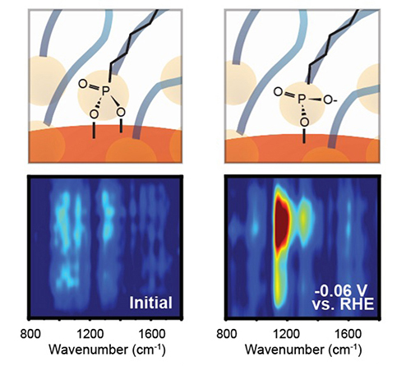
Mechanics of a Floating Molecular Layer for CO₂ Reduction
Scientific Achievement
Researchers discovered how a layer of organic molecules on a nanoparticle surface detaches to create a highly catalytic pocket for reducing CO₂ to CO.
Significance and Impact
The ability to probe molecular-scale events under realistic conditions with nanometer resolution will help guide the design of responsive systems for a wide range of applications, from medicine to optoelectronics.
Research Details
Samples: Ag nanoparticles with tetradecylphosphonic acid (TDPA) ligands.
Probed using infrared nanospectroscopy (nano-FTIR) at the Advanced Light Source (ALS) and laser-based surface-enhanced Raman spectroscopy (SERS).
The highly catalytic pocket forms through a bias-induced transition from bidentate to monodentate binding between the ligand and Ag.
Top: Organic-molecule bonding at nanoparticle surface. Bottom: Change in nano-FTIR data as negative bias increases (RHE is the reference electrode).
Y. Shan, X. Zhao, M. Fonseca Guzman, A. Jana, S. Chen, S. Yu, K.C. Ng, I. Roh, H. Chen, V. Altoe, S. Gilbert Corder, H.A. Bechtel, J. Qian, M.B. Salmeron, and P. Yang, Nat. Catal. 7, 422 (2024), doi:10.1038/s41929-024-01119-2. Work was performed at ALS/LBNL, Molecular Foundry/LBNL, and NERSC/LBNL.
Notes:
In living things, enzymes catalyze chemical reactions with exquisite efficiency and specificity. These enzymes are proteins with amino-acid side chains that optimize the active site for specific reactions. Inspired by nature, scientists have been working to improve electrocatalysts using a similar strategy. Several years ago, a group led by Peidong Yang at Berkeley Lab invented a system in which chains of organic molecules (ligands) are attached to the surface of a silver nanoparticle. Upon application of an external negative potential, the ligands reversibly dissociate from the nanoparticle. The resulting reaction pocket, called a Nanoparticle/Ordered-Ligand Interlayer (NOLI), supports the markedly efficient conversion of CO₂ to CO with 100% selectivity. However, understanding of the mechanism by which electrochemical bias modulates nanoparticle–ligand interactions has been elusive. To investigate, the researchers turned to two forms of infrared spectroscopy: synchrotron-based Fourier-transform infrared nanospectroscopy (nano-FTIR) and laser-based surface-enhanced Raman spectroscopy (SERS).
Researchers: Y. Shan, X. Zhao, M. Fonseca Guzman, S. Chen, S. Yu, I. Roh, and M.B. Salmeron (UC Berkeley and Berkeley Lab); A. Jana (Berkeley Lab and ALS); K.C. Ng, H. Chen, V. Altoe, and J. Qian (Berkeley Lab); S. Gilbert Corder and H.A. Bechtel (ALS); and P. Yang (UC Berkeley, Berkeley Lab, and Kavli Energy NanoScience Institute.
Acknowledgment from paper: US Department of Energy, Office of Science, Basic Energy Sciences program (DOE BES); University of Chinese Academy of Sciences; National Science Foundation; and US-Israel Binational Science Foundation. J. Qian is supported by Laboratory Directed Research and Development program (Berkeley Lab) and received a DOE BES Early Career Award in 2023. Operation of the ALS, Molecular Foundry, and NERSC is supported by DOE BES.
Full highlight: https://als.lbl.gov/mechanics-of-a-floating-molecular-layer-for-CO2-reduction/

