Slide 1
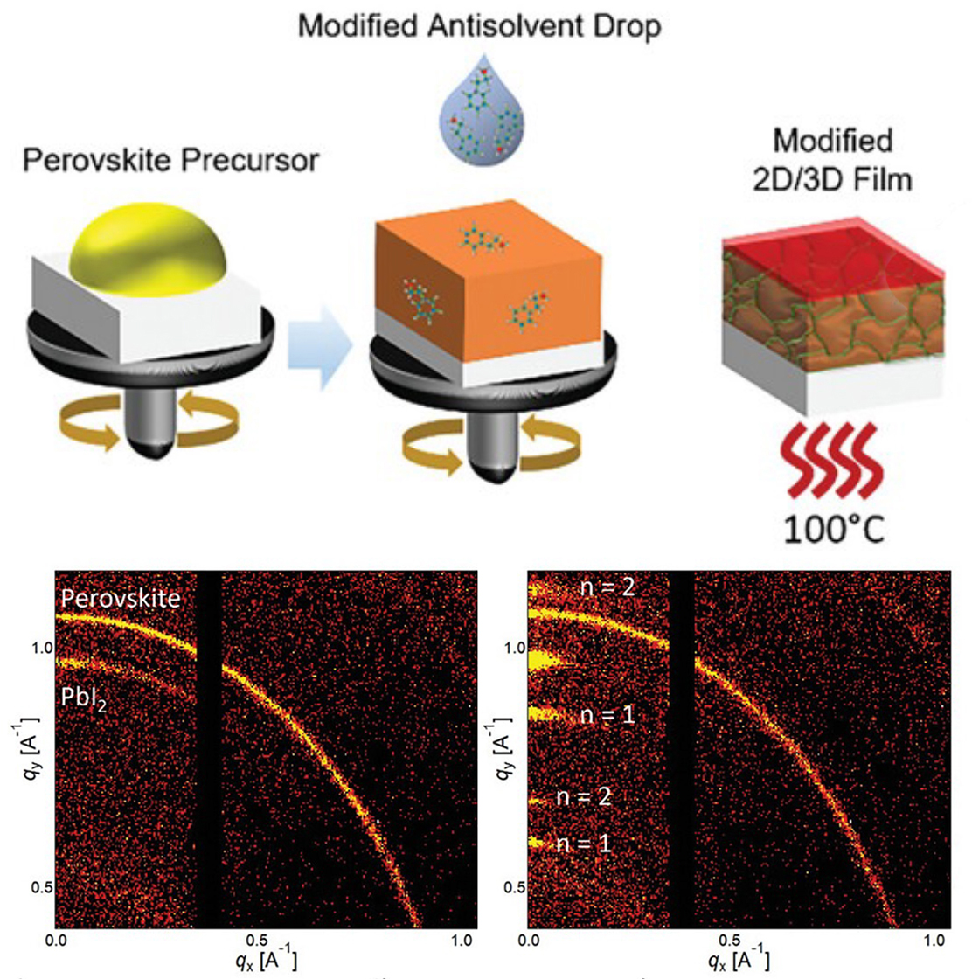






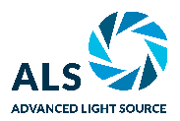

How Bulky Molecules Improve Next-Generation Solar Cells
Scientific Achievement
Adding “bulky” organic molecules earlier in solar-film synthesis slows crystal growth, leading to the formation of a protective surface layer that improves durability and efficiency.
Significance and Impact
These next-gen materials could revolutionize solar-cell technology, offering increased efficiency, lower cost, lighter weight, and flexible solar modules.
Research Details
  New fabrication method integrates a large organic molecule (PEACl) into the antisolvent during the crystallization step.
  At the Advanced Light Source (ALS), grazing-incidence wide-angle x-ray scattering (GIWAXS) was combined with a laser photoluminescence probe.
  Correlated data revealed that, in the new method, crystals grew more slowly and were of higher quality.
Top: A simplified synthesis method infuses the antisolvent drop with large organic molecules. Bottom: In situ GIWAXS reveals structural changes between the two fabrication methods.
T. Kodalle, M.M. Byranvand, M. Goudreau, C. Das, R. Roy, M. Kot, S. Briesenick, M. Zohdi, M. Rai, N. Tamura, J.I. Flege, W. Hempel, C.M. Sutter-Fella, and M. Saliba, Adv. Mater. 2309154 (2024), doi:10.1002/adma.202309154. Work was performed at ALS/LBNL and Molecular Foundry/LBNL.
Notes:
Perovskites—crystalline materials with the potential to revolutionize solar technology—have numerous advantages over traditional silicon-based solar panels. They absorb light much more broadly and efficiently, can be made 100 times thinner, perform well with material impurities, and require lower temperatures to process. Despite their advantages, however, perovskite solar panels lack the stability and durability to last for 20 to 30 years in all kinds of weather. Recently, scientists from the University of Stuttgart developed a new process for making perovskite photovoltaic films. The resulting cells are very efficient and stable, but it was not clear why the process worked so well. To find out, the researchers collaborated with a team from Berkeley Lab’s Molecular Foundry, who had developed multimodal tools for in situ monitoring of photovoltaic materials at an ALS beamline. There, the researchers could watch the formation of perovskite films in real time, from initial building blocks to final state. The insights from this work can help address key barriers to commercializing this promising technology.
Researchers: T. Kodalle, M. Goudreau, and C.M. Sutter-Fella (Berkeley Lab); M.M. Byranvand, C. Das, and M. Saliba (University of Stuttgart, Germany, and Forschungszentrum Jülich, Germany); R. Roy, M. Zohdi, and M. Rai (University of Stuttgart, Germany); M. Kot (Brandenburg University of Technology Cottbus-Senftenberg, Germany); S. Briesenick (Berkeley Lab and McGill University, Canada); N. Tamura (ALS); J.I. Flege (Brandenburg University of Technology Cottbus-Senftenberg, Germany); and W. Hempel (Centre for Solar Energy and Hydrogen Research Baden-Württemberg, Germany).
Acknowledgment from paper: German Research Foundation (DFG); US Department of Energy, Office of Science, Basic Energy Sciences program (DOE BES); UC Berkeley and Berkeley Lab; Center for the Development of Industrial Technology (CDTI), Spain; State Research Agency (AEI), Spain; Federal Ministry for Economic Affairs and Climate Action (BMWK), Germany; Israel Ministry of Energy; European Research Council; and Federal Ministry of Education and Research (BMBF), Germany. Operation of the ALS and Molecular Foundry is supported by DOE BES.
Full highlight: https://als.lbl.gov/how-bulky-molecules-improve-next-generation-solar-cells/

