Slide 1
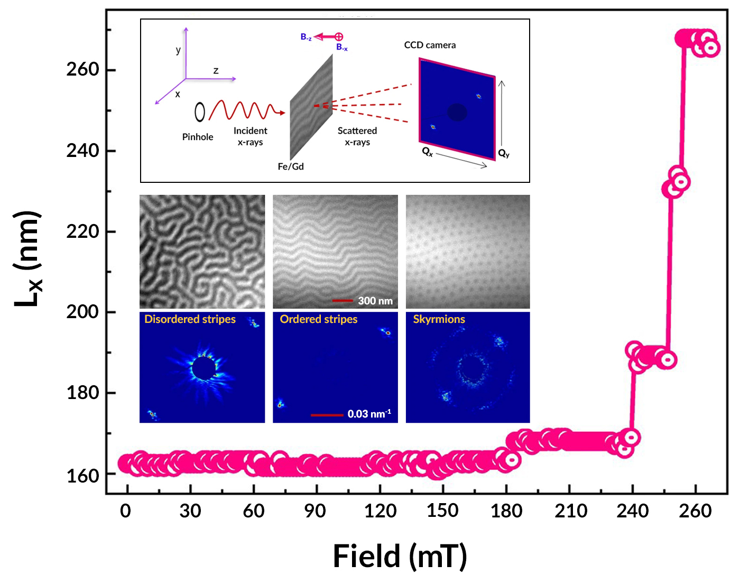
A Novel Staircase Pattern in Spin-Stripe Periodicity
Scientific Achievement
Striped patterns of spins in a magnetic thin film were found to evolve, under an applied magnetic field, in steps reminiscent of a structure known as the “Devil’s Staircase.”
Significance and Impact
Such studies are valuable for understanding competing interactions at the atomic level for applications such as magnetic sensors and spintronic devices.
Research Details
Coherent resonant soft x-ray scattering (RSoXS) was performed at the Advanced Light Source (ALS) on Fe/Gd multilayer samples.
The stripe periodicity jumps by integer multiples of 7 nm, about twice the domain-wall minimum width (​​≈ 3.2 nm).
Theoretical calculations indicate that the staircase pattern originates in the material's perpendicular magnetic anisotropy.
Upper inset: Schematic of the x-ray scattering geometry. Lower inset: X-ray microscopy (top row) and scattering (bottom row) images of the sample’s magnetic phases. Frame: Graph of the periodicity of the ordered stripe domains (T= 85 K) as a function of applied field.
A. Singh, J. Li, S.A. Montoya, S. Morley, P. Fischer, S.D. Kevan, E.E. Fullerton, D.-X. Yao, T. Datta, and S. Roy, npj Quantum Mater. 9, 2 (2024), doi:10.1038/s41535-023-00613-3. Work was performed at ALS/LBNL.
Notes:
The “Devil’s Staircase” is a peculiar mathematical function that rises continuously but has no slope (i.e., its derivative is zero almost everywhere). This is because it consists of “runs” (flat sections) connected by “rises” that are fractal: each contains successively smaller copies of the main step, to the infinitesimal limit. Similar structures have emerged in phenomena ranging from earthquakes to charge density waves—systems characterized by competing pressures that result in periods of stability punctuated by short bursts of activity. Here, researchers report the observation of novel staircase patterns in the evolution of spin-stripe domains in an iron/gadolinium (Fe/Gd) multilayer system. Theoretical modeling that builds on the measurements revealed which of the competing atomic-level interactions in this system is the dominant cause of the staircase structure. The findings help unravel the complex interplay of forces affecting spins in systems relevant to applications in magnetic sensing, information storage, and spintronics.
Researchers: A. Singh, S. Morley, S.D. Kevan, and S. Roy (ALS); J. Li and D.-X. Yao (Sun Yat-Sen University, China); S.A. Montoya and E.E. Fullerton (University of California San Diego); P. Fischer (Berkeley Lab); and T. Datta (Augusta University and University of California, Santa Barbara).
Acknowledgment from paper: National Science Foundation; National Key Research and Development Program of China; National Natural Science Foundation of China; Kavli Institute for Theoretical Physics; and US Department of Energy, Office of Science, Basic Energy Sciences program (DOE BES). Operation of the ALS is supported by DOE BES.
Full highlight: https://als.lbl.gov/a-novel-staircase-pattern-in-spin-stripe-periodicity/

