Slide 1
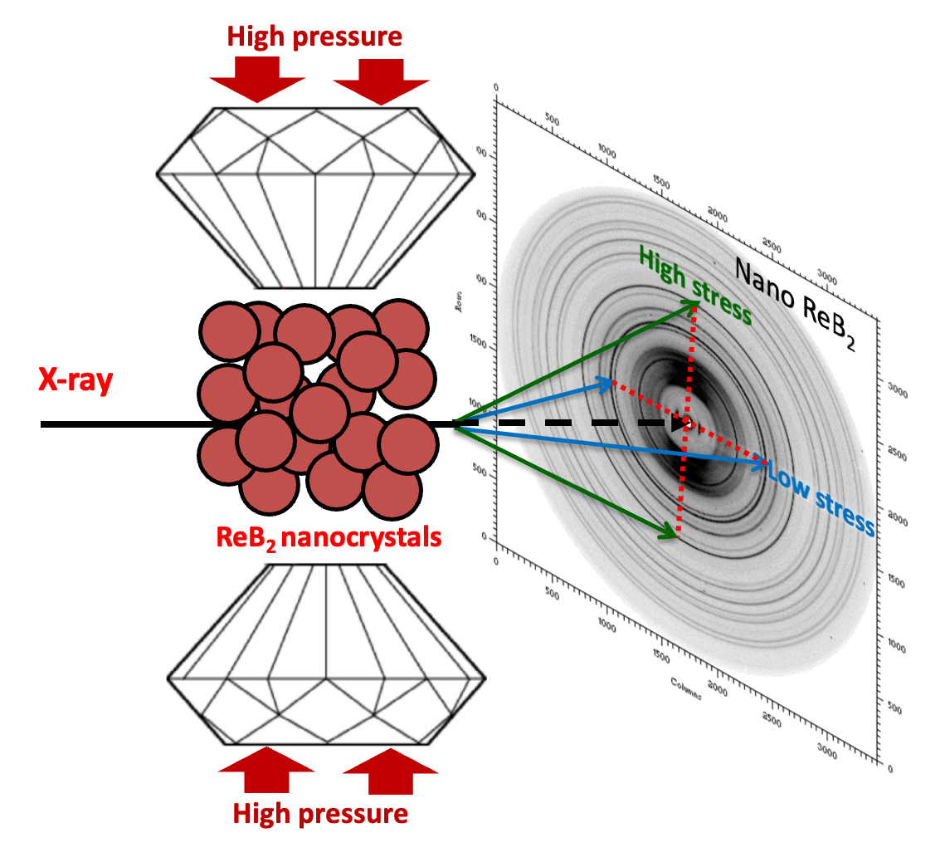
Superhard Materials at the Nanoscale: Smaller is Better
Scientific Achievement
Using high-pressure radial x-ray diffraction, researchers found that in the superhard material, rhenium diboride, smaller grain size leads to greater yield strength (i.e., the amount of stress tolerated before permanent deformation).
Significance and Impact
Because transition-metal borides are extremely hard, metallic, and can be synthesized at ambient pressure, they have exciting potential for use in next-generation cutting tools.
Research Details
ReB₂ powder was synthesized with grain sizes of 20, 50, and 60 nm.
High-pressure radial x-ray diffraction at the Advanced Light Source (ALS) was used to explore effect of grain size on yield strength.
Smallest grains exhibited the most slip resistance, and reducing grain size strengthens the primary slip mechanism of the material.
Radial x-ray diffraction. A rhenium diboride (ReB₂) powder sample is compressed uniaxially, creating differential compressive stresses that provide insight into the strength, deformation mechanisms, and elasticity of the material.
S. Hu, S.G. Hamilton, C.L. Turner, D.D. Robertson, J. Yan, A. Kavner, R.B. Kaner, and S.H. Tolbert, Nanoscale Horiz. 9, 646 (2024), doi:10.1039/D3NH00489A. Work was performed at ALS/LBNL.
Notes:
As we get better at making robust, durable materials that resist wear, corrosion, and extreme temperatures—think aerospace, automotive, and industrial machining applications—we also need to step up the quality of the tools we use to cut, form, and polish these hardened materials. Researchers have found that transition-metal borides are promising in this regard because of their low costs and advantageous mechanical properties. Metal borides combine highly incompressible transition metals (e.g., tungsten, rhenium, and osmium) with boron, which readily forms strong covalent bonds—a key characteristic of the prototypical superhard material, diamond. In this work, researchers used radial x-ray diffraction at high pressures to gain insight into how grain size affects the nanoscale deformation mechanics of the superhard material, rhenium diboride (ReB₂).
Researchers: S. Hu, S.G. Hamilton, C.L. Turner, D.D. Robertson, A. Kavner, R.B. Kaner, and S.H. Tolbert (Univ. of California, Los Angeles), and J. Yan (ALS).
Acknowledgment from paper: National Science Foundation, Consortium for Materials Properties Research in Earth Sciences. Operation of the ALS is supported by the US Department of Energy, Office of Science, Basic Energy Sciences program.
Full highlight: https://als.lbl.gov/superhard-materials-at-the-nanoscale-smaller-is-better/

