Slide 1
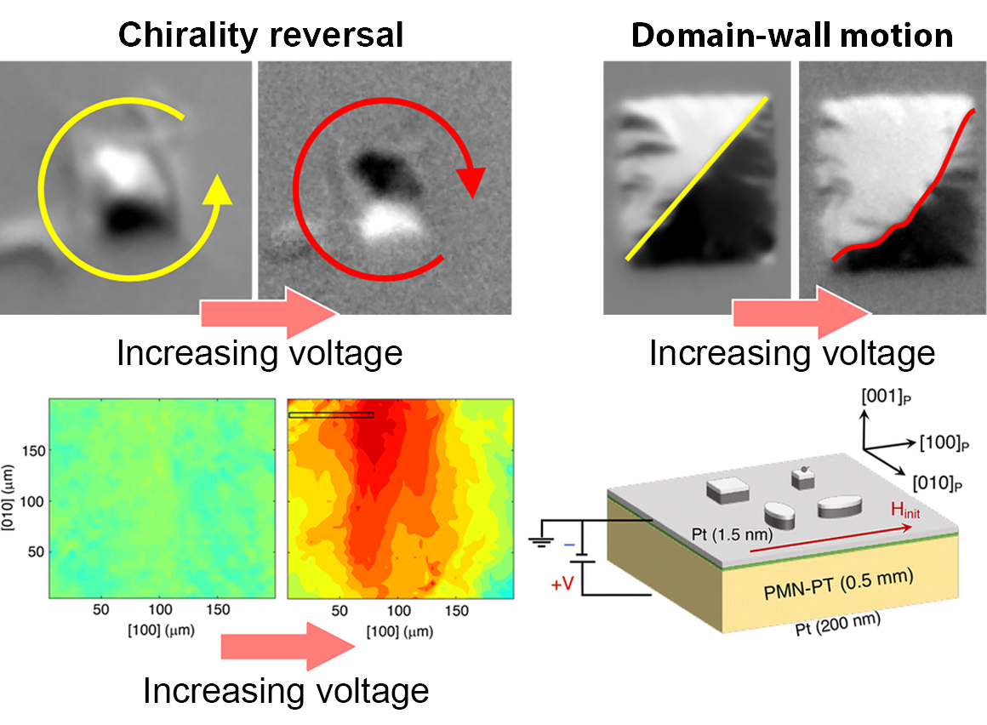
Magnetization Switching in Highly Magnetostrictive Microstructures
Scientific Achievement
Using several x-ray probes, researchers learned how the size, shape, and orientation of microstructures affect how they switch magnetization directions in response to an applied voltage.
Significance and Impact
The work advances our understanding of strain-responsive composite materials for use in energy-efficient electronic applications such as memory devices, sensors, and actuators.
Research Details
Advanced Light Source (ALS) x-ray techniques used in this work included photoemission electron microscopy (PEEM), microdiffraction, and magnetic spectroscopy.
The results demonstrated that engineering the behavior of highly magnetostrictive epitaxial microdevices is possible.
Top: PEEM reveals responses of 1 and 2 µm² microstructures (left and right, respectively) when a voltage is applied. Bottom left: X-ray micro-diffraction provides a correlated map of the strain distribution in the piezoelectric substrate. Bottom right: Heterostructure stack showing micro-structures on the piezoelectric layer (PMN-PT).
M. Goiriena, Z. Xiao, R. Steinhardt, V. Estrada, N. Tamura, R.V. Chopdekar, A.T. N'Diaye, A. Sepúlveda, D.G. Schlom, R.N. Candler, and J. Bokor, Nanoscale 16, 9021 (2024), doi:10.1039/d4nr00739e. Work was performed at ALS/LBNL.
Notes:
Today’s memory and logic devices require large electric currents to flip magnetic domains that store binary data. Unfortunately, this current-driven approach results in significant energy losses through heating. A more energy-efficient alternative is to control magnetization using voltage, through the use of multiferroic heterostructures—that is, a ferromagnetic layer coupled to a ferroelectric substrate. One promising material for the ferromagnetic layer is an iron-gallium alloy (Fe-Ga, or galfenol), known for its large magnetostrictive effect: its magnetization can significantly change in response to mechanical strain. In this work, researchers explored the magnetoelectric behavior of tiny epitaxial Fe-Ga structures on a piezoelectric PMN-PT substrate, using multiple synchrotron x-ray probes. Studying such structures at small scales is vital to understanding how to manipulate them using voltage, with significant implications for the development of energy-efficient applications such as memory devices, sensors, and actuators.
Researchers: M. Goiriena (UC Berkeley and University of the Basque Country, UPV/EHU); Z. Xiao (UCLA and ALS); R. Steinhardt and D.G. Schlom (Cornell University); V. Estrada and A. Sepúlveda (UCLA); N. Tamura, R.V. Chopdekar, and A.T. N'Diaye (ALS); R.N. Candler (UCLA and California NanoSystems Institute); and J. Bokor (UC Berkeley and Berkeley Lab).
Acknowledgment from paper: National Science Foundation, Ministry of Science and Inovation (Spain), and California NanoSystems Institute. Operation of the ALS is supported by the US Department of Energy, Office of Science, Basic Energy Sciences program.
Full highlight: https://als.lbl.gov/magnetization-switching-in-highly-magnetostrictive-microstructures/

