Slide 1
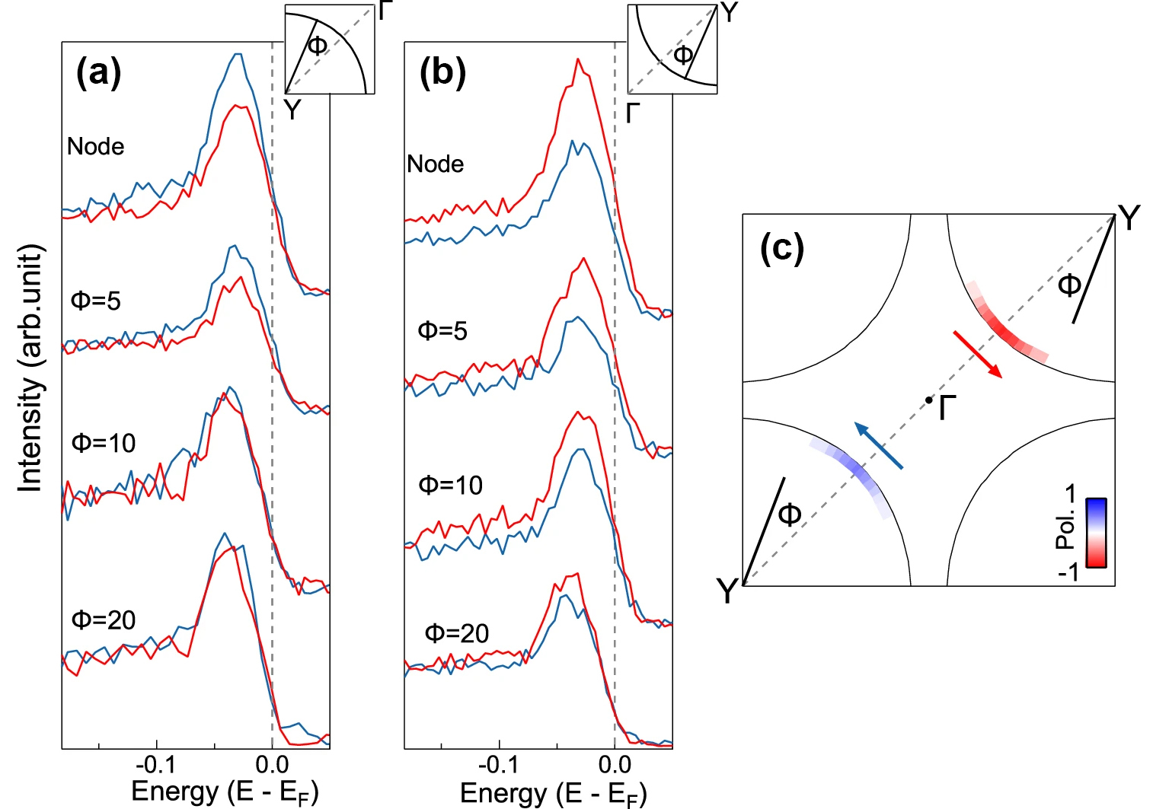
Lattice-Dependent Spin Textures in High-T_{c} Superconductors
Scientific Achievement
Researchers found that in bismuth-based cuprate superconduc-tors, charge imbalances caused by lattice distortions generate persistent and universal patterns of spin polarization.
Significance and Impact
The results supply a previously missing but essential ingredient in efforts to understand the mechanisms driving the electronic behavior of high-temperature superconductors.
Research Details
At the Advanced Light Source (ALS), a newly developed angle-resolved photoemission spectroscopy (ARPES) instrument with spin resolution revealed patterns of spin polarization across momentum space.
This spin texture is seen in single- and double-layer Bi-based cuprates with various doping levels (and thus, critical temperatures), but disappears upon the removal of lattice distortions (via partial substitution of Bi with Pb).
Spin-resolved ARPES data measured from the (a) bottom left and (b) top right quadrants of the Fermi surface in (c), along the nodal direction (dashed line) and at various off-node angles ϕ. The spin components show opposite signs (blue, red) in the two quadrants.
H. Luo, K. Currier, C.-Y. Lin, K. Gotlieb, R. Mori, H. Eisaki, A. Fedorov, Z. Hussain, and A. Lanzara, Commun. Mater. 5, 140 (2024), doi:10.1038/s43246-024-00567-4. Work was performed at ALS/LBNL and benefited the LBNL Ultrafast Materials Sciences program.
Notes:
Copper oxide (cuprate) superconductors have attracted tremendous interest because of their potential for resistance-free conduction in electromagnets, generators, power-transmission lines, and energy-storage applications. However, elusive questions still remain regarding the mechanisms driving the electronic behavior of these high-temperature superconductors. Spin-orbit coupling—an important property shaping many exotic phenomena of quantum materials—has long been neglected in studies of cuprate superconductors. In this work, researchers uncovered electron spin textures (patterns in a material’s spin polarization) in several forms of bismuth-based cuprates across a wide doping range, using spin- and angle-resolved spectroscopy. The findings suggest that the observed spin textures are the result of local distortions in the lattice, which produce non-negligible spin–orbit coupling. The work raises the intriguing possibility that the interplay between spin-orbit coupling and lattice symmetry might constitute a heretofore missing but essential ingredient in our understanding of cuprate physics.
Researchers: H. Luo, K. Currier, C.-Y. Lin, K. Gotlieb, and A. Lanzara (UC Berkeley and Berkeley Lab); R. Mori (Berkeley Lab); H. Eisaki (National Institute of Advanced Industrial Science and Technology, Japan); and A. Fedorov and Z. Hussain (ALS).
Acknowledgment from paper: US Department of Energy, Office of Science, Basic Energy Sciences program (DOE BES), Materials Sciences and Engineering Division. Operation of the ALS is supported by DOE BES.
Full highlight: https://als.lbl.gov/lattice-dependent-spin-textures-in-high-tc-superconductors/

