Slide 1
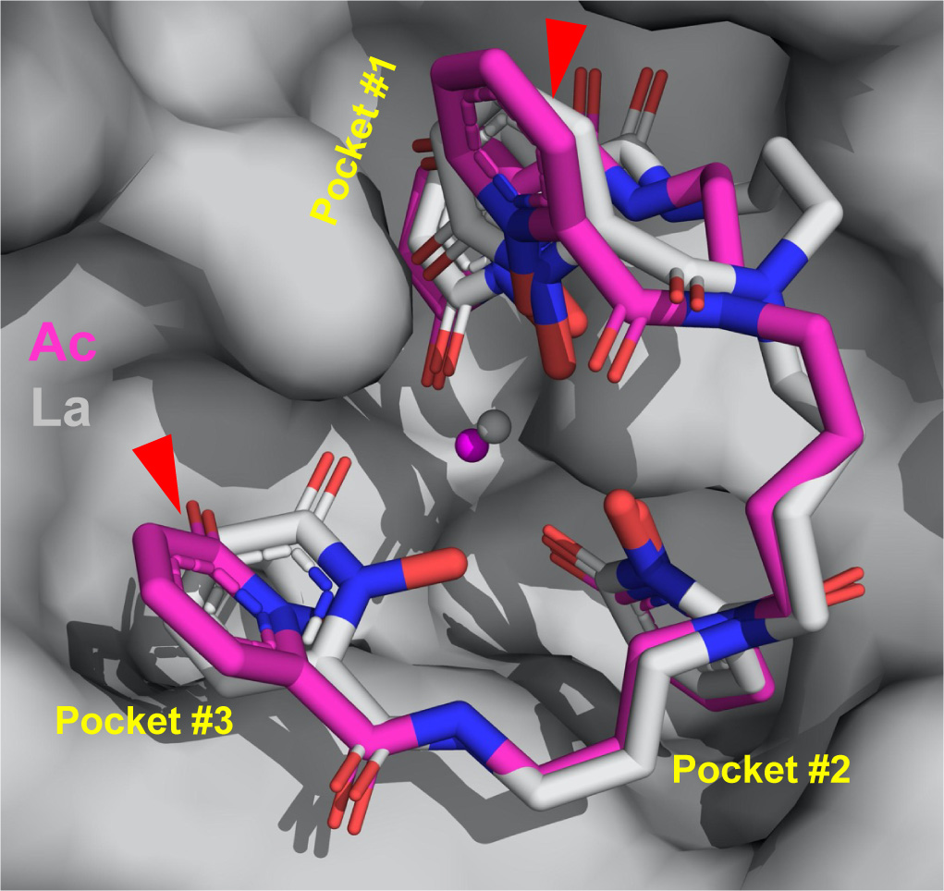
A Macromolecular Scaffold for Probing Actinium Chemistry
Scientific Achievement
By encapsulating actinium atoms within a macromolecular complex for analysis using protein crystallography, researchers discovered that actinium has a unique solid-state bonding configuration.
Significance and Impact
A better understanding of actinium behavior could help improve a promising cancer treatment known as targeted alpha therapy.
Research Details
Protein crystallography at the Advanced Light Source (ALS) was performed on actinium bound to a protein–ligand complex.
The bonding geometry for the actinium metal center was found to deviate from that of other trivalent metals, such as lanthanum.
Protein crystallography provided information about how actinium (magenta sphere, center) binds to a scaffold consisting of a synthetic ligand (magenta sticks) and a mammalian protein (gray surface). The structure for lan-thanum (gray sphere and sticks), is also shown.
J.N. Wacker, J.J. Woods, P.B. Rupert, A. Peterson, M. Allaire, W.W. Lukens, A.N. Gaiser, S.G. Minasian, R.K. Strong, and R.J. Abergel, Nat. Commun. 15, 5741 (2024), doi:10.1038/s41467-024-50017-5. Work was performed at ALS/LBNL and benefited the LBNL Heavy Element Chemistry Program.
Notes:
The element actinium (Ac) was first discovered at the turn of the 20th century, but even now, nearly 125 years later, researchers still don’t have a good grasp on the metal’s chemistry. That’s because actinium is only available in extremely small amounts, and working with the radioactive material requires special facilities. But to improve emerging cancer treatments using actinium, researchers will need to better understand how the element binds with other molecules. In this study, researchers created a macromolecular scaffold, consisting of a synthetic ligand bound to a mammalian protein, to stabilize and “trap” an actinium atom. When crystallized, this macromolecular complex allowed the researchers to probe actinium's chemical behavior using protein crystallography. While elements often behave similarly to their lighter cousins on the periodic table, researchers were surprised to find that the actinium behaved differently than predicted by similar experiments performed with its lighter counterpart, lanthanum (La).
Researchers: J.N. Wacker, J.J. Woods, A. Peterson, M. Allaire, W.W. Lukens, and S.G. Minasian (Berkeley Lab); P.B. Rupert and R.K. Strong (Fred Hutchinson Cancer Center); A.N. Gaiser (Berkeley Lab and Michigan State University); and R.J. Abergel (UC Berkeley and Berkeley Lab).
Acknowledgment from paper: National Institutes of Health; US Department of Energy, Office of Science, Basic Energy Sciences program (DOE BES), Chemical Sciences, Geosciences, and Biosciences Division. Operation of the ALS is supported by DOE BES.
Full highlight: https://newscenter.lbl.gov/2024/07/15/caught-in-the-actinium/

