Slide 1
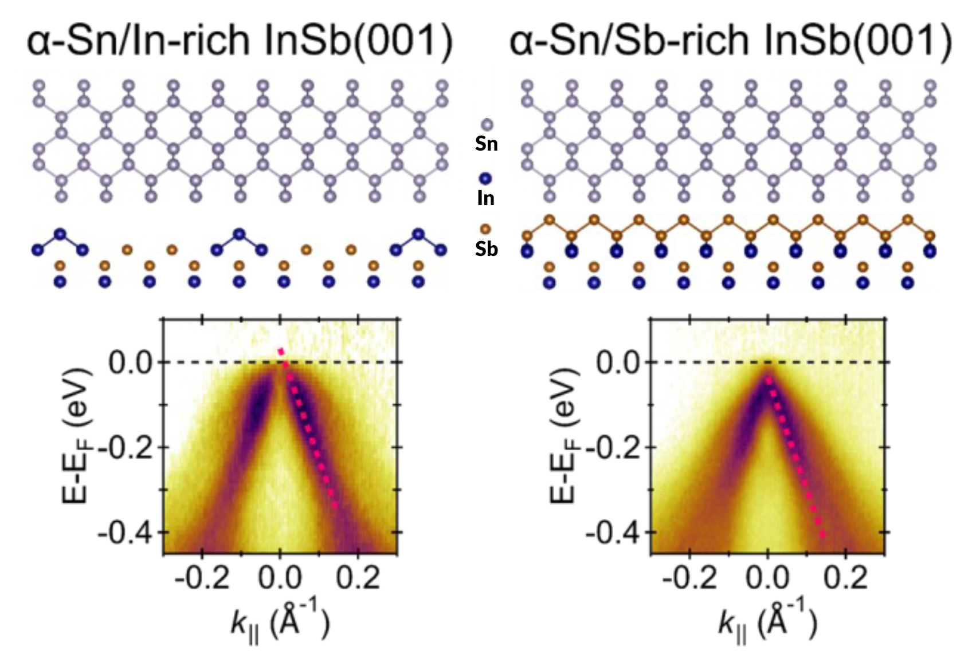
Stabilizing Pristine α-Sn Thin Films for Topological Investigation
Scientific Achievement
Researchers developed a substrate-preparation recipe that minimizes impurities in alpha-tin (α-Sn) thin films, facilitating studies of topologically nontrivial phases in the material.
Significance and Impact
The results greatly simplify electronic-structure studies of a material with potentially useful properties for next-generation electronic devices.
Research Details
Enrichment of an indium antimonide (InSb) substrate with Sb prevents diffusion of In impurities into the α-Sn.
Enables characterization of electronic structure using angle-resolved photoemission spectroscopy (ARPES) at the Advanced Light Source (ALS) and Stanford Synchrotron Radiation Laboratory (SSRL).
Top row: Side views of In-rich (left) and Sb-rich (right) substrate structures. Bottom row: Corresponding ARPES data showing that the Sb-rich substrate (right) raises the α-Sn chemical potential (dotted line), making the material’s electronic properties accessible to conventional photoelectron spectroscopies.
A.N. Engel, C.P. Dempsey, H.S. Inbar, J.T. Dong, S. Nishihaya, Y. Chang, A.V. Fedorov, M. Hashimoto, D. Lu, and C.J. Palmstrøm, Phys. Rev. Mater. 8, 044202 (2024), doi:10.1103/PhysRevMaterials.8.044202. Work was performed at ALS/LBNL and SSRL/SLAC.
Notes:
Elemental tin (Sn) undergoes a number of phase transitions that can change its electronic properties. For example, “alpha-tin” (α-Sn) is a zero-gap semiconductor exhibiting a variety of topologically nontrivial phases. Aside from fundamental interest in understanding the details of topological electronic states, there is widespread hope that unique functionalities in next-generation electronic devices can be based on such states. However, α-Sn is unstable and goes through a phase transition to a trivial metal phase, β-Sn, at room temperature. In the past, a few approaches have been developed aimed at stabilizing it at higher temperatures. The most promising dealt with growing the films on substrates with closely matching lattices, such as indium antimonide (InSb), at room temperature. The resulting α-Sn films, however, contained indium impurities. As result, the properties of the alpha-tin essential to novel electronics applications were severely altered. In this work, researchers demonstrated how an InSb substrate can be treated in such a way as to produce an increased concentration of Sb on the surface.
Researchers: A.N. Engel, C.P. Dempsey, H.S. Inbar, J.T. Dong, S. Nishihaya, Y. Chang, and C.J. Palmstrøm (Univ. of California, Santa Barbara); A.V. Fedorov (ALS); and M. Hashimoto and D. Lu (SSRL/SLAC).
Acknowledgment from paper: Army Research Laboratory, National Science Foundation, and U.S. Department of Energy, Office of Science, Basic Energy Sciences program (DOE BES). Operation of the ALS and SSRL is supported by DOE BES.
Full highlight: https://als.lbl.gov/https://als.lbl.gov/stabilizing-pristine-alpha-sn-thin-films-for-topological-investigation//

