Slide 1
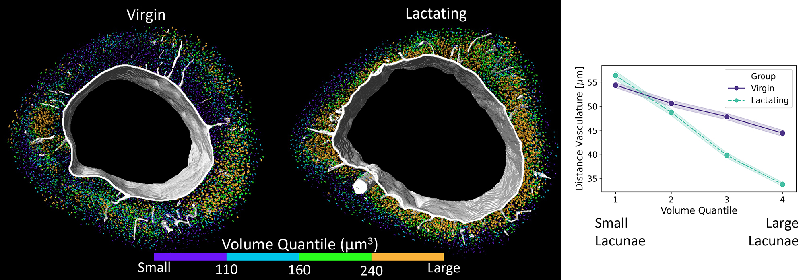
The Spatial Dynamics of Bone Remodeling During Lactation
Scientific Achievement
Using 3D reconstructions of bone microstructure, researchers learned where and how lactation-induced bone remodeling occurs.
Significance and Impact
The findings provide valuable insights into how the competing demands of calcium release and bone preservation are managed during lactation, informing future strategies for addressing bone fragility and metabolic bone diseases.
Research Details
3D reconstructions of bones from virgin and lactating mice were generated via microcomputed tomography at the Advanced Light Source.
In lactating mice, cavities (lacunae) housing cells that maintain bone quality (osteocytes) were larger near vascular structures.
Clarified the role of an osteocyte-specific enzyme (MMP13) in bone-matrix resorption.
Representative 3D renderings of the lacunae and vasculature in mouse bones, generated using synchrotron microcomputed tomography. Vasculature is colored white, and lacunae (indicating bone resorption) are colored according to volume.
In lactating mice, lacunae near vasculature are larger than in virgin mice.
M. Sieverts, C. Yee, M. Nemani, D.Y. Parkinson, T. Alliston, and C. Acevedo, Sci. Rep. 14, 14655 (2024), doi:10.1038/s41598-024-63645-0. Work was performed at ALS/LBNL.
Notes:
Lactation places large metabolic demands on a mother’s skeleton. To mobilize the minerals needed for milk production, osteocytes—the cells responsible for maintaining bone quality—facilitate the release of calcium and other minerals from the bone. In this study, researchers investigated how this process occurs throughout the bone during lactation and how osteocytes balance the rapid release of calcium while maintaining bone integrity. The researchers compared virgin and lactating mice, with and without the osteocyte-specific deletion of an enzyme (MMP13) responsible for the resorption of bone matrix in the surrounding of the osteocyte. To visualize and quantify local changes in mouse tibias, they employed microcomputed tomography at Advanced Light Source (ALS) Beamline 8.3.2.
Researchers: Michael Sieverts (University of Utah); Cristal Yee, Minali Nemani, and Tamara Alliston (University of California, San Francisco); Dilworth Y. Parkinson (ALS); and Claire Acevedo (University of Utah and University of California, San Diego).
Acknowledgment from paper: National Institutes of Health and National Institute for Occupational Safety and Health. Operation of the ALS is supported by the US Department of Energy, Office of Science, Basic Energy Sciences program.
Full highlight: https://als.lbl.gov/the-spatial-dynamics-of-bone-remodeling-during-lactation/

