Slide 1
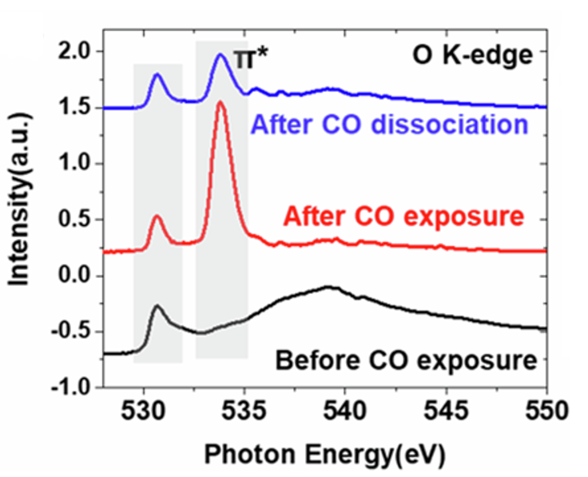
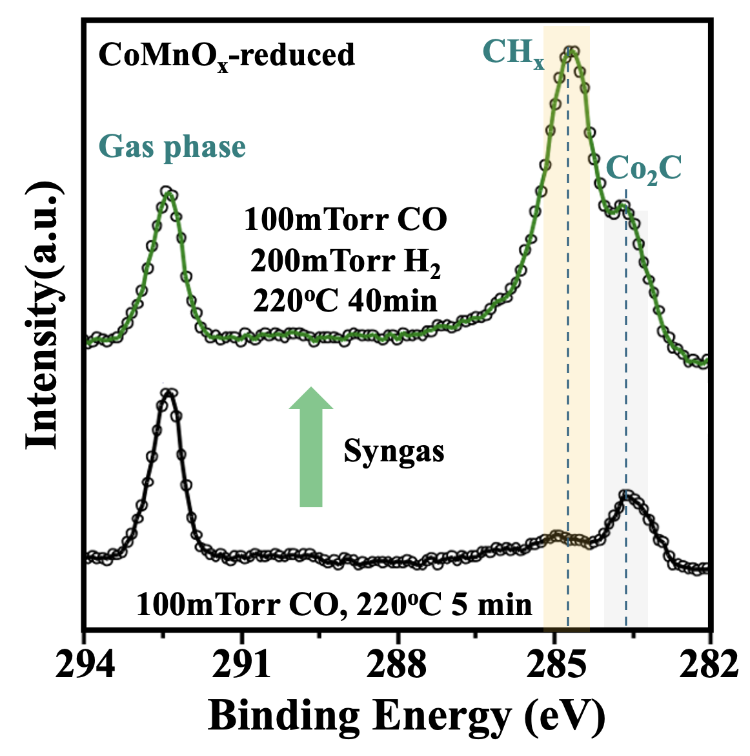
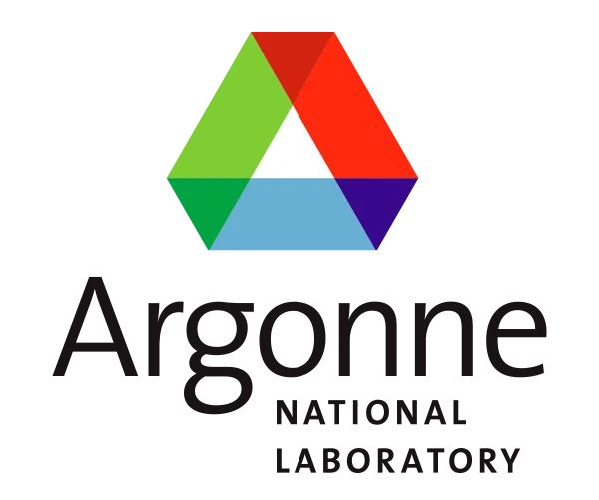
Understanding the Role of Manganese in Fuel-Production Catalysts
Scientific Achievement
Using specialized equipment, including a custom-built reaction cell, researchers uncovered the role of manganese in cobalt manganese oxide catalysts used for fuel production.
Significance and Impact
This work opens the door to improved catalyst designs that could decrease the production of harmful methane byproducts in a common petrochemical process.
Research Details
At the Advanced Light Source, CoMnO_{x} samples were probed using ambient-pressure x-ray photoelectron spectroscopy (APXPS) and x-ray absorption spectroscopy (XAS), the latter with a custom-built ambient-pressure cell that allows real-time monitoring under realistic reaction conditions.
Complementary density functional theory (DFT) analysis indicated that MnO binds with H, making it unavailable for termination of hydrocarbon chains.
Left: XAS showed the breakdown of CO (peak at 534 eV) after the introduction of H₂ (blue curve). Right: APXPS showed the increase in CH_{x} (peak at 284 eV) after the introduction of syngas (top curve).
H. Chen, Z. Lian, X. Zhao, J. Wan, P.F. Pieters, J. Oliver-Meseguer, J. Yang, E. Pach, S. Carenco, L. Treps, N. Liakakos, Y. Shan, V. Altoe, E. Wong, Z. Zhuo, F. Yang, J. Su, J. Guo, M. Blum, S.H. Lapidus, A. Hunt, I. Waluyo, H. Ogasawara, H. Zheng, P. Yang, A.T. Bell, N. López, and M. Salmeron, Nat. Commun. 15, 10294 (2024), doi:10.1038/s41467-024-54578-3. Work was performed at ALS/LBNL, NSLS-II/BNL, and SSRL/SLAC.
Notes:
The Fischer-Tropsch synthesis is a common chemical process used to convert carbon monoxide and hydrogen from coal into liquid hydrocarbons, or fuel. Cobalt is an efficient catalyst for this reaction, and its combination with manganese has been known for decades to further improve the process by promoting the production of long-chain hydrocarbons in favor of methane, a detrimental contributor to climate change. However, the molecular-scale origin for why manganese improves the efficiency of this reaction remains unclear. In this work, researchers uncovered the role of manganese in cobalt manganese oxide systems by combining well-defined model catalysts with advanced x-ray spectroscopy techniques. These results provide a platform for how customized equipment can answer challenging scientific questions and set the stage for new catalyst designs that may further decrease the production of methane during Fischer-Tropsch synthesis.
Researchers: H. Chen, X. Zhao, J. Oliver-Meseguer, J. Yang, E. Pach, S. Carenco, L. Treps, N. Liakakos, V. Altoe, E. Wong, and J. Su (Berkeley Lab); Z. Lian and N. López (Barcelona Institute of Science and Technology); J. Wan, Y. Shan, H. Zheng, P. Yang, A.T. Bell, and M. Salmeron (Berkeley Lab and UC Berkeley); P.F. Pieters (UC Berkeley); Z. Zhuo, F. Yang, J. Guo, and M. Blum (ALS); S.H. Lapidus (Argonne National Laboratory); A. Hunt and I. Waluyo (Brookhaven National Laboratory); and H. Ogasawara (SLAC National Accelerator Laboratory).
Acknowledgment from paper: US Department of Energy, Office of Science, Basic Energy Sciences program (DOE BES); National Science Foundation–US-Israel Binational Science Foundation (NSF-BSF); European Union Horizon research and innovation program; and Spanish Ministry of Science and Innovation. Operation of the ALS, NSLS-II, and SSRL is supported by DOE BES.
Full highlight: https://als.lbl.gov/understanding-the-role-of-manganese-in-fuel-production-catalysts/

