Slide 1
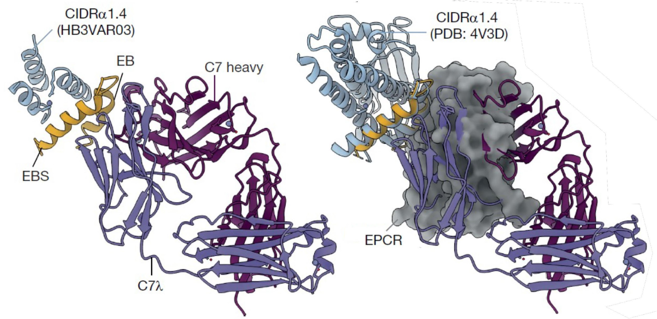
Identification and Structural Characterization of Antibodies for Severe Malaria
Scientific Achievement
Researchers discovered two antibodies that can prevent the protein interactions responsible for severe malaria and elucidated their binding mechanism.
Significance and Impact
These broadly reactive antibodies are likely to represent a common mechanism of acquired immunity to severe malaria and offer novel insights for vaccine design or targeted treatment.
Research Details
X-ray crystallography at the Advanced Light Source showed that one antibody (C7) directly blocks binding of the vaccine target domain (CIDRα1) with its receptor protein (EPCR).
A second antibody (C74), derived from a different individual and having a different structure, used the same conserved sites as C7 to bind CIDRα1.
Left: A variant of the target domain for vaccines, CIDRα1.4 (light blue/yellow), in complex with a broadly reactive antibody, C7 (purple/maroon). Right: Superposition of the receptor protein, EPCR (gray surface), shows that C7 directly blocks the EPCR binding site (yellow helices), thus inhibiting the interaction responsible for severe malaria.
R.A. Reyes, S.S.R. Raghavan, N.K. Hurlburt, V. Introini, S. Bol, I.H. Kana, R.W. Jensen, E. Martinez-Scholze, M. Gestal-Mato, B. López-Gutiérrez, S. Sanz, C. Bancells, M.L. Fernández-Quintero, J.R. Loeffler, J.A. Ferguson, W.-H. Lee, G.M. Martin, T.G. Theander, J.P. A. Lusingu, D.T.R. Minja, I. Ssewanyana, M.E. Feeney, B. Greenhouse, A.B. Ward, M. Bernabeu, M. Pancera, L.Turner, E.M. Bunnik, and T. Lavstsen., Nature 636, 182 (2024), doi:10.1038/s41586-024-08220-3. Work was performed at ALS/LBNL.
Notes:
Malaria causes approximately 600,000 deaths each year, mainly among young children living in sub-Saharan Africa, and ten times as many suffer from severe forms of the disease that result in long-lasting health and socioeconomic consequences. In the last few years, the number of malaria cases and deaths has not decreased and emerging vaccines lack sufficient success rates, necessitating new interventions to combat this disease. An important interaction that underlies severe malaria is the binding between the endothelial protein C receptor (EPCR) to CIDRα1, a specific domain within a key protein expressed on the surface of infected red blood cells. However, CIDRα1 has evolved extensive amino acid sequence diversity, enabling it to appear in thousands of variants and hampering vaccine development that targets its interaction with EPCR. In this study, researchers identified two antibodies that can inhibit the interaction between EPCR and CIDRα1 despite this sequence diversity and structurally characterized their mechanism for preventing this interaction.
Researchers: R.A. Reyes, S. Bol, E. Martinez-Scholze, and E.M. Bunnik (University of Texas Health Science Center at San Antonio); S.S.R. Raghavan (Scripps Research Institute and University of Copenhagen and Righospitalet, Denmark); N.K. Hurlburt and M. Pancera (Fred Hutchinson Cancer Center); V. Introini, M. Gestal-Mato, B. López-Gutiérrez, S. Sanz, C. Bancells, and M. Bernabeu (European Molecular Biology Laboratory Barcelona); I.H. Kana, R.W. Jensen, T.G. Theander, L.Turner, and T. Lavstsen (University of Copenhagen and Righospitalet, Denmark); M.L. Fernández-Quintero, J.R. Loeffler, J.A. Ferguson, W.-H. Lee, G.M. Martin, and A.B. Ward (Scripps Research Institute); J.P. A. Lusingu and D.T.R. Minja (Tanga Research Centre, Tanzania); I. Ssewanyana (Infectious Disease Research Collaboration, Uganda); and M.E. Feeney and B. Greenhouse (University of California San Francisco).
Acknowledgment from paper: National Institutes of Health, Howard Hughes Medical Institute, Lundbeck Foundation, Independent Research Fund Denmark, Kirsten & Freddy Johansens Fond, Novo Nordisk Fonden, Marie Skłodowska-Curie Actions fellowship, European Molecular Biology Laboratory, University of Texas Health Science Center at San Antonio, and Cancer Prevention and Research Institute of Texas. Operation of the ALS is supported by the US Department of Energy, Office of Science, Basic Energy Sciences program.
Full highlight: https://als.lbl.gov/identification-and-structural-characterization-of-antibodies-for-severe-malaria/

