Slide 1
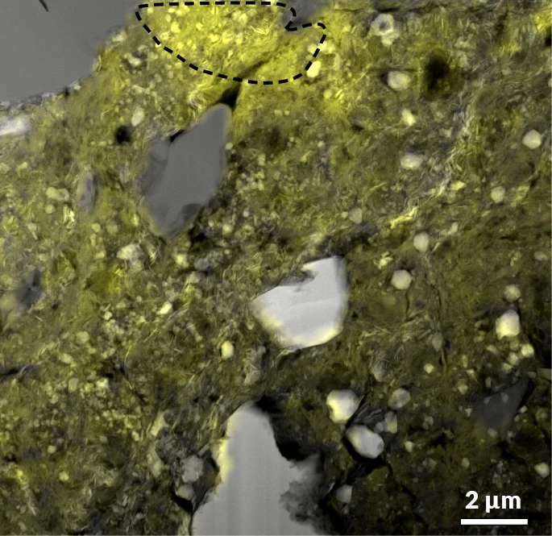








Bennu’s Ancient Brine Sheds Light on Recipe for Life
Scientific Achievement
Researchers traced the evolution of minerals (“salts”) in an ancient brine, as recorded in samples from the asteroid Bennu, returned to Earth by NASA’s OSIRIS-REx mission.
Significance and Impact
The results support the idea that asteroids like Bennu may have delivered water and essential chemical building blocks of life to Earth in the distant past.
Research Details
  Scanning transmission x-ray microscopy (STXM) at the Advanced Light source (ALS) was combined with transmission electron microscopy (TEM) at the Molecular Foundry.
  The resulting data on carbonate abundance and form provided clues to the conditions under which the liquid water from the brine evaporated.
STXM map shows amorphous (non-crystalline) carbonate (yellow shading) overlaid on a TEM image of a sample returned to Earth from the asteroid Bennu.
T.J. McCoy, S.S. Russell, T.J. Zega, et al. Nature 637, 1072 (2025), doi: 10.1038/s41586-024-08495-6. Work was performed at ALS/LBNL and Molecular Foundry/LBNL.
Notes:
Samples from the 4.5-billion-year-old asteroid Bennu were gathered by NASA’s OSIRIS-REx mission, the first US mission to return samples from an asteroid. The mission returned nearly 122 grams of material—the largest sample ever captured in space and returned to Earth from an extraterrestrial body beyond the Moon. In this study, researchers found evidence that Bennu contained a set of salty mineral deposits that formed in a specific sequence when a brine evaporated, leaving clues about the type of water that flowed billions of years ago. Brines could be a productive broth for cooking up some of the key ingredients of life, and the same type of minerals are found in dried-up lake beds on Earth (such as Searles Lake in California) and have been observed on Jupiter’s moon Europa and Saturn’s moon Enceladus.
Researchers: T.J. McCoy, C.M. Corrigan, L.R. Wardell, T. Gooding, T.R. Rose, and T. Salge (Smithsonian Institution); S.S. Russell, A.J. King, N.V. Almeida, C.S. Harrison, H.C. Bates, and P.F. Schofield (Natural History Museum, UK); T.J. Zega, J.J. Barnes, P. Haenecour, D.N. DellaGiustina, I.J. Ong, B.S. Prince, K. Ishimaru, L.R. Smith, M.C. Benner, N.A. Kerrison, Z. Zeszut, D.H. Hill, and D.S. Lauretta (University of Arizona); K.L. Thomas-Keprta, L.P. Keller, S.A. Eckley, L.B. Seifert, L. Le, V.M. Tu, and N.G. Lunning (NASA Johnson Space Center); S.A. Singerling and F.E. Brenker (Goethe University, Germany); N.E. Timms, W.D.A. Rickard, P.A. Bland, F. Jourdan, S.M. Reddy, D.W. Saxey, C. Mayers, and X. Sun (Curtin University, Australia); G. Libourel (Laboratoire Lagrange, France); S. Ray (Smithsonian Institution and Los Alamos National Laboratory); Z. Gainsforth (University of California, Berkeley); G. Dominguez (Cal State University San Marcos); M.S. Thompson (Purdue University); S.A. Sandford (NASA Ames Research Center); R.H. Jones (University of Manchester, UK); H. Yurimoto, N. Sakamoto, and N. Kawasaki (Hokkaido University, Japan); K. Righter (NASA Johnson Space Center and University of Rochester); M.A. Marcus (ALS); T.R. Ireland (University of Queensland, Australia); M. Portail and V. Guigoz (Université Côte d’Azur, France); P.-M. Zanetta (Université Jean Monnet Saint-Étienne, France); V.E. Hamilton (Southwest Research Institute); D.P. Glavin, J.P. Dworkin, and H.H. Kaplan (NASA Goddard Space Flight Center); I.A. Franchi (Open University, UK); K.T. Tait (Royal Ontario Museum, Canada); S. Tachibana (University of Tokyo, Japan); H.C. Connolly Jr. (University of Arizona, Rowan University, and American Museum of Natural History). Note: Not all participating institutions are shown in the slide footer.
Acknowledgment from paper: National Aeronautics and Space Administration, UK Research and Innovation, UK Science and Technology Facilities Council, and Canadian Space Agency. Operation of the ALS and Molecular Foundry is supported by the US Department of Energy, Office of Science, Basic Energy Sciences program.
Full highlight: https://als.lbl.gov/bennus-ancient-brine-sheds-light-on-recipe-for-life/

