Slide 1
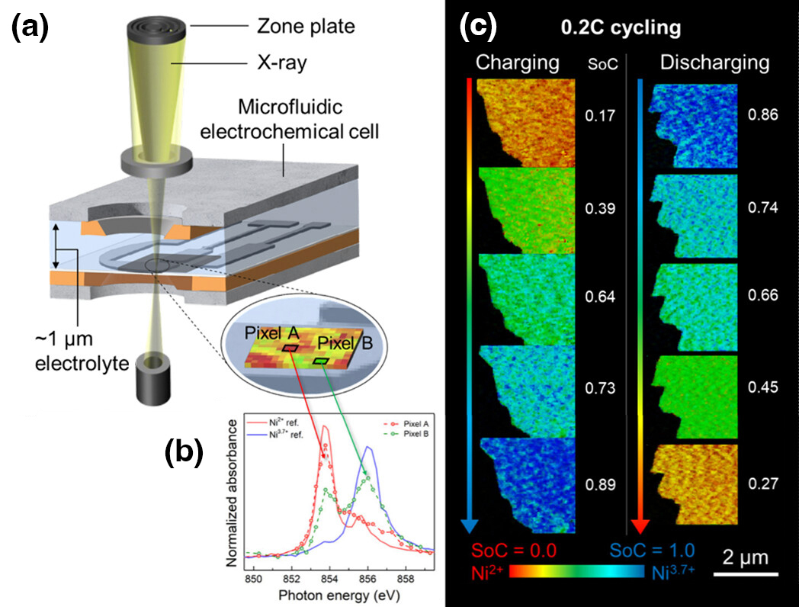




A Clearer Look at Lithium-Ion Traffic Jams in Batteries
Scientific Achievement
By directly visualizing the uneven insertion of lithium ions into electrodes with well-defined crystal orientations, researchers learned why fast charging decreases battery lifespan and performance.
Significance and Impact
The work could provide insights into better battery utilization and help investigations of the surface insertion reaction during fast charging.
Research Details
  LiNi_{1/3}Mn_{1/3}Co_{1/3}O₂ samples were probed using operando scanning transmission x-ray microscopy (STXM) at the Advanced Light Source (ALS).
  Alignment of samples' crystallographic channels helped isolate the source of the heterogeneous lithium distribution as variations in channel-by-channel insertion rates.
(a) Schematic of the cell used for operando STXM. (b) X-ray absorption spectra taken at each pixel correlates to lithium composition. (c) Operando state of charge (SoC) maps of the sample at a charging and discharging rate of 0.2C (20% of capacity/h).
J. Chung, C. Nam, J.Y. Kim, T.H. Lee, J. Kim, D. Lee, B. Koo, S. Jo,
J. Cho, S. Kunze, Y.S. Choi, J. Song, H. Choi, J. Kim, S.H. Park, H. Lee, B.H. Hong, N. Kim, D.A. Shapiro, H.W. Jang, and J. Lim, Nano Lett. 24, 14766 (2024), doi:10.1021/acs.nanolett.4c04129. Work was performed at ALS/LBNL.
Notes:
The rapid charging of lithium-ion batteries leads to significant performance degradation over time. In electric vehicles, this manifests as a shorter driving range per charge. To mitigate this, slow charging is often recommended, despite the fact that rapid charging is essential for the widespread adoption of environmentally friendly electric vehicles. A key factor influencing this performance degradation is the uniformity of the lithium flow into and out of battery electrodes during charging and discharging. Nonuniform insertion leads to localized expansion of the lattice structure, causing local strain and stress that exacerbates degradation. A better understanding of this unevenness will help scientists design better batteries that last longer and charge faster. However, the spatial heterogeneity of lithium insertion is challenging to study because of the complexity of the materials (layered oxides) and generally poorly defined interfaces. In this study, researchers developed a model system that allowed them to decouple competing effects and watch, in real-time, how and where batteries charge at the nanoscale.
Researchers: J. Chung, C. Nam, J.Y. Kim, T.H. Lee, J. Kim, D. Lee, B. Koo, S. Jo, J. Cho, S. Kunze, Y.S. Choi, J. Song, H. Choi, J. Kim, S.H. Park, H. Lee, H.W. Jang, and J. Lim (Seoul National University, Republic of Korea); B.H. Hong (Seoul National University, Republic of Korea, and Advanced Institute of Convergence Technology, Republic of Korea); N. Kim (Pohang Accelerator Laboratory); and D.A. Shapiro (ALS).
Acknowledgment from paper: National Research Foundation of Korea, Ministry of Small and Medium-sized Enterprises and Startups of Korea, and LG Energy Solution. Operation of the ALS is supported by the US Department of Energy, Office of Science, Basic Energy Sciences program.
Full highlight: https://als.lbl.gov/a-clearer-look-at-lithium-ion-traffic-jams-in-batteries/

