Slide 1
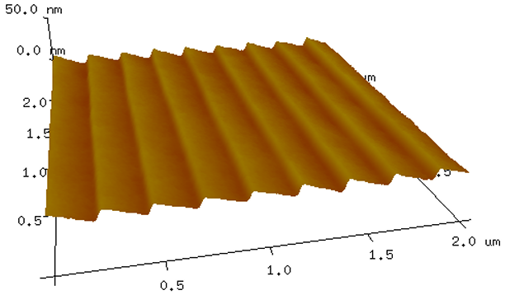
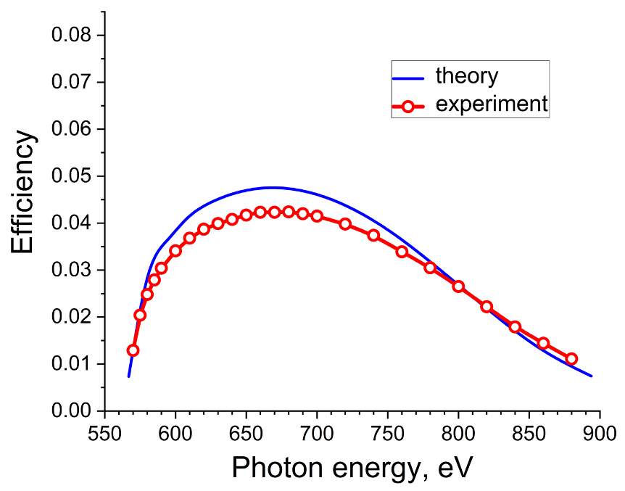
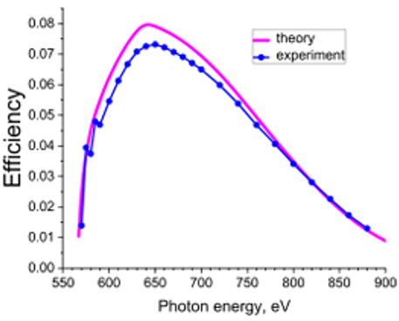



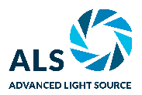
Thin-Film Coating Boosts X-Ray Instrument Performance
Scientific Achievement
Optimized coatings on diffraction gratings at the Advanced Light Source (ALS) use thin-film interference to double the light reaching the sample, capturing power otherwise lost to absorption.
Significance and Impact
Every soft x-ray beamline monochromator uses gratings and can benefit from increased diffraction efficiency.
Research Details
  Blazed diffraction gratings with a half-million grooves were fabricated at the Molecular Foundry.
  Simulations predicted that thinner Cr/Au layers would double the grating efficiency, relative to standard thicknesses.
  Tests at the Center for X-Ray Optics reflectometer beamline at the ALS confirmed the predicted 100% boost in efficiency.
theory
experiment
theory
experiment
Efficiency
Efficiency
Photon Energy [eV]
Photon Energy [eV]
When the densely packed, nanometers-wide grooves of a grating (top) are coated with an atoms-thin layer of chromium and gold, the structure’s diffraction efficiency doubles from 4% (bottom left) to 8% (bottom right).
D.L. Voronov, E.M. Gullikson, F. Salmassi, et al.,
Optics Letters 50(18), 5929–5932 (2025). DOI:10.1364/OL.573022
Work was performed at ALS and Molecular Foundry/LBNL.
Notes:
Soft x-rays allow us glimpses into the most fundamental properties of many materials by revealing what electrons are doing in a solid. But the gratings that separate and bend x-rays in these studies struggle to deliver more than a small fraction of an incoming beam’s energy to its target. This has led researchers on a quest to improve the efficiency of gratings, without compromising the resolution of the output data.
In this study, researchers sought to win back some of the x-rays that are lost by adjusting the thin metal coatings on diffraction gratings. The team, led by ALS Staff Scientist Dmitriy Voronov, used the Molecular Foundry to fabricate a silicon grating with half a million grooves over the entire element—itself a nanoscale engineering feat. The team coated the silicon with a reflective layer of 5-nm-thick Cr and 30-nm-thick Au, the standard design for inhibiting direct absorption by the silicon. Then, they replaced the coating with a layer of 1-nm-thick Cr and 4-nm-thick Au, a combination that their simulations indicated would double the grating’s efficiency.
Tests at Berkeley Lab’s Center for X-Ray Optics (CXRO) Beamline 6.3.2 demonstrated that the new design delivered double the incoming soft-x-ray energy reaching its target, in perfect agreement with simulations. The improved gratings will have applications across many areas of high-resolution spectroscopy, including the ALS Double-Dispersion Resonant Inelastic X-Ray Scattering (RIXS) system (QERLIN, Beamline 6.0.2).
Acknowledgement from paper: The Advanced Light Source and the Molecular Foundry are supported by the Director, Office of Science, Office of Basic Energy Sciences, of the U.S. Department of Energy under Contract No. DE-AC02-05CH11231.
Full highlight: https://als.lbl.gov/thin-film-coating-boosts-x-ray-instrument-performance

