Slide 1
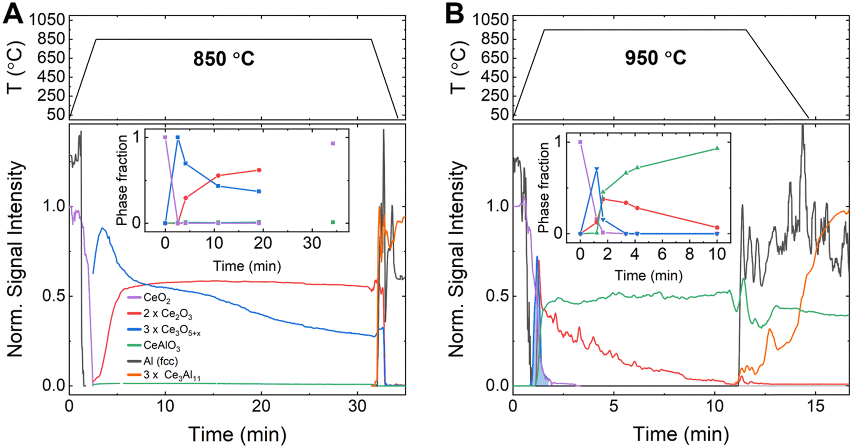
Mechanism of an Economical Way to Produce Al–Ce Alloy
Scientific Achievement
A time-resolved diffraction study revealed mechanistic insight into a multi-step chemical reaction for the economical production of aluminum–cerium alloy, a high-performance material with superior temperature stability.
Significance and Impact
The work will improve the economics of Al–Ce alloy production while utilizing an often discarded byproduct of rare earth mining.
Research Details
X-ray diffraction at the Advanced Light Source (ALS) tracked how CeO₂ reacts with liquid aluminum at high temperatures.
The results were combined with differential scanning calorimetry, metallography, and thermodynamic calculations.
The reaction of Ce₂O₃ with Al to form CeAlO₃ showed markedly different dynamics depending on temperature.
The high data-acquisition rate and heating capabilities of the time-resolved diffraction experiments enabled the observation of short-lived intermediate phases, highlighting the importance of temperature control to maximize the reaction yield while minimizing heating costs. The results provide crucial information for the application of the method on an industrial scale.
A. Amon, E.E. Moore, H.B. Henderson, J. Shittu, M. Kunz, S. Kastamo, N. Huotari, A. Loukus, R. Ott, D. Weiss, and S.K. McCall, Mater. Horiz. 11, 2382 (2024), doi:10.1039/D4MH00087K. Work was performed at ALS/LBNL.
Notes:
Cerium oxide (CeO₂), the largest fraction of rare earth element ores, is often discarded as a low-value byproduct of rare earth mining for materials used in green-energy transition technologies. Converting this byproduct to a value-added co-product, such as aluminum–cerium alloy, could support the volatile rare earth market. In the last decade, high-performance aluminum (Al) alloys with up to 10% cerium (Ce) have been developed that exhibit superior temperature stability, in addition to being lightweight and strong. However, the current Al–Ce alloy production method, which uses Al melts and metallic Ce, is costly and consumes large amounts of energy, particularly because the process first requires CeO₂ reduction to metallic Ce. A recent study co-authored by Alfred Amon, a staff scientist at Lawrence Livermore National Laboratory, proposed an energy- and cost-efficient route for Al–Ce alloy production without requiring the production of metallic Ce.
Researchers: A. Amon, E.E. Moore, H.B. Henderson, J. Shittu, and S.K. McCall (Lawrence Livermore National Laboratory); M. Kunz (ALS); S. Kastamo, N. Huotari, A. Loukus, and D. Weiss (Loukus Technologies Inc.); and R. Ott (Ames National Laboratory).
Acknowledgment from paper: Critical Materials Institute (an Energy Innovation Hub funded by the U.S. Department of Energy, Office of Energy Efficiency and Renewable Energy, Advanced Materials and Manufacturing Technologies Office). This work was performed under the auspices of the U.S. Department of Energy by Lawrence Livermore National Laboratory under Contract DE-AC52-07NA27344. Operation of the ALS is supported by the DOE Office of Science, Basic Energy Sciences program.
Full highlight: https://als.lbl.gov/mechanism-of-an-economical-way-to-produce-al-ce-alloy/

