Slide 1
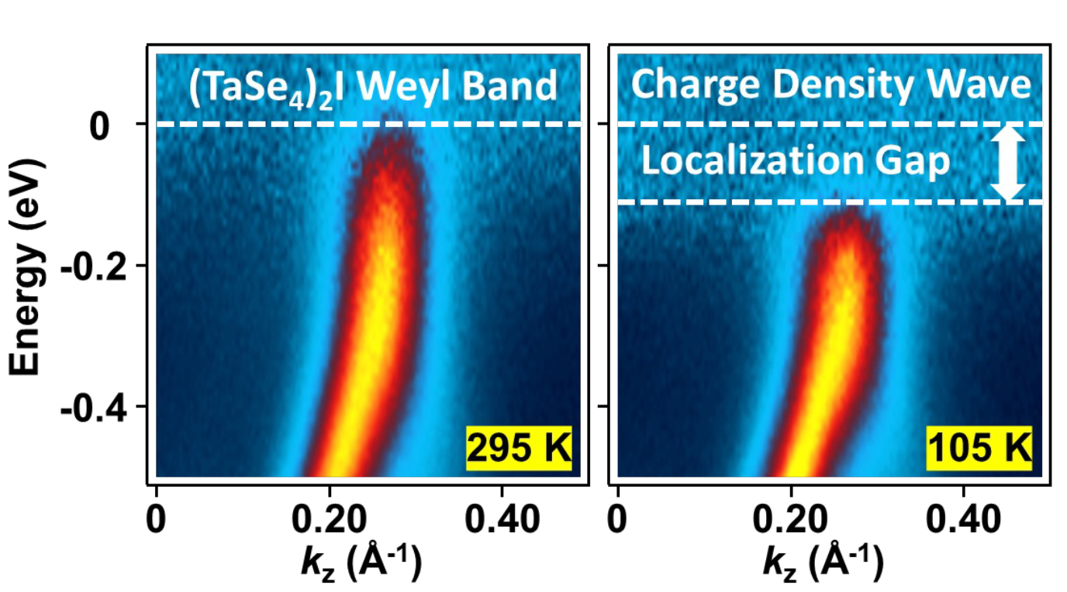






Not All Gaps Are Created Equal
Scientific Achievement
Researchers found that charge density waves (CDWs) in topological materials induce unconventional spectral gaps in the materials’ electronic structure.
Significance and Impact
The finding that CDWs in topological materials can be essentially different from those in other materials should be carefully considered when designing quantum devices.
Research Details
  At the Advanced Light Source (ALS) and other synchrotron facilities, high-statistics angle-resolved photoemission spectroscopy (ARPES) was used to bring out subtle features in the data.
  The results were explained by quasiparticle localization arising from the incommensurate modulation of the lattice by the CDW.
Left: ARPES map for the Weyl semimetal, (TaSe₄)₂I, in the normal phase at room temperature. Right: ARPES map of (TaSe₄)₂I in the CDW phase at a low temperature. According to theory, the CDW transition should lead to a dispersion gap at the Weyl point (in this case, at E_{W} = −0.384 eV). Instead, the Weyl bands were observed to recede from the Fermi level to open a spectral gap wherein quasiparticles seem to simply disappear.
M.-K. Lin, J.A. Hlevyack, C.X. Zhao, P. Dudin, J. Avila, S.-K. Mo, C.-M. Cheng,
P. Abbamonte, D.P. Shoemaker, and T.-C. Chiang, Nano Lett. 24, 8778 (2024), doi:10.1021/acs.nanolett.4c02701. Work was performed at ALS/LBNL.
Notes:
In a charge density wave (CDW), conduction electrons in a metal (typically a low-dimensional material) arrange themselves in a regular pattern, sometimes accompanied by lattice distortions. One material that undergoes a CDW transition is a compound of tantalum, selenium, and iodine [(TaSe₄)₂I]. Its quasi-one-dimensional structure consists of TaSe₄ molecular chains interspersed with I– ionic chains. The CDW transition in (TaSe₄)₂I is of particular interest because it’s potentially a mechanism that could lead to a spontaneous transformation into an “axion” state of matter. Axions are hypothetical particles that were proposed as a way to solve a well-known problem in particle physics. But the concept has crossed over to condensed matter physics, as a way to describe emergent properties in topological materials. Prevailing theories predict that the CDW transition in (TaSe₄)₂I—a type of topological material known as a Weyl semimetal—should lead to a dispersion gap at points where linear Weyl bands intersect, but this has never been confirmed experimentally through angle-resolved photoemission spectroscopy (ARPES), because of difficulties arising from a very weak ARPES intensity near the Fermi level.
Researchers: M.-K. Lin (National Central University, Taiwan); J.A. Hlevyack, C.X. Zhao, P. Abbamonte, D.P. Shoemaker, and T.-C. Chiang (University of Illinois at Urbana−Champaign); P. Dudin and J. Avila (Synchrotron SOLEIL and Universite Paris-Saclay, France); S.-K. Mo (ALS); and C.-M. Cheng (National Synchrotron Radiation Research Center, Taiwan).
Acknowledgment from paper: Center for Quantum Sensing and Quantum Materials (an Energy Frontier Research Center funded by the U.S. Department of Energy, Office of Science, Basic Energy Sciences program [DOE BES]) and National Science and Technology Council of Taiwan. Operation of the ALS is supported by DOE BES.
Full highlight: https://als.lbl.gov/not-all-gaps-are-created-equal/

