Slide 1
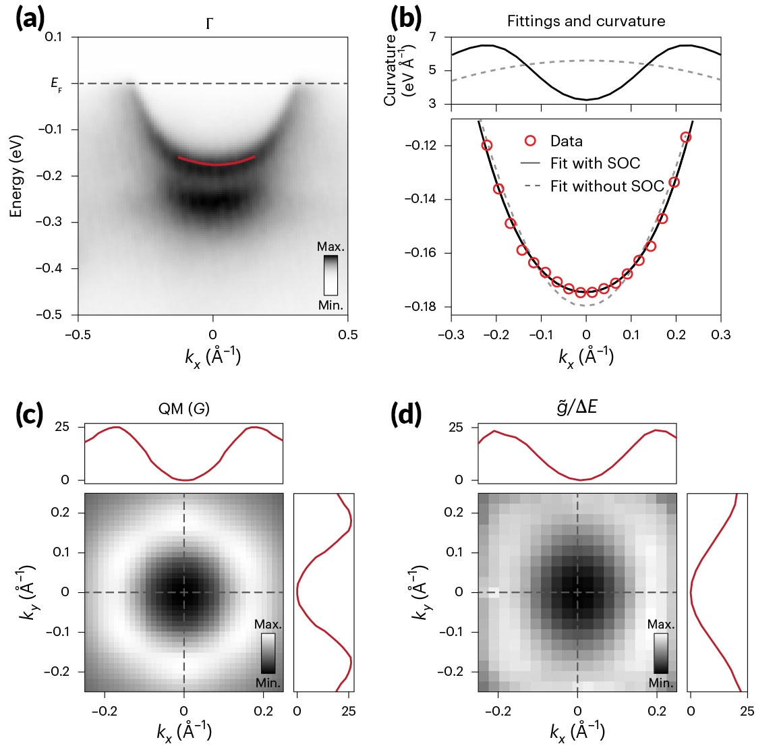
Mapping the Quantum Landscape of Electrons in Solids
Scientific Achievement
Researchers found a way to reconstruct quantum geometric tensors (QGTs)—mathematical entities that encode how an electron’s wave function is shaped by its quantum environment.
Significance and Impact
The mapping of QGTs enables the discovery and control of novel quantum phenomena such as superconductivity and unconventional electronic phases.
Research Details
CoSn is a kagome metal that exhibits a topological flat band.
Studied using angle-resolved photemission spectroscopy (ARPES) at the Advanced Light Source (ALS) and Elettra Synchrotron (Trieste, Italy).
Combination of theory and experiment established a momentum- and energy-resolved spectroscopic probe of the QGT.
ALS data (a-b) enabled the reconstruction of quantities such as (c) the "quantum metric" (QM)—the real part of the QGT—from experimental estimates, such as (d) g̃/ΔE.
M. Kang, S. Kim, Y. Qian, P.M. Neves, L. Ye, J. Jung, D. Puntel, F. Mazzola, S. Fang, C. Jozwiak, A. Bostwick, E. Rotenberg, J. Fuji, I. Vobornik, J.-H. Park, J.G. Checkelsky, B.-J. Yang, and R. Comin, Nat. Phys. 21, 110 (2025), doi:10.1038/s41567-024-02678-8. Work was performed at ALS/LBNL.
Notes:
The development of quantum mechanics—featuring concepts such as quantized energy levels, wave-particle duality, and the uncertainty principle—revolutionized physics in the early 20th century. It led to the rise of the wave function as a way to describe, mathematically, the quantum state of a system (such as electrons in a crystal). A more recent development, the quantum geometric tensor (QGT) is also a mathematical entity, this time describing how wave functions are affected by changes in a material’s quantum “landscape” (e.g., the material’s structure, its topological properties, electron-electron interactions, and spin-orbit coupling). The QGT is therefore a fundamental physical concept that helps explain a range of quantum phenomena in materials. However, despite its importance, a generic method for measuring the QGT in solids has been lacking. In this work, researchers outline a way to measure the momentum-resolved QGT of solids using angle-resolved photoemission spectroscopy (ARPES). In addition to being fundamentally interesting, the QGT is also important for potential applications in next-generation microelectronics and advanced energy technologies. Studies involving the QGT will contribute immensely to what’s been dubbed the “second quantum revolution,” focusing on the control and harnessing of quantum nature at the device scale.
Researchers: M. Kang (MIT and Max Planck POSTECH/Korea Research Initiative); S. Kim, Y. Qian, J. Jung, and B.-J. Yang (Seoul National University); P.M. Neves, S. Fang, J.G. Checkelsky, and R. Comin (MIT); L. Ye (Stanford University and MIT); D. Puntel (University of Trieste, Italy); F. Mazzola (National Research Council, Italy, and Ca’ Foscari University of Venice); C. Jozwiak, A. Bostwick, and E. Rotenberg (ALS); J. Fuji and I. Vobornik (National Research Council, Italy); and J.-H. Park (Max Planck POSTECH/Korea Research Initiative and Pohang University of Science and Technology).
Acknowledgment from paper: Air Force Office of Scientific Research; National Science Foundation; Gordon and Betty Moore Foundation; National Research Foundation of Korea; Samsung Science and Technology Foundation; Army Research Office; US Department of Energy, Office of Science, Basic Energy Sciences Program (DOE BES), Center for Advancement of Topological Semimetals (an Energy Frontier Research Center led by Ames National Laboratory); Heising-Simons Physics Research Fellow Program; Tsinghua Education Foundation; Nanoscience Foundries and Fine Analysis Project, Italy; Samsung Foundation of Culture; and Kavli Institute. Operation of the ALS is supported by DOE BES.
Full highlight: https://als.lbl.gov/mapping-the-quantum-landscape-of-electrons-in-solids/

