Slide 1
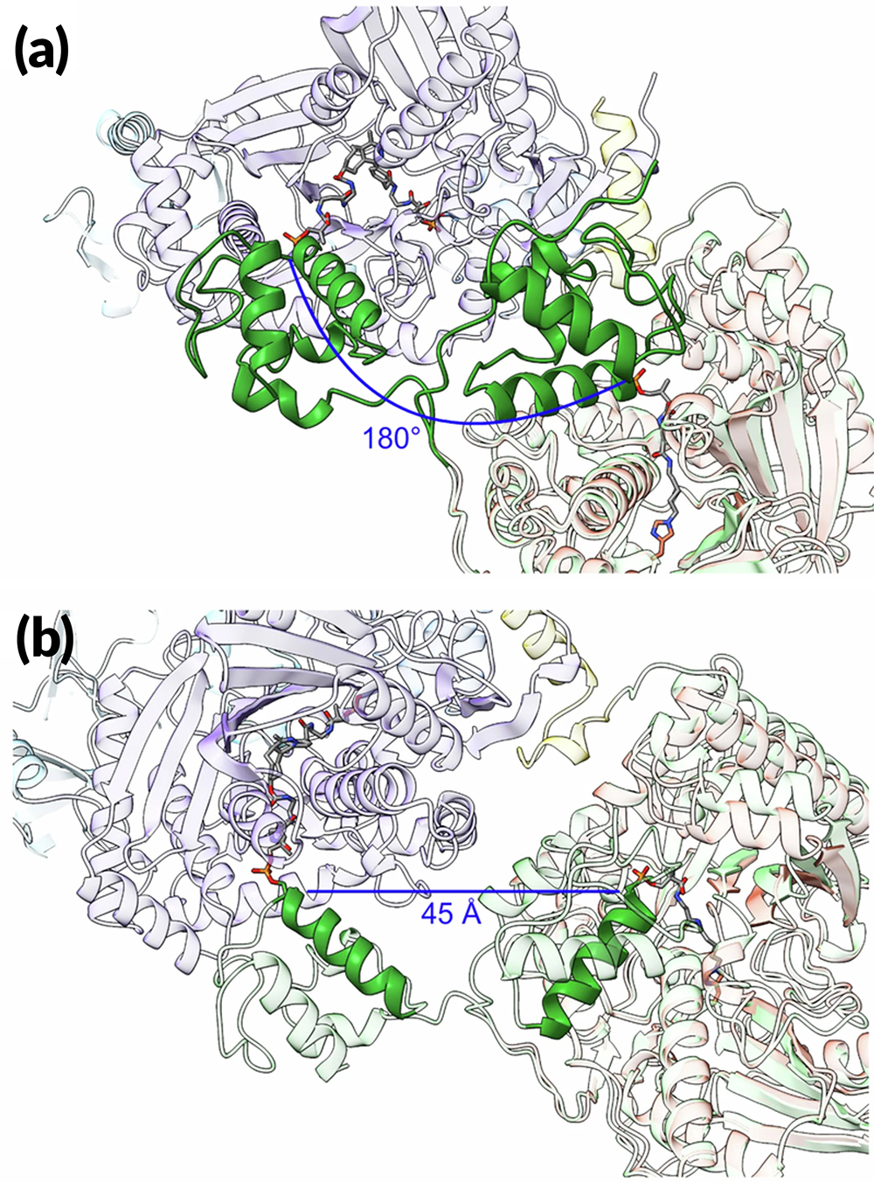
Deep-Dive Inspection of a Molecular Assembly Line
Scientific Achievement
By locking down certain movable parts of a modular drug-building protein, researchers learned new details about how carrier proteins transfer the product protein between modules.
Significance and Impact
The results offer insights that could enable scientists to design and create new and improved medicines, such as antibiotics, using synthetic biology.
Research Details
The "molecular assembly line" was a model nonribosomal peptide synthetase (NRPS) produced by the bacterium Brevibacillus parabrevis.
Flexible components were trapped in place using a "click chemistry" approach.
Protein crystallography at the Advanced Light Source (ALS) complemented cryogenic electron microscopy (cryo-EM) structural characterizations.
Structures highlight interfacial mechanics between key modular components and the movement of a carrier protein from one catalytic step to the next.
Motion of a carrier protein (green) that shuttles amino acids between domains. The carrier protein pivots approximately 180° and shifts by 45 Å.
G.W. Heberlig, J.J. La Clair, and M.D. Burkart, Nature 638, 261 (2025), doi:10.1038/s41586-024-08306-y. Work was performed at ALS/LBNL.
Notes:
Many drugs used today are peptides (short amino-acid chains) produced on enzymatic assembly lines—i.e., giant proteins known as nonribosomal peptide synthetases (NRPSs), which occur naturally in bacteria. Each “module” on the assembly line installs a single amino-acid building-block onto a growing peptide chain. This modularity initially led researchers to believe that NRPS functionality could be mixed and matched to create whatever peptide was desired. However, it turns out that the modules typically cannot be recombined. While each module is essentially self-contained, there are subtle interactions that determine whether modules can work together. In this work, researchers collected multiple structures—snapshots of the assembly line in action—using both cryo-electron microscopy (cryo-EM) and protein crystallography, the latter at the ALS. By comparing multiple snapshots, the researchers learned new details about how components of the assembly line work together at the molecular level, a prerequisite to rationally altering the assembly process to speed it up or to make an improved or more potent medicine.
Researchers: G.W. Heberlig, J.J. La Clair, and M.D. Burkart (University of California San Diego).
Acknowledgment from paper: National Institutes of Health. Operation of the ALS is supported by the US Department of Energy, Office of Science, Basic Energy Sciences program.
Full highlight: https://als.lbl.gov/deep-dive-inspection-of-a-molecular-assembly-line/

