Slide 1
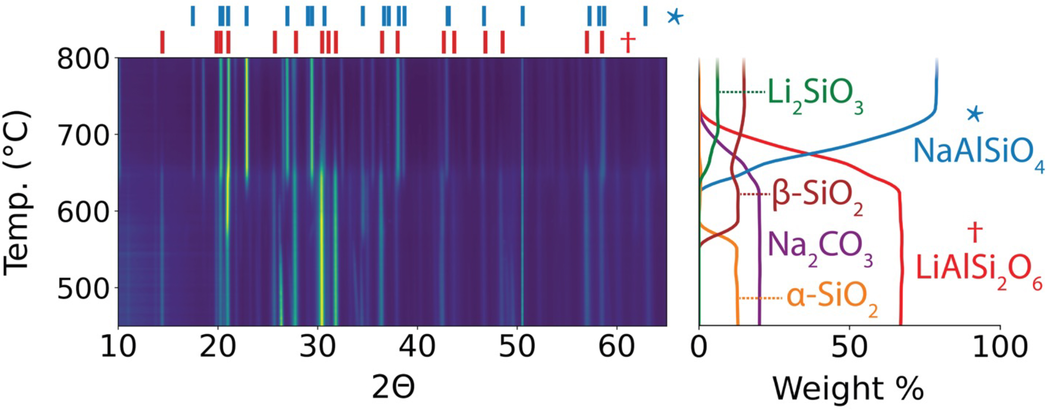




Energy-Saving, Acid-Free, Hard-Rock Lithium Extraction
Scientific Achievement
In situ x-ray diffraction helped researchers to develop an optimized synthesis procedure to produce Li₂CO₃ directly from spodumene, an abundant Li-bearing mineral, without requiring the use of acid leaching.
Significance and Impact
The approach is performed at a moderate temperature (750 °C) and uses acid-free separation. It will support the sustainable scaling of lithium production to meet growing market needs.
Left: XRD intensities from α-spodumene with Na₂CO₃ during heating (up to 800 °C). Right: Weight fraction of each phase as a function of temperature. The reaction of α-spodumene with Na₂CO₃ produces a mixture of NaAlSiO₄ and Li₂SiO₃, with Li₂CO₃ anticipated as a potential product.
Research Details
  In situ x-ray diffraction (XRD) at the Advanced Light Source (ALS) enabled real-time monitoring of the reaction of sodium carbonate (Na₂CO₃) introduced directly to α-spodumene and its reaction products.
  The data showed that some Li⁺ was trapped in an inactive phase; allowed researchers to identify a suitable additive to avoid this, enabling a 90.4% lithium recovery rate using a low-cost washing procedure without acid.
S. Wang, N. Szymanski, Y. Fei, W. Dong, J.N. Christensen, Y. Zeng, M. Whittaker, and G. Ceder, Inorg. Chem. 63, 13576 (2024), doi:10.1021/acs.inorgchem.4c01722. Work was performed at ALS/LBNL.
Notes:
The increasing popularity of hybrid and electric vehicles is driving a surge in global lithium demand, necessitating a robust and reliable supply. Currently, most lithium-ion battery cathodes are synthesized from lithium carbonate (Li₂CO₃) or lithium hydroxide (LiOH), both of which can be obtained by processing brines or hard rocks. While brine extraction is common, the processing of hard rocks—particularly spodumene (LiAlSi₂O₆)—is faster and typically yields a higher recovery rate. Lithium extraction from spodumene involves first transforming α-spodumene (the naturally occurring form) into β-spodumene (a high-temperature polymorph) through calcination (heating above 1000 °C). Then, the mineral is acid roasted (heated in strong acid) before undergoing neutralization to precipitate Li₂CO₃. These processes are both energy intensive and costly, posing significant sustainability and economic challenges. To develop an energy-saving, acid-free route, the researchers explored direct lithium extraction from α-spodumene through solid-state reactions.
Researchers: S. Wang, N.J. Szymanski, Y. Fei, M. Whittaker, and G. Ceder (UC Berkeley and Berkeley Lab); W. Dong and J.N. Christensen (Berkeley Lab); and Yan Zeng (Berkeley Lab and Florida State University).
Acknowledgment from paper: US Department of Energy, Office of Science, Basic Energy Sciences program (DOE BES), MINES project; Jane Lewis Fellowship (UC Berkeley). Operation of the ALS is supported by DOE BES.
Full highlight: https://als.lbl.gov/energy-saving-acid-free-hard-rock-lithium-extraction/

