Slide 1
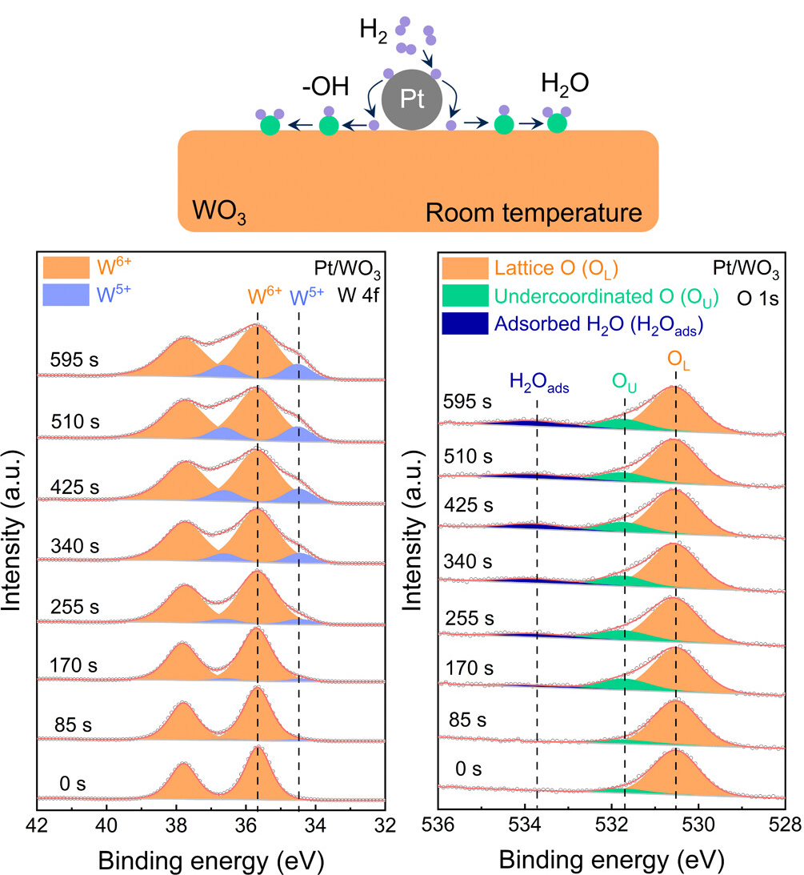
Catching "Hydrogen Spillover" onto a Catalytic Surface
Scientific Achievement
Researchers uncovered the precise mechanism of hydrogen spillover (H₂ splitting and migration) onto a catalytic surface by watching it happen under various conditions.
Significance and Impact
The research lays the foundation for designing more efficient catalysts and storage materials essential for next-generation hydrogen energy technologies.
Research Details
At the Advanced Light Source (ALS), ambient-pressure x-ray photoelectron spectroscopy (APXPS) was applied to a platinum/tungsten trioxide (Pt/WO₃) catalytic surface in hydrogen gas over time at various temperatures.
The data, combined with theory and modeling, revealed three different temperature-dependent reaction processes, resulting from the interplay between hydrogen spillover (and its reverse), H⁺ diffusion to the bulk, and water desorption.
Top: Hydrogen spillover on a Pt/WO₃ surface. Bottom: APXPS of W 4f (left) and O 1s (right) photoelectrons. The W⁵⁺ (purple), adsorbed water (blue), and undercoordinated oxygen (green) are signs of hydrogen spillover.
H. Li, M. Abdelgaid, J.R. Paudel, N.P. Holzapfel, V. Augustyn, J.R. McKone, G. Mpourmpakis, and E.J. Crumlin, J. Am. Chem. Soc. 147, 6472 (2025), doi:10.1021/jacs.4c13711. Work was performed at ALS/LBNL.
Notes:
The splitting and migration of molecular hydrogen (H₂) over a catalytic surface (a process known as “hydrogen spillover”) is a fundamental yet elusive phenomenon in catalysis that affects a wide range of uses, from hydrogenation (which can be used to upgrade or purify crude oil components) to energy storage (when bonded to a metal, hydrogen can be stored in the solid state). Despite its importance, direct experimental evidence capturing the real-time mechanistic steps of hydrogen spillover remains scarce. In particular, tungsten trioxide (WO₃), a widely used catalytic material, exhibits dynamic interactions with hydrogen, yet the precise nature of these interactions has been a subject of long-standing debate, especially for distinguishing the chemical dynamics occurring on the surface from those in the bulk. This research was driven by the need to resolve these ambiguities using ambient-pressure x-ray photoelectron spectroscopy (APXPS), which provides direct spectroscopic evidence of the spillover process as it unfolds. By integrating experimental observations with theoretical models, the researchers unlocked a comprehensive understanding of how hydrogen interacts with reducible oxide surfaces and influences their catalytic properties.
Researchers: H. Li and J.R. Paudel (Berkeley Lab), M. Abdelgaid and J.R. McKone (University of Pittsburgh), N.P. Holzapfel and V. Augustyn (North Carolina State University), G. Mpourmpakis (University of Pittsburgh and National Technical University of Athens, Greece), and E.J. Crumlin (Berkeley Lab and ALS).
Acknowledgment from paper: US Department of Energy, Office of Science, Basic Energy Sciences program (DOE BES); Center for Research Computing at the University of Pittsburgh; and National Science Foundation. Operation of the ALS is supported by DOE BES.
Full highlight: https://als.lbl.gov/catching-hydrogen-spillover-onto-a-catalytic-surface/

