Slide 1
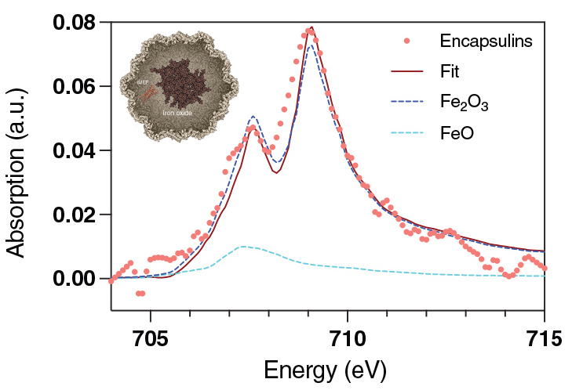
Self-Generated Magnetic Handles in Modified Mammalian Cells
Scientific Achievement
Researchers genetically engineered mammalian cells to produce their own magnetic “handles” and revealed their magnetic, physical, and chemical properties.
Significance and Impact
The work provides a foundation for future bioengineering efforts aimed at enabling genetically controlled magnetic manipulation of molecular processes in living mammalian cells.
Research Details
Mammalian cells were modified to overexpress encapsulins.
Encapsulins form shells that accumulate magnetic material in their cores.
X-ray absorption spectroscopy and scanning transmission x-ray microscopy (XAS-STXM) at the Advanced Light Source (ALS), combined with Raman spectroscopy, led to the conclusion that the dominant form of iron oxide in the core is consistent with maghemite (γ-Fe₂O₃).
XAS-STXM provided data characterizing the chemical state of iron oxide species that accumulate in encapsulin shells (inset) produced by genetically modified mammalian cells.
M.V. Efremova, U. Wiedwald, F. Sigmund, S.-V. Bodea, H. Ohldag, T. Feggeler, R. Meckenstock, L.N. Panzl, J. Francke, I. Beer, N.P. Ivleva, I.B. Alieva, A.S. Garanina, A.S. Semkina, F. Curdt, N. Josten, S. Wintz, M. Farle, R. Lavrijsen, M.A. Abakumov, M. Winklhofer, and G.G. Westmeyer, Adv. Funct. Mater. 35, 2418013 (2025), doi:10.1002/adfm.202418013. Work was performed at ALS/LBNL.
Notes:
Some bacteria have evolved the remarkable ability to align themselves with Earth’s magnetic field, owing to internally synthesized chains of magnetic nanocrystals that provide them with an internal compass needle. It’s thought that following magnetic field lines helps these single-celled organisms propel themselves toward optimal (for them) environments. Multicellular organisms—including humans—can also benefit from cellular compasses, or magnetic “handles,” to maneuver cells as needed. Possible future applications include cell sorting, cell tracking (and imaging), and targeted drug delivery. However, the genetic programming that allows bacteria to natively produce magnetic organelles is lacking in mammals, and attempts to introduce magnetic agents into mammalian cells are stymied by cellular defense mechanisms. To get around this, a large multinational research collaboration based in Germany genetically modified mammalian cells to self-produce protein nanocompartments in which iron oxides can be created and stored. The group then characterized the magnetic, physical, and chemical properties of the nanocompartment cargo and demonstrated the ability to manipulate the resulting live engineered cells using magnetic fields.
Researchers: M.V. Efremova (Technical University of Munich, Helmholtz Center Munich, and Eindhoven University of Technology, the Netherlands); U. Wiedwald, R. Meckenstock, N. Josten, and M. Farle (University of Duisburg-Essen, Germany); F. Sigmund, S.-V. Bodea, L.N. Panzl, and G.G. Westmeyer (Technical University of Munich and Helmholtz Center Munich); H. Ohldag (ALS, Stanford University, and UC Santa Cruz); T. Feggeler (ALS and UC Berkeley); J. Francke and R. Lavrijsen (Eindhoven University of Technology, the Netherlands); I. Beer and N.P. Ivleva (Technical University of Munich); I.B. Alieva (Lomonosov Moscow State University); A.S. Garanina (National University of Science and Technology, Russian Federation); A.S. Semkina (Russian National Research Medical University); F. Curdt and M. Winklhofer (Carl von Ossietzky University of Oldenburg, Germany); S. Wintz (Max Planck Institute for Intelligent Systems, Germany); and M.A. Abakumov (National University of Science and Technology and Russian National Research Medical University).
Acknowledgment from paper: Helmholtz Association, Russian Science Foundation, Alexander von Humboldt Foundation, Federation of European Biochemical Societies, Joachim Herz Foundation, European Union Horizon 2020, European Research Council, and German Science Foundation. Operation of the ALS is supported by the US Department of Energy, Office of Science, Basic Energy Sciences program.
Full highlight: https://als.lbl.gov/self-generated-magnetic-handles-in-modified-mammalian-cells/

