Slide 1
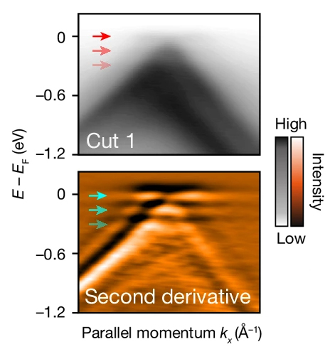
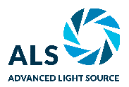
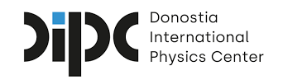
A New Twist for Superconductivity in Bilayer Graphene
Scientific Achievement
In a study of twisted bilayer graphene (TBG) systems, researchers found intriguing spectroscopic features in a superconducting “magic-angle” TBG—features that are absent in non-superconducting TBG.
Significance and Impact
The results provide crucial information on superconductivity in magic-angle TBG for next-gen electronics and advanced energy technologies.
Research Details
At the Advanced Light Source (ALS), angle-resolved photoemission spectroscopy with micron spatial resolution (micro-ARPES) revealed flat-band replicas in superconducting magic-angle TBG.
Calculations suggest that replica formation can be attributed to strong coupling between flat-band electrons and an optical phonon mode.
An ARPES spectrum and its second derivative reveal equally spaced flat-band "replicas" in superconducting magic-angle TBG samples.
C. Chen, K.P. Nuckolls, S. Ding, W. Miao, D. Wong, M. Oh, R.L. Lee, S. He, C. Peng, D. Pei, Y. Li, C. Hao, H. Yan, H. Xiao, H. Gao, Q. Li, S. Zhang, J. Liu, L. He, K. Watanabe, T. Taniguchi, C. Jozwiak, A. Bostwick, E. Rotenberg, C. Li, X. Han, D. Pan, Z. Liu, X. Dai, C. Liu, B.A. Bernevig, Y. Wang, A. Yazdani, and Y. Chen, Nature 636, 342 (2024), doi:10.1038/s41586-024-08227-w. Work was performed at ALS/LBNL.
Notes:
Two-dimensional materials like graphene give scientists great flexibility in engineering electronic properties because they can be stacked like sheets of paper. Besides choosing what materials to stack and in what order, researchers can manipulate the electrical and optical properties of these stacks by controlling the twist angle between layers. Because of this versatility, two-dimensional materials provide an ideal platform for investigating the complex interplay between phenomena such as band topology, strong electron correlation, magnetism, and superconductivity, all of which are relevant to next-gen electronics and advanced energy technologies. So-called “magic-angle” twisted bilayer graphene (MATBG) attracts broad research interest primarily because of its surprising and unusual superconducting properties, which resemble those of high-temperature superconductors. The superconductivity in MATBG devices is thought to arise from flat bands that form in a material’s electronic band structure when two layers of graphene are twisted at a “magic” angle of about 1.08 degrees. Flat bands indicate a high density of states, which significantly enhances electron interactions and the resulting potential for exotic phenomena. Despite intensive experimental efforts, the origin of MATBG superconductivity remains elusive.
Researchers: C. Chen and Y. Chen (ShanghaiTech University and University of Oxford); K.P. Nuckolls, D. Wong, M. Oh, R.L. Lee, and A. Yazdani (Princeton University); S. Ding and H. Yan (Emory University); W. Miao (University of California, Santa Barbara); S. He and C. Peng (University of Oxford); D. Pei, H. Xiao, H. Gao, Q. Li, S. Zhang, J. Liu, and Z. Liu (ShanghaiTech University); Y. Li (Wuhan University); C. Hao and L. He (Beijing Normal University); K. Watanabe and T. Taniguchi (National Institute for Materials Science, Japan); C. Jozwiak, A. Bostwick, and E. Rotenberg (ALS); C. Li, X. Han, D. Pan, and X. Dai (Hong Kong University of Science and Technology); C. Liu (Pennsylvania State University); B.A. Bernevig (Princeton University, Donostia International Physics Center, Spain, and Basque Foundation for Science); and Y. Wang (Emory University and Clemson University).
Acknowledgment from paper: Oxford–ShanghaiTech collaboration project; Shanghai Municipal Science and Technology Major Project; Gordon and Betty Moore Foundation; US Department of Energy, Office of Science, Basic Energy Sciences program (DOE BES); National Science Foundation; Army Research Office; Office of Naval Research; Simons Foundation; European Research Council; National Natural Science Foundation of China; National Key R&D program of China; and Research Grants Council of the Hong Kong Special Administrative Region, China. Operation of the ALS is supported by DOE BES.
Full highlight: https://als.lbl.gov/a-new-twist-for-superconductivity-in-bilayer-graphene/

