Slide 1
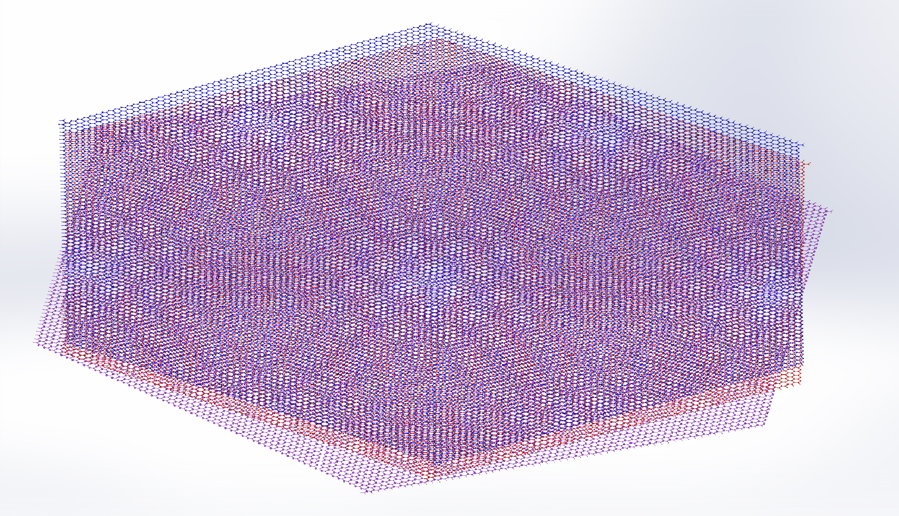
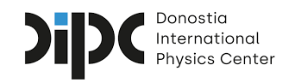
Moiré Patterns Can Make Or Break A Superconductor
Scientific Achievement
The onset of superconductivity in magic-angle, twisted bilayer graphene (MATBG) on boron nitride is associated with electronic 'fingerprints' that appear or vanish upon formation of different moiré patterns.
Significance and Impact
The state of the ‘fingerprint’ signals the coherence of the coupling, a superconductivity requirement that can be tuned by moiré engineering.
Research Details
Angle-resolved photoemission spectroscopy with micron spatial resolution revealed ghost-like replicas of flat states, signaling coherent electron-boson scattering.
The samples showed both flat bands and replicas, where the energy of the states indicates electron-phonon scattering as the likely explanation for the superconductivity.
An ARPES spectrum illustrating flat bands (green arrows) and an illustration of TBG [boron nitride = purple (bottom) and two twisted graphene layers = red (middle) and blue (top)].
C. Chen, K.P. Nuckolls, S. Ding, W. Miao, D. Wong, M. Oh, R.L. Lee, S. He, C. Peng, D. Pei, Y. Li, C. Hao, H. Yan, H. Xiao, H. Gao, Q. Li, S. Zhang, J. Liu, L. He, K. Watanabe, T. Taniguchi, C. Jozwiak, A. Bostwick, E. Rotenberg, C. Li, X. Han, D. Pan, Z. Liu, X. Dai, C. Liu, B.A. Bernevig, Y. Wang, A. Yazdani, and Y. Chen, Nature 636, 342 (2024), doi:10.1038/s41586-024-08227-w. Work was performed at ALS/LBNL.
Notes:
Two-dimensional materials like graphene give scientists great flexibility in engineering electronic properties, because they can be stacked like sheets of paper. Besides choosing what materials to stack and in what order, researchers can manipulate the electrical and optical properties of these stacks by controlling the twist angle between layers. Because of this versatility, two-dimensional materials provide an ideal platform for investigating the complex interplay between phenomena, such as band topology, strong electron correlation, magnetism, and superconductivity, all of which are relevant to next-gen electronics and advanced energy technologies. So-called “magic-angle” twisted bilayer graphene (MATBG) attracts broad research interest due to its surprising and unusual superconducting properties, which resemble those of high-temperature superconductors. The superconductivity in MATBG devices require strong and coherent electron-boson coupling. Previous ALS work demonstrated the strength through 'flat' states at a magic twist angle. This work finds ‘fingerprint’ states signal the coherence of the coupling, another requirement for superconductivity that can be tuned by moiré engineering.
Researchers: C. Chen and Y. Chen (ShanghaiTech University and University of Oxford); K.P. Nuckolls, D. Wong, M. Oh, R.L. Lee, and A. Yazdani (Princeton University); S. Ding and H. Yan (Emory University); W. Miao (University of California, Santa Barbara); S. He and C. Peng (University of Oxford); D. Pei, H. Xiao, H. Gao, Q. Li, S. Zhang, J. Liu, and Z. Liu (ShanghaiTech University); Y. Li (Wuhan University); C. Hao and L. He (Beijing Normal University); K. Watanabe and T. Taniguchi (National Institute for Materials Science, Japan); C. Jozwiak, A. Bostwick, and E. Rotenberg (ALS); C. Li, X. Han, D. Pan, and X. Dai (Hong Kong University of Science and Technology); C. Liu (Pennsylvania State University); B.A. Bernevig (Princeton University, Donostia International Physics Center, Spain, and Basque Foundation for Science); and Y. Wang (Emory University and Clemson University).
Acknowledgment from paper: Oxford–ShanghaiTech collaboration project; Shanghai Municipal Science and Technology Major Project; Gordon and Betty Moore Foundation; US Department of Energy, Office of Science, Basic Energy Sciences program (DOE BES); National Science Foundation; Army Research Office; Office of Naval Research; Simons Foundation; European Research Council; National Natural Science Foundation of China; National Key R&D program of China; and Research Grants Council of the Hong Kong Special Administrative Region, China. Operation of the ALS is supported by DOE BES.
Full highlight: https://als.lbl.gov/a-new-twist-for-superconductivity-in-bilayer-graphene/

