Slide 1
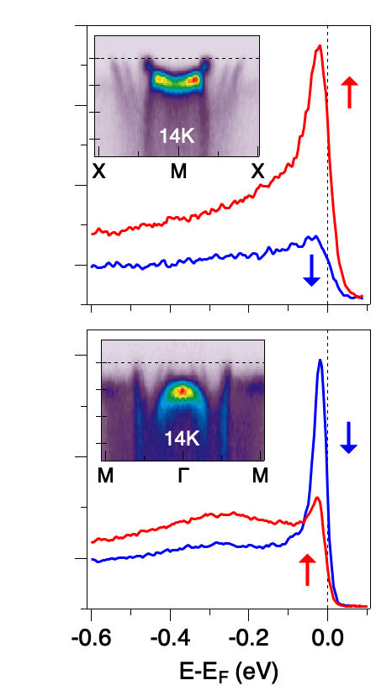
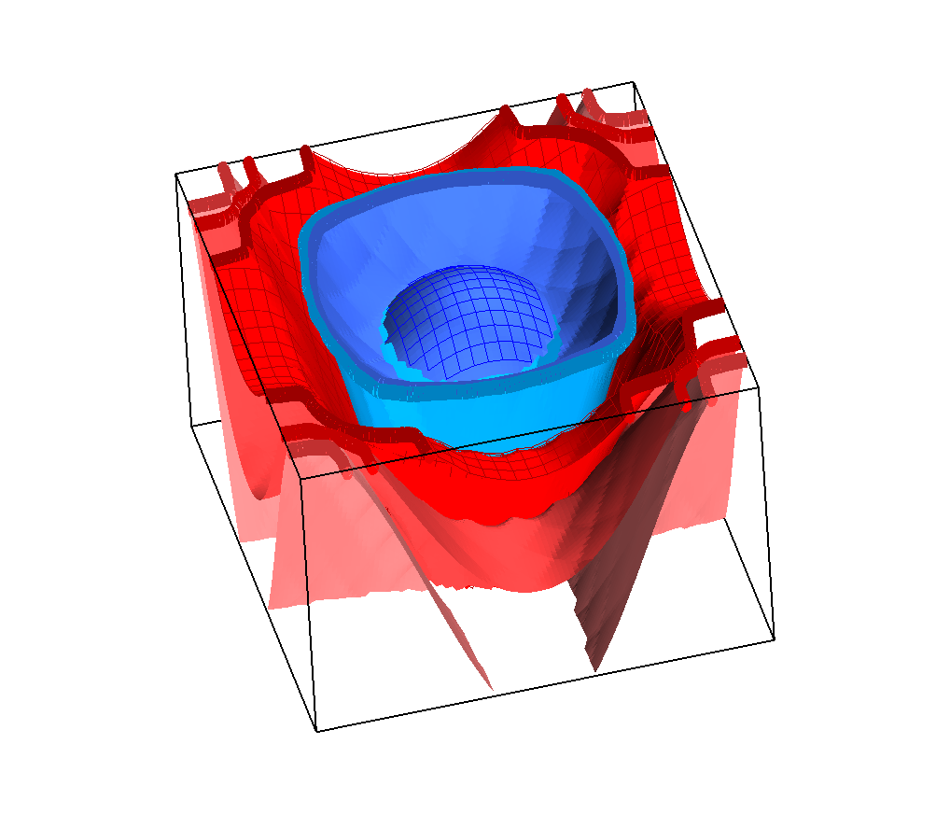
Pinpointing Magnetic Mysteries and Mechanisms in a Layered Perovskite
Scientific Achievement
Researchers revealed how electrons with different spins behave in distinct layers of a three-layer magnetic material, helping to explain its unusual magnetic behavior.
Significance and Impact
The results deepen the field’s understanding of how magnetism emerges in layered materials, which are important for future magnetic technologies and quantum electronic devices.
Research Details
Spin- and angle-resolved photoemission spectroscopy at the Advanced Light Source revealed two localized, narrow spectral peaks with opposite-spin polarization and strong coherence temperature dependence for a layered perovskite.
The researchers found these narrow spectral peaks are theoretically linked to separate spatial layers of the three-layer magnetic material, thus anomalous in-plane metamagnetism occurs in this material.
Energy
k_{b}
k_{a}
Schematic representation of the spin-polarized electronic band structure of triple-layer strontium ruthenate (Sr₄Ru₃O₁₀). Select locations (yellow points) along the k-axes show band dispersions and opposite-sign, spin-resolved spectra.
P. Ngabonziza, J.D. Denlinger, A.V. Fedorov, G. Cao, J.W. Allen, G. Gebreyesus, and R.M. Martin, Phys. Rev. B 111, 115146 (2025), doi:10.1103/PhysRevB.111.115146.
Work was performed at ALS/LBNL and was initiated via the US-Africa Initiative for Electronic Structure (US-AfrI) and African School for Electronic Structure Methods and Applications (ASESMA).
Notes:
Perovskite ruthenates (Sr_{n+1}Ru_{n}O_{3n+1}) are materials that play a pivotal role in studies of strongly correlated electron systems. These materials exhibit a range of unique characteristics, depending on the number of ruthenium oxide octahedral layers. Triple-layer Sr₄Ru₃O₁₀ adds a new dimension to correlated electron phenomena of the layered ruthenates. It exhibits a mix of anisotropic ferromagnetism and layer-dependent octahedral rotations, with special interest in its anomalous metamagnetism for in-plane applied magnetic fields. The research team determined that the in-plane meta-magnetism in Sr₄Ru₃O₁₀ occurs in the outer-layers. This novel electronic-structure origin of spatial-dependent magnetic behavior offers insights that could be applicable to thin-film and heterostructure fabrication for magnetic device applications.
Researchers: P. Ngabonziza (Louisiana State University); J.D. Denlinger, A.V. Fedorov (ALS); G. Cao (University of Colorado); J.W. Allen (University of Michigan); G. Gebreyesus (University of Ghana); and R.M. Martin (Stanford University).
Funding: Operation of the ALS is supported by the US Dept. of Energy, Office of Science, Basic Energy Sciences. U.S.-Africa Initiative in Electronic Structure (USAfrI) and the American Physical Society Innovation Fund. African School for Electronic Structure Methods and Applications (ASESMA) and the Abdus Salam International Centre for Theoretical Physics. The ALS is supported by the U.S. DOE BES.
Full highlight:

