Slide 1
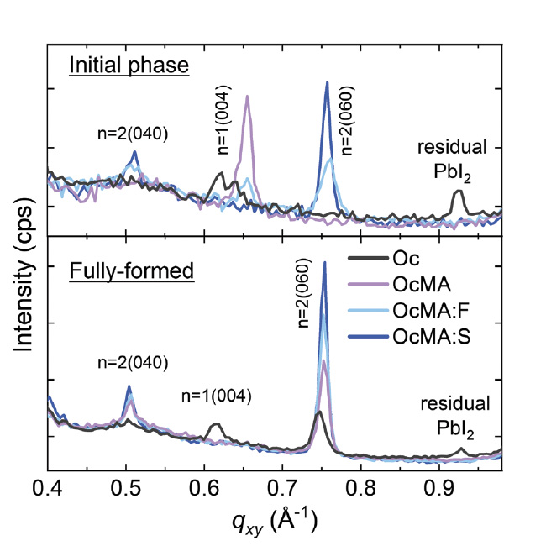







Mixed Solvent Strategy Yields Stable 2D Perovskite
Scientific Achievement
Researchers optimized thin film deposition of 2D perovskites using a mixed solvent approach to achieve phase purity and high crystallinity.
Significance and Impact
This result paves the way for commercially viable, high-performance, and long-lasting electronic and photonic devices.
Research Details
  The team used in situ grazing-incidence wide-angle x-ray scattering at the Advanced Light Source to deposit and analyze the purity and crystallinity of 2D perovskites in real time to understand the dynamic formation process of the thin film.
  The 2D perovskite-based devices achieved 25.9% efficiency and retained 91% of their initial performance, representing one of the best stabilities reported for its kind.
Using an iterative, real-time, mixed solvent approach, the team refined the production
of perovskite thin films from initial samples (top) to phase pure, highly crystalline samples (bottom) for four mixed solvents.
S. Tan, M. Shih, Y. Lu, S. Choi, Y. Dong, J.H. Lee, I. Yavuz, B.W. Larson, S.Y. Park, T. Kodalle, R. Zhang, M.J. Grotevent, Y. Lin, H. Zhu, V. Bulović, C.M. Sutter-Fella, N. Park, M.C. Beard, J.W. Lee, K. Zhu, and M.G. Bawendi, Science 388, 639–645 (2025). DOI:10.1126/science.adr1334.
Work was performed at ALS/LBNL and Molecular Foundry/LBNL.
Notes:
Two-dimensional on three-dimensional (2D/3D) perovskite bilayer heterostructures have the potential to boost the performance and durability of many types of electronic and photonic devices, including photovoltaics, light-emitting diodes, photodetectors, lasers, and transistors, but maintaining this performance depends on the stability of the cell’s 2D interlayer. In this sandwich-like 2D/3D structure, the 2D interlayer consists of monolayer or multilayer stacks of hybrid organic–inorganic halide perovskites. The 2D interlayer protects the 3D perovskite in the stack by reducing negative effects from defects in the material, controlling the movement of electrons or ions through the material, creating a built-in potential, preventing the movement of ions or electrons from the environment into the material, and blocking ion migration. This interlayer improves power conversion efficiency and device stability. As the device ages, the 2D interlayer can evolve differently, altering device stability. In this study, researchers developed a durable 2D interlayer to improve the efficiency and longevity of the 2D/3D perovskite bilayer heterostructures.
Researchers: S. Tan, M. Shih, Y. Lu, M.J. Grotevent, Y. Lin, H. Zhu, R. Zhang and V. Bulović, and M.G. Bawendi (Massachusetts Institute of Technology); S. Choi, J.H. Lee, N. Park, and J.W. Lee (Sungkyunkwan University, Republic of Korea); Y. Dong, B.W. Larson, S.Y. Park, M.C. Beard, and K. Zhu (NREL); I. Yavuz (Marmara University, Turkey); T. Kodalle (ALS, MF); C.M. Sutter-Fella (ALS)
Funding: US Department of Energy (DOE), Office of Energy Efficiency and Renewable Energy (EERE), US DOE Office of Science, Office of Basic Energy Sciences, US DOE Office of Science, Center for Hybrid Organic-Inorganic Semiconductors for Energy, National Research Foundation of Korea, and First Solar, Inc. Operation of the ALS and Molecular Foundry are supported by DOE BES.
Full Highlight: https://als.lbl.gov/stable-2d-interlayer-prolongs-perovskite-devices/

