Slide 1
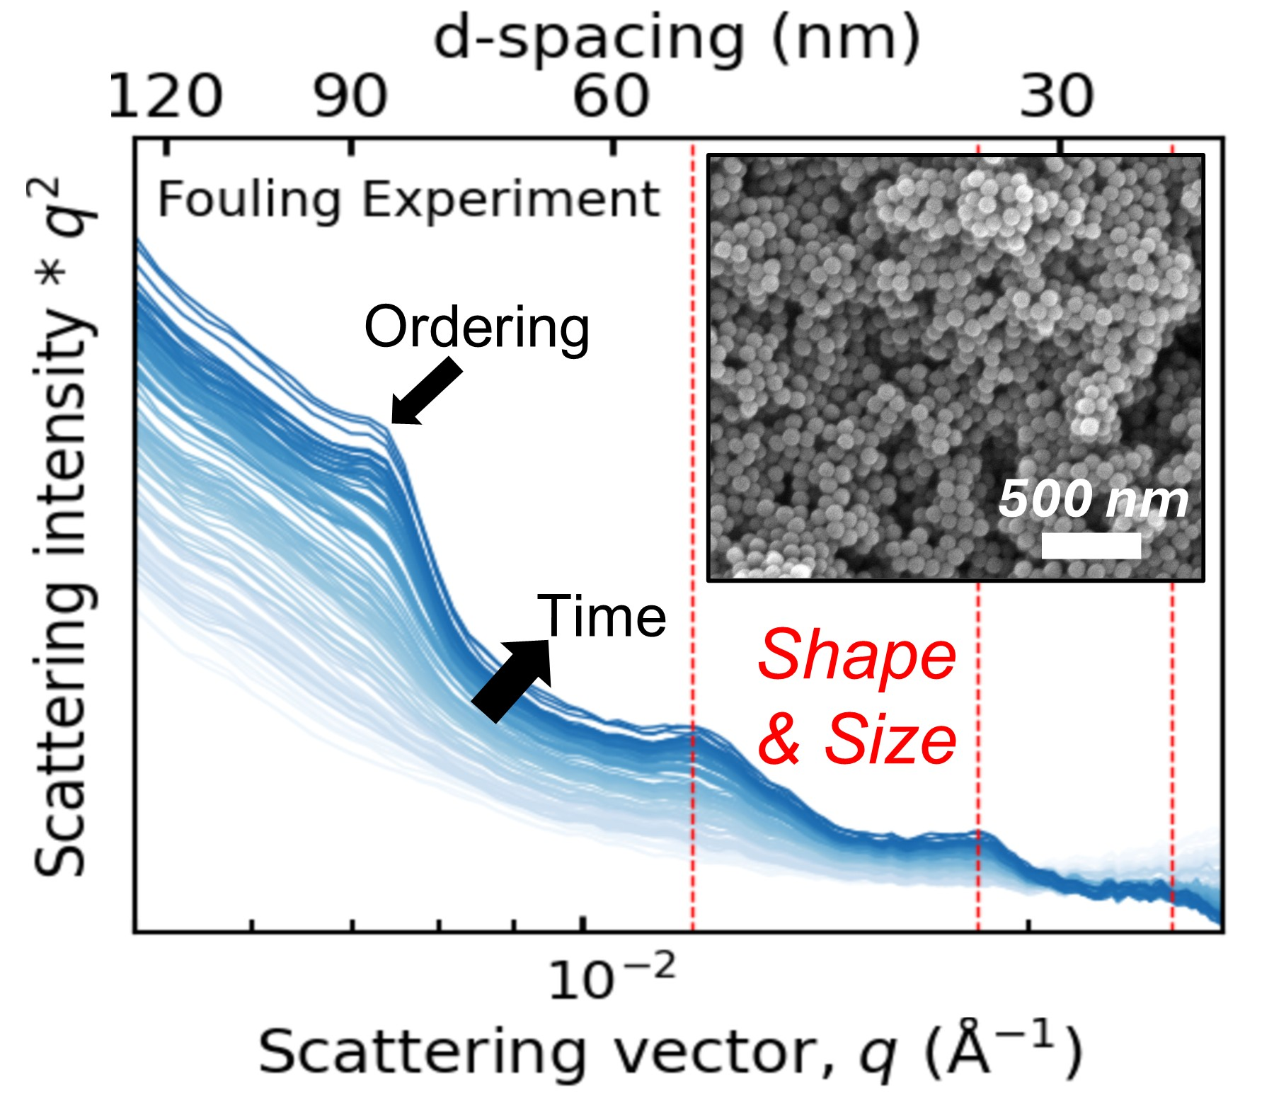
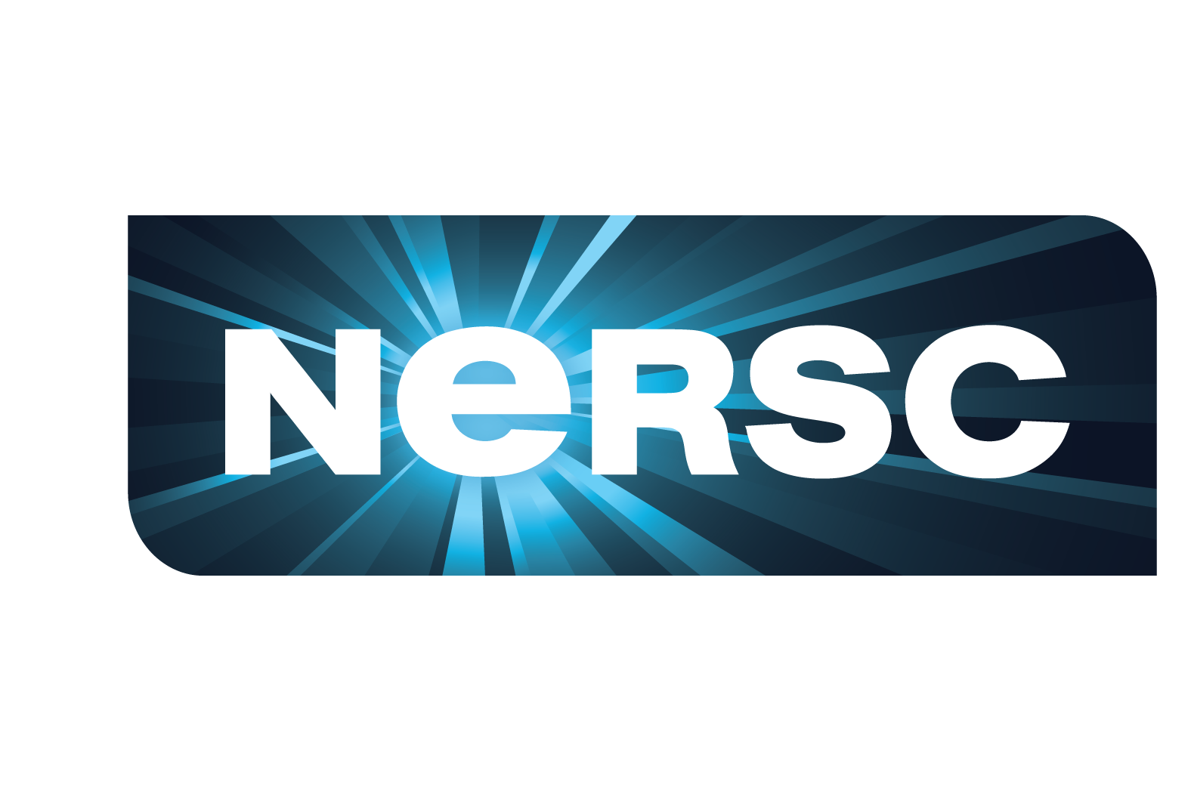

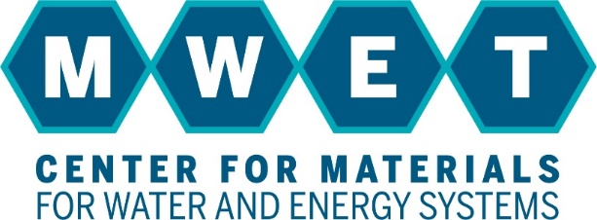


Characterizing Membrane Fouling with Operando Experiments
Scientific Achievement
A new, portable experimental system at the Advanced Light Source (ALS) monitors the accumulation and precipitation of foulants on a filtration membrane under realistic pressurized flow regimes.
Significance and Impact
This apparatus provides new insight into how fouling occurs in real time and under realistic water treatment conditions, enabling the design of improved, fouling-resistant membranes.
Research Details
  Operando x-ray scattering and diffraction reveal how foulants arrange near membrane surfaces as well as the crystalline phases of inorganic materials precipitating on membranes.
  The experimental design, which mimics a laboratory-scale, flat sheet membrane testing apparatus, can be used by ALS users or recreated at another light source.
Operando small-angle x-ray scattering results reveal the accumulation of polystyrene nanoparticles on porous ultrafiltration membranes at relevant operational conditions.
M. Nassr, M.R. Landsman, S. Ivandic, E. Schaible, D. McReynolds, N.A. Lynd, L.E. Katz, B.D. Freeman, G.M. Su, Review of Scientific Instruments 96, (2025). doi:10.1063/5.0264117.
Work was performed at ALS/LBNL/NERSC.
Notes:
Membranes are used for a variety of water treatment applications, from desalination (reverse osmosis, nanofiltration, and electrodialysis) to the removal of bacteria and viruses (ultrafiltration and microfiltration) and potable reuse of municipal wastewater (membrane bioreactors). Compared to conventional treatment technologies (thermal distillation), membranes provide modular, energy-efficient, low-cost alternatives that can be selective for target contaminants. Despite the benefits, membrane filtration is limited by fouling, where unwanted materials deposit, sorb, or crystallize on the surface of or within the pores of the membrane. As these materials accumulate, it creates resistance on the system, which requires more energy to push water through the membrane and diminishes productivity over time. To address membrane fouling, researchers traditionally examine the dried material after it collects on the membrane surface to characterize how fouling occurs. This ex situ approach has been beneficial to a point, but the act of fouling is dynamic, and ex situ studies miss the complex, transient fouling behavior that occurs during water treatment. A team of researchers built a portable cart that contains water tanks and remotely-controlled pumps and valves to ensure industrially relevant water flow conditions around the membrane and monitor the in situ fouling process at the ALS in real time under pressurized conditions.
Researchers: M. Nassr, S. Ivandic, N.A. Lynd, K.L. Gleason, B.D. Freeman, and L.E. Katz (University of Texas at Austin), M.R. Landsman (ALS, University of Texas at Austin), E. Schaible, D. McReynolds (ALS), and G.M. Su (ALS, Berkeley Lab)
Funding: Center for Materials for Water and Energy Systems (M-WET), an Energy Frontier Research Center funded by the U.S. Department of Energy (DOE), Office of Science, Basic Energy Sciences (BES) program, DOE Office of Workforce Development for Teachers and Scientists, Office of Science Graduate Student Research (SCGSR) program, and the ALS Collaborative Postdoctoral Fellowship program. Operation of NERSC is supported by the DOE Office of Science Advanced Scientific Computing Research program and operation of the ALS is supported by DOE BES.
Full highlight: https://als.lbl.gov/characterizing-membrane-fouling-with-operando-experiments/

